Slide 1
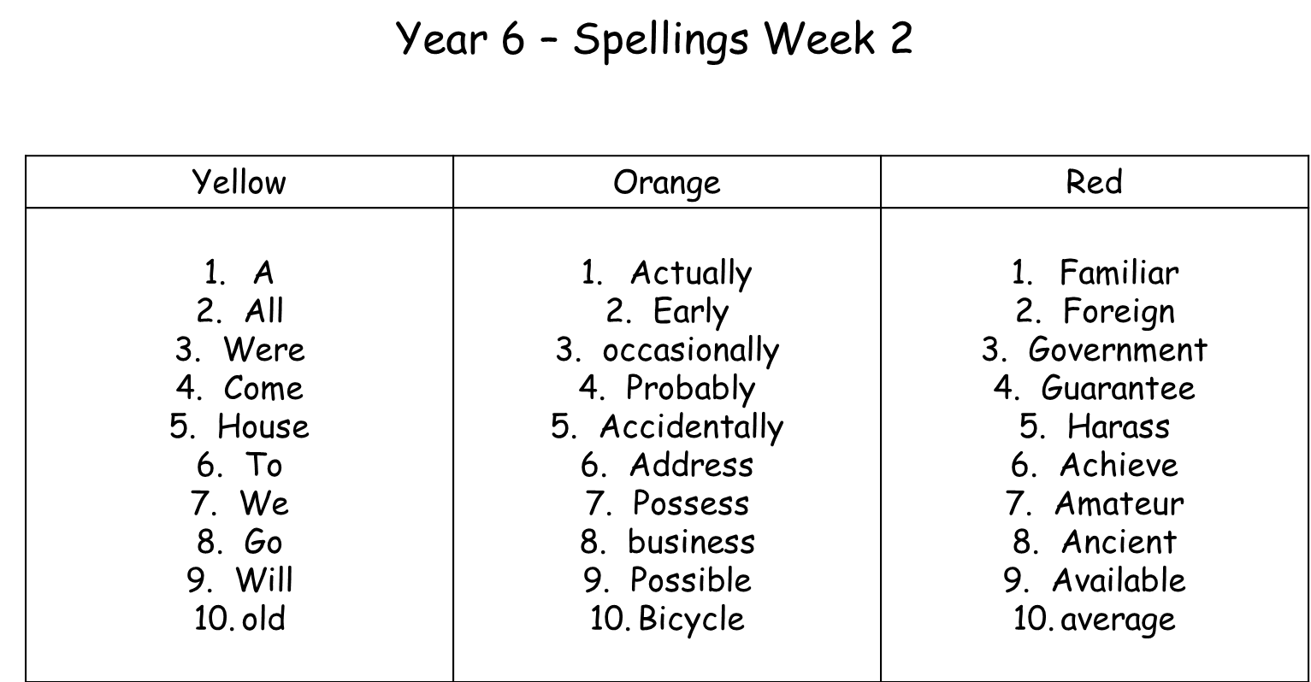
Year 6 Homework for Wednesday 23rd September 2015 1) Read at least three times and ask an adult to sign/comment to confirm this. 2) Learn your spellings. 3) Complete sentences and definitions in your homework book for each spelling. 4) Decorate your Art Smart folder! The children will all be working towards an Art Smart Award this term. One thing they need to achieve for the assessment is to decorate their folder with art! The children can cut up images (remember art includes adverts, photography, signage etc) or draw their own! Make sure it is well presented!

