Slide 1
THE NJS Newsletter
“learning to make a difference"
Friday 4th March ‘16 http://www.newportjuniorschool.org.uk/ Issue 567
OPEN LUNCHES
This term’s Workshops and Open Lunches will take place on the following dates:
Thursday 3rd March– Yr 5
Thursday 10th March – Yr 6
All parents are welcome to attend the workshop (in classrooms) at 11am and/or lunch at 12pm.
PLEASE ENSURE YOU RETURN THE REPLY SLIP SO WE CAN CATER FOR THE APPROPRIATE NUMBER OF ADULTS.
ACCESS TO SCHOOL
ALL parents are reminded that children are to enter and leave school through the ‘Parent and Child Entrance’ by the conservatory.
Children/parents should not use the entrance through the Visitors Car Park unless collecting children during the school day.
Reading Support
Are you able to offer time to support children with their reading? We need voluntary helpers to come into school and listen to children read on a regular basis.
If this is something you feel that you can offer please let me know!
Many thanks.
Mr Rotherham
Reminder about mobile phones!
If children bring mobile phones into school please can they make sure they are handed into the office or their class teacher at the start of the school day. Mobile phones are not to be kept in lockers for safety and security.
At the end of the school day the children may then collect their mobile phone from the office or class teacher.
Thank you for your support.
Confirmation at St. Nicholas’ Church
On Wednesday last week, Rector Steve came into school to talk to the Year 5/6 children about being confirmed.
He advised children in Years 5/6 to go home and talk to you, as parents, to see if you would like your child to be confirmed.
At this stage if anyone is interested, please notify Mrs. Stanley in the school office and she will add your child’s name to the list.
The Rector will then be in touch, via a letter, when the confirmation classes begin.
Book Week
This week the children have taken part in a range of different reading activities, such as quizzes, competitions, story times, book fairs, a book treasure hunt and a book swap. Please remember it is Book Character Dress Up day on Friday 4th. Please remember your book as well!!!
PTA Easter Bingo!
This year’s Easter Bingo is on
Friday 11th March
Doors open at 6pm with “Eyes Down” at 6.30pm.
Bingo Books are £1 and there is a £1 Egg Tombola where everyone is a winner!!
Refreshments are also available.
Everyone and anyone welcome!
Congratulations
We all send our congratulations to
Mr and Mrs Moody on the arrival of their new baby boy!
Seth Patrick Moody,
7lb 1oz, who arrived on
Sunday 28th February.
Learn the Clarinet, Saxophone, Flute or Recorder!
Mr Gray has vacancies for woodwind pupils. There are school instruments available for pupils to use.
If you are interested please contact Mr Gray on 01952 255205 for details of terms and conditions and current fees.
Attendance for w/beginning 22/02/16
Well done to class 4F with 99.63% attendance.
They will receive an extra ten minutes play.

Slide 2
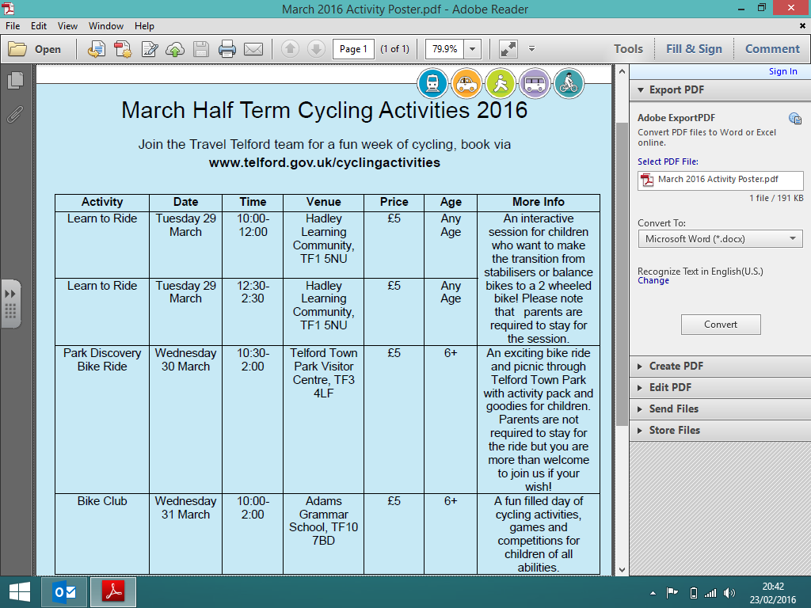
Up Coming Dates:
Friday 4th March – Book Week Dress up Day
Monday 7th March – Travelling Book Fair
Tuesday 8th March – Yr 2 Transition #2 from 2.45pm
Thursday 10th March – Yr6 Open Lunch
Open lunch – lesson 11am, lunch 12pm.
Friday 11th March – Mufti for an egg day and Easter Bingo 6pm.
Monday 14th – Friday 18th March – Science Week, with Literacy taking a Shakespeare focus.
Tuesday 15th March –Yr 2 Transition #3 from 2.45pm
Wednesday 16th March – Yr 5 and Yr 6 Parents Evening.
From 1.30pm in the school hall.
Thursday 17th March – Yr 3 and Yr 4 Parents Evening.
From 1.30pm in the school hall.
Friday 18th March – 3S Class Assembly
Tuesday 22nd March – Yr 2 Transition #4 from 2.45pm
Tuesday 22nd March – PAG in 5M
Wednesday 23rd March - End of Term Church Service.
Children to go directly to church for 8.50am
Wednesday 23rd March - Senior Citizens, 2pm in the school hall.
Thursday 24th March - Easter lunch
Thursday 24th March – PTA Cake Stall
Thursday 24th March – Break Up for Easter!
NJS CLUB WEEKLY DIARY
Please read this section every week as there are occasions when we have to amend or cancel clubs. CLUBS NOW FINISH AT 4.30pm UNLESS STATED!
Monday 7th March
- Lower School Football, run by AFC Telford on the school field, 3.30-4.30pm.
- Girls Football, run by Mrs Phillips, on the school field, 3.30 - 4.30pm
- Non Swimmers Club, run by Mrs McGrath, 2 sessions 12-1pm
- Book Club, run by Miss Branton, in the school library, 12-12.30pm.
- Dance Club, run by Sarah, in the school hall, 3.30pm-4.30pm
Tuesday 8th March
- Choir, run by Mrs Green, in the Year 5 area, 12.30-1pm.
- Book Club, run by Miss Branton, in the school library, 12-12.30pm.
- School Council, run by Mrs Follos, in class 4 F, 12-12.30pm
- Netball Club for Yr 5/6, run by Miss Sherry, 3.30-4.30pm
- Newspaper Club, run by Mrs Kerr, 3.30-4.30pm
- Zumba Club, run by Mrs Barker, in the school hall, 3.30-4.30pm, this term
only!
Wednesday 9th March
- Tag Rugby Club, run by Mr Jones, on the school field, 3.30-4.30pm - Upper
School Only.
- Cookery Club, run by Mrs Sisson, in the school kitchen, 3.30-5pm (signed up
children only)
- Cross Country, run by Miss Hardy, on the school field, 3.30-4.30pm.
Thursday 10th March
- Drama Club, run by Mrs Green, in the school hall, 3.30-4.30pm.
- Computing Club, run by Mr B, in the ICT suite, 3.30-4.30pm – Upper School
Only.
Friday 11th March
- Upper School Football, run by Mr M and Mr Jones, on the school field, 3.30-
4.30pm.
- Eco Club, run by Mrs Green, in the Year 5 area, 12.30-1pm.
- Netball, run by Mr & Mrs Johnstone, on the small yard 3.30-4.30pm.
- Book Club, run by Miss Branton, in the school library, 12-12.30pm.
SCHOOL DINNERS
Please remember if your child pays for lunch their money needs to be in an envelope with the child’s name and class on it. If you are paying by cheque, these details also need to be on the back.
Senior Citizens
Easter Tea Party
Wednesday 23rd March
2 – 3.30pm in the School Hall
All senior citizens are invited along for free refreshments, entertainment and a raffle.
Invite someone you know along!
Class Assemblies
A class assembly is time for children to share with family and friends some of the experiences they have had during their time in the classroom. Class assemblies are on Fridays and usually start at 2.50pm. Dates for this school year are:
3S – 18th March ‘16
3B – 20th May ‘16
6J – 27th May ’16
4F – 10th June ‘16
6M – 24th June ‘16
Cold Weather
Parents are reminded that during this time of cold weather children are to come to school with a coat. As the weather is getting a lot colder also think about hats, scarves and gloves – please ensure all items are clearly named.
School Nurse
Your school nurse is Rachel Osbourne and she can be contacted on 01952 621340 for any health concerns.
Reminder for All Parents and Children!
Children should be in school by 8.50am, ready for classes to start at 9.00am.

