Slide 1
HOMEWORK due in Wednesday 25th January
Read at least 3 times and ask an adult to sign your reading diary to confirm.
Learn your spellings. Complete detailed sentences and definitions in your homework book.
3) *** complete questions on commas to change meaning
** commas for clauses – chn to rearrange sentences to show 3 possibilities
* re-write sentences to show all correct punctuation.
Due to the changes in the Literacy curriculum children in Year 6 are expected to be secure with all KS2 spellings. There will be no choice of spellings, in terms of degree of difficulty. All children, of all abilities, need to learn the following for next term:
conscious dictionary
equip equipped
equipment definite
harass controversy
convenience correspond
Note: please encourage your child to present work in their homework book to a high standard.

Slide 2
***

Slide 3
**
Can you find 3 different ways to structure this sentence?

Slide 5
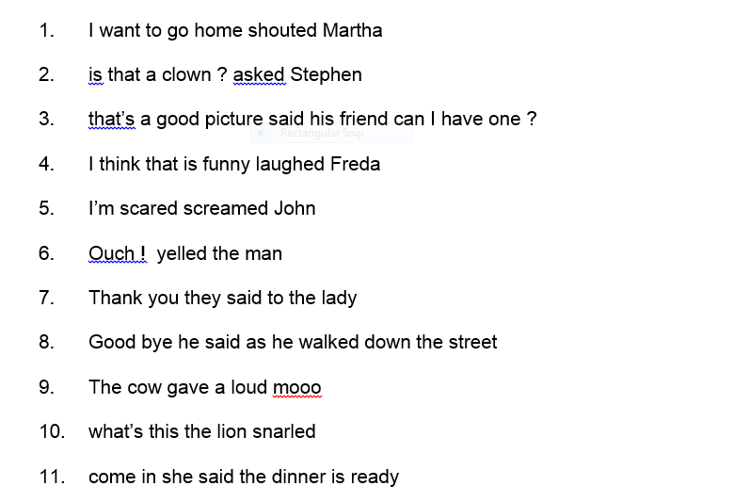
*
Re-write, showing correctly punctuated sentences. Think about using: capital letters, full stops, commas and speech marks.

