Slide 1
Peace Babies

Slide 2
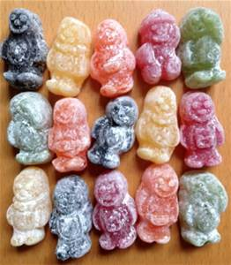
What are these?
Do you like sweets?
How does eating sweets make you feel?
What flavours are the babies?
What is your favourite flavour?

Slide 3
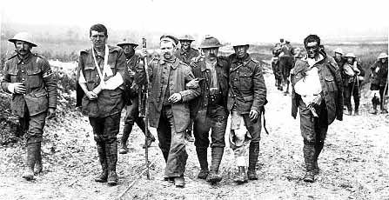
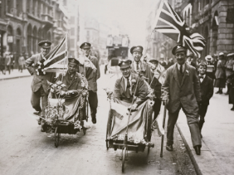
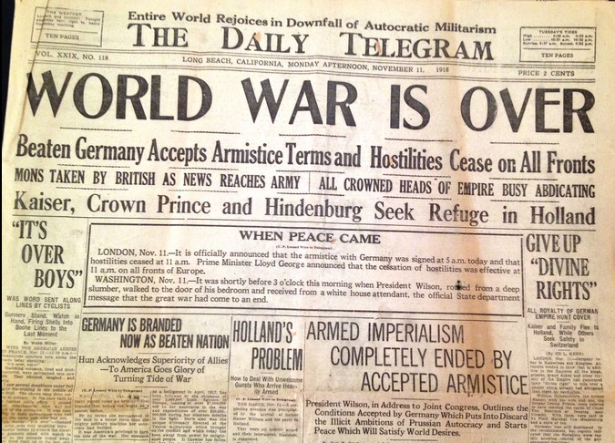
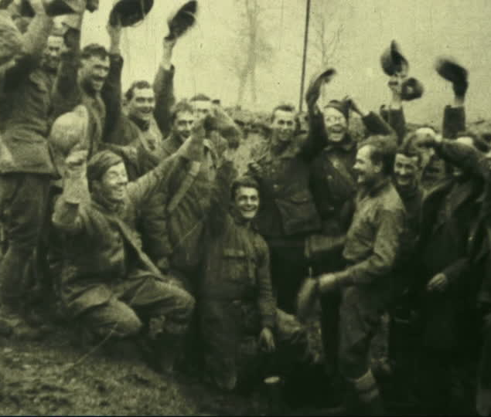
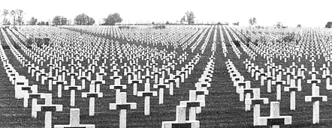
How do you think people were feeling at the end of the war?

Slide 4
Did you know that Jelly Babies were originally called Peace Babies?

Slide 5
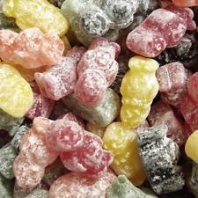
A bag of sweets to represent peace?
The reason why Bassets called them Peace Babies isn’t clear. Some say the different colours represented the different nations coming together in peace. Some people say it was because what the world needed was a sweet treat after all the sadness brought by the war and others have said that a baby represents new life, a fresh beginning after the horror of war.
What do you think?
Peace is enjoyed when people of different ages, interests and appearances live together in harmony. (Wouldn't a bag of jelly babies be dull if the sweets were all one colour and flavour!)
Working for peace doesn't mean being soft (like a jelly baby).
It calls for a strong commitment to friendship, fairness, being ready to share, and
celebrating the good things of life together. Pass the sweets around and everyone can enjoy a peace baby!

Slide 6
Loving God, help us to work for peace, and to pray for peace, believing that all people are your children. Amen.

