Slide 1
Multiplication and Division Support

Slide 2
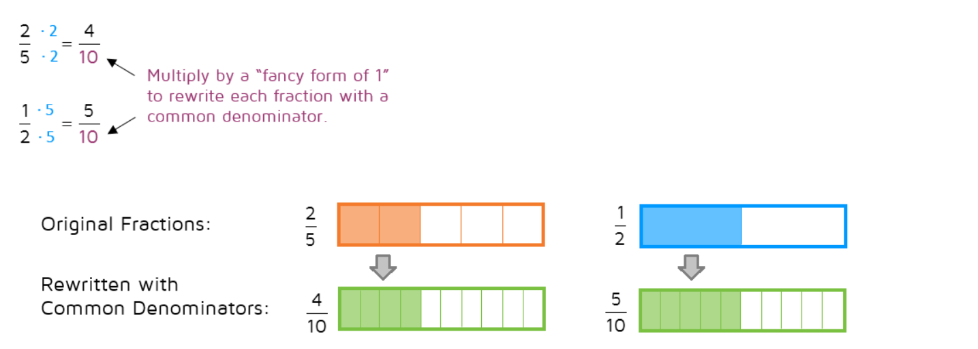
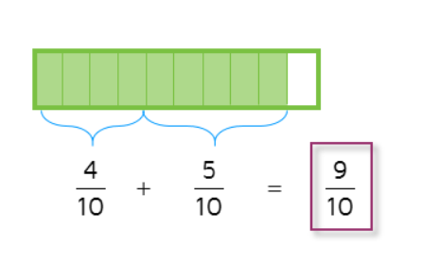
Add and Subtract Fractions
When the denominator is the same, simply add the numerator values and ensure answer is in its simplest form.

Slide 3
Multiply and Divide Fractions
Answers need to be in their simplest form
For multiply you can apply times table facts along diagonals and simplify before solving.
This needs to be converted to a mixed number fraction.
1
3
2
10

