Slide 2
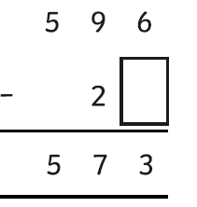
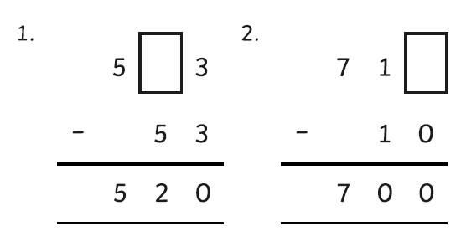
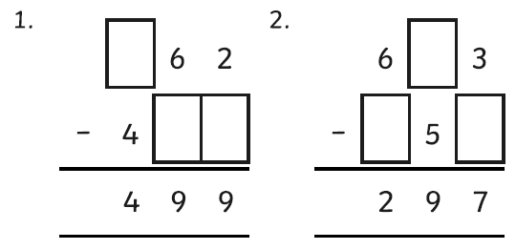
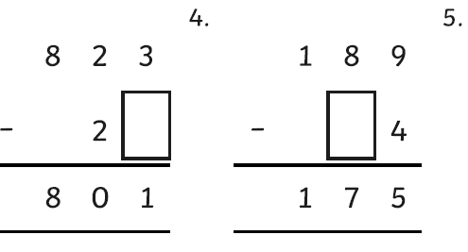
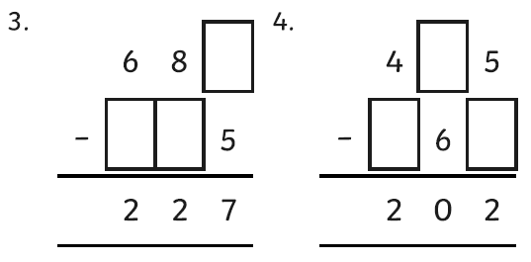
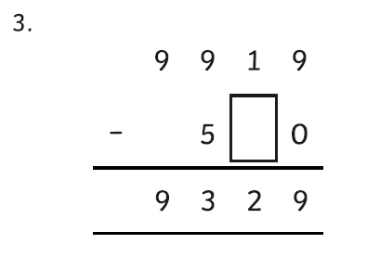
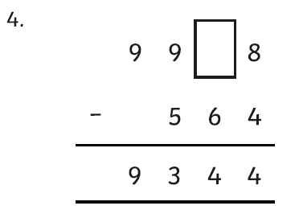
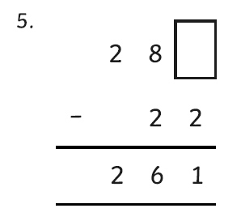
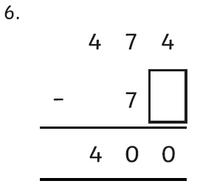
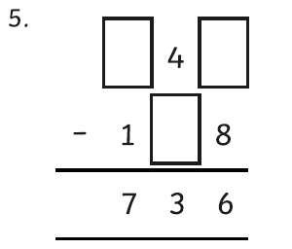
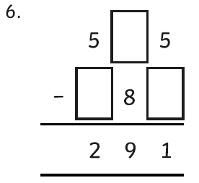
Thursday’s Maths for Year 4
Yesterday you focused on addition using the column method.
Today we would like you to focus on missing numbers within column subtractions.
Here is an example of the method you need to use:
You can look at the calculation policy for more help:
https://newportjuniorschool.org.uk/home/key-info/policies/
* | ** | ***

Slide 3
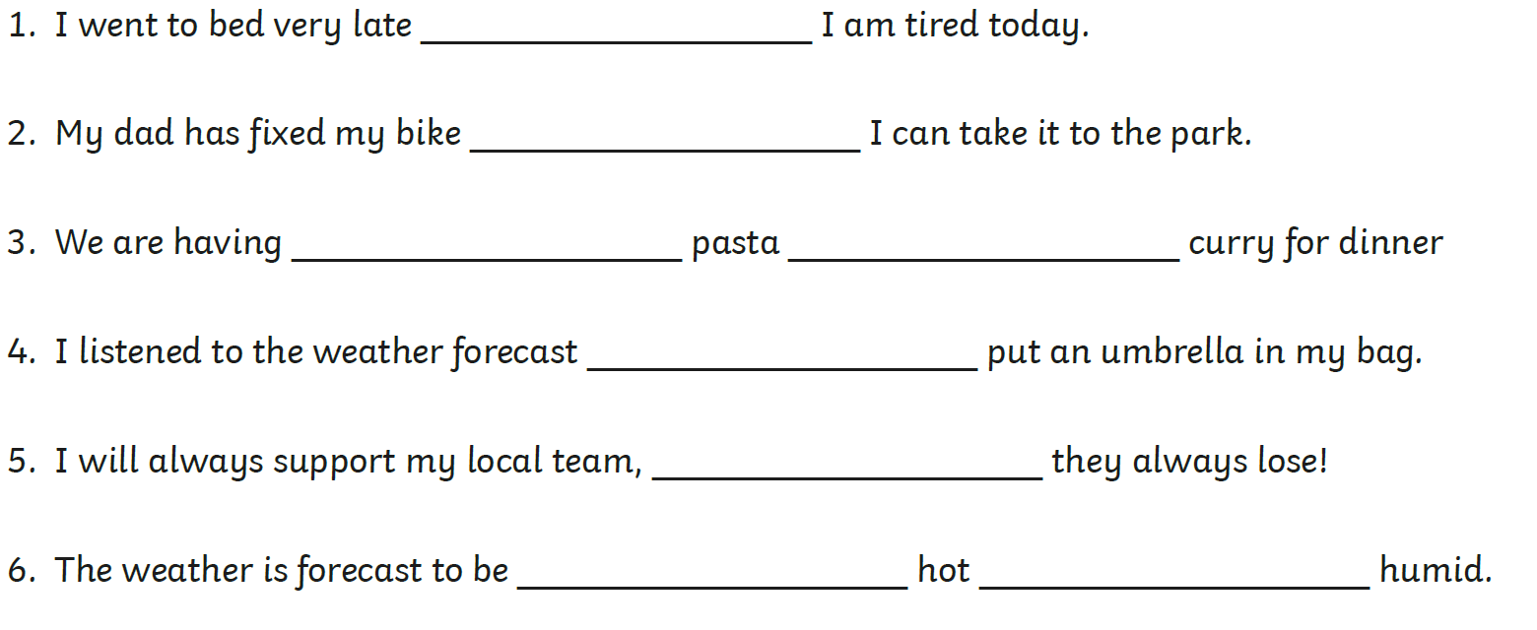
Thursday’s English for Year 4
Recently we have been learning how to use a variety of conjunctions in our sentences. A conjunction is a joining word that links part of a sentence together.
You can find out more here: https://www.bbc.co.uk/bitesize/topics/zwwp8mn/articles/z9wvqhv
* Write a sentence using the following conjunctions: and but or so although because | ** Re-write the sentences and choose a conjunction to complete it and make it make sense. | *** Write a paragraph about anything of your choice! Your paragraph should include ten different conjunctions. The paragraph needs to make sense and be accurately punctuated!

Slide 4
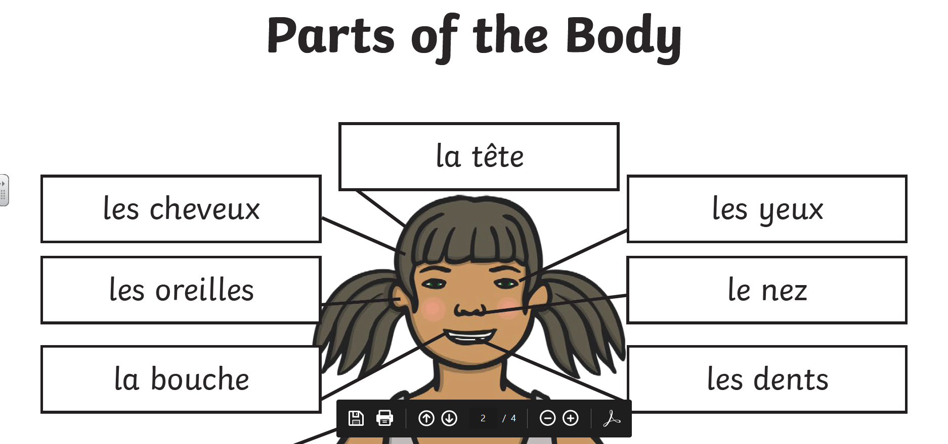
Todays other activity:
We have been learning about body parts in French. Look at the diagram below. Draw a portrait of yourself and label all the different parts of your face in French.
https://www.youtube.com/watch?v=bChrAwLzoSo
Watch the video and listen to the song.

