Slide 2
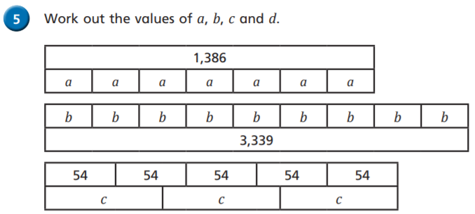
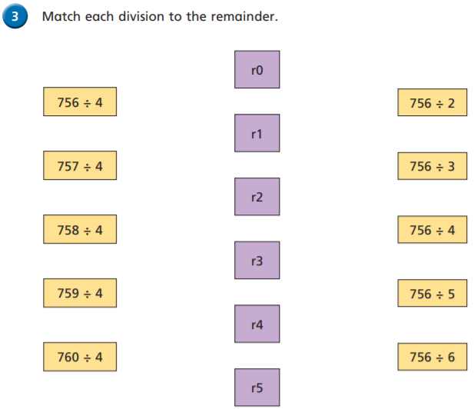
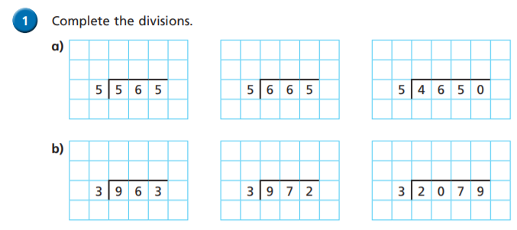
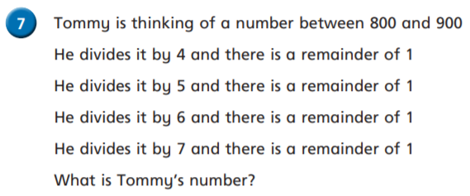
Follow this sheet to revisit a topic from year 6 maths. Complete as much as you feel confident doing.
Warm up
Day 4: Short Division

Slide 3
Thursday’s Maths for Year 6
Recently you have been practising your addition skills and you are really good at these calculations now. Remember the method most of us use looks like this:
You can look at the calculation policy for more help: https://newportjuniorschool.org.uk/home/key-info/policies/

Slide 4
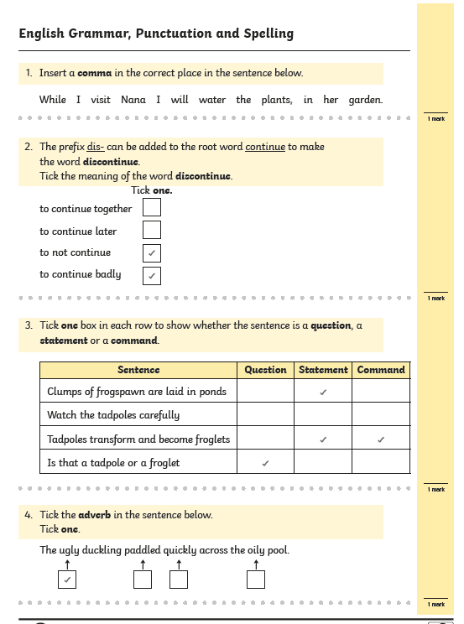
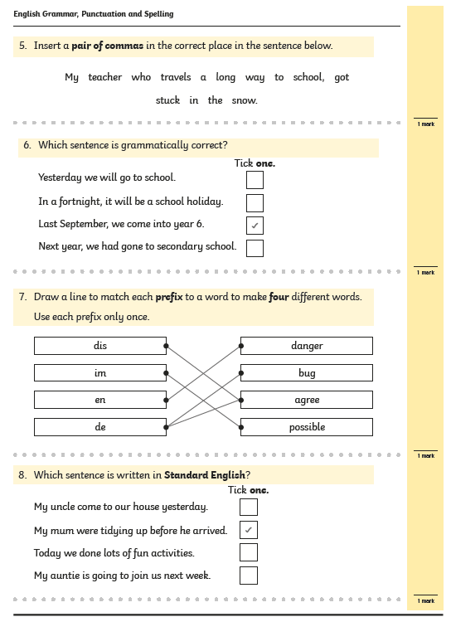
Thursday’s English for Year 6
Children are teachers today!
Children to mark and spot errors in the SPAG questions.

Slide 5
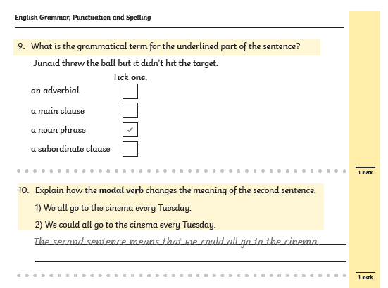
Thursday’s English for Year 6
Children are teachers today!
Children to mark and spot errors in the SPAG questions.

Slide 6
Today’s other activity:
How would a Christian feel after visiting the tomb of Jesus?
https://gardentomb.com/about
Use the website to show children that the tomb where Jesus was buried is still a site of Christian worship today. How do you think people feel when they visit this place? Happy? Sad? Curious?
Sentences in book:
A Christian might be happy to visit the tomb because….
A Christian might be sad to visit the tomb because….
https://www.tripadvisor.co.uk/Attraction_Review-g293983-d318946-Reviews-The_Garden_Tomb-Jerusalem_Jerusalem_District.html
Scroll down the read the reviews of the garden tomb. What are people saying about it? Do you think these people are Christians? What do many of them have in common?
https://www.youtube.com/watch?v=kagLdjf26FY
A virtual tour of the tomb. Ask children to imagine they are there visiting the tomb. What impression do they get of the site? Ask children to use their experience from the website to create their own Trip Advisor reviews. Can they create two or three that take on different viewpoints?

