Slide 2
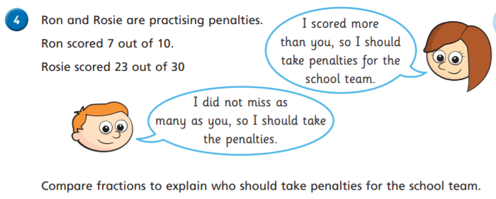
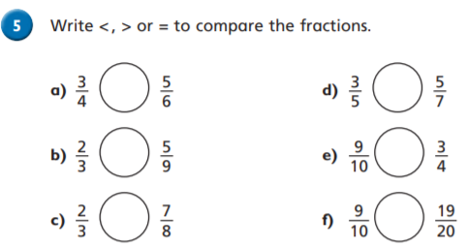
Follow this sheet to revisit a topic from year 6 maths. Complete as much as you feel confident doing.
Warm up
Day 2: Comparing Fractions – Same Numerator, smaller denominator = bigger fraction.

Slide 3
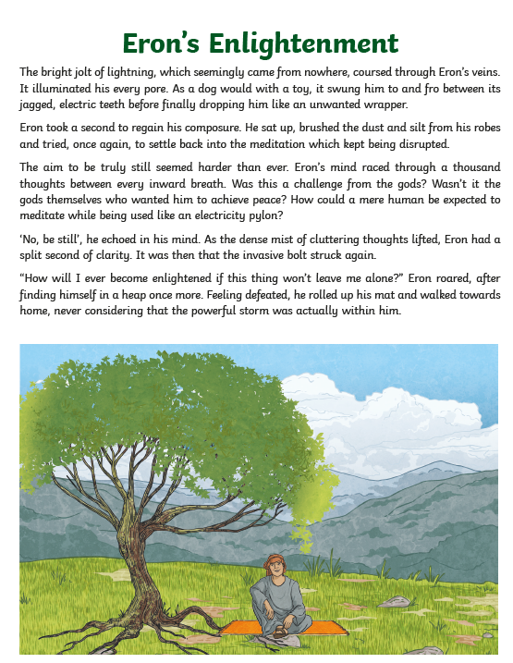
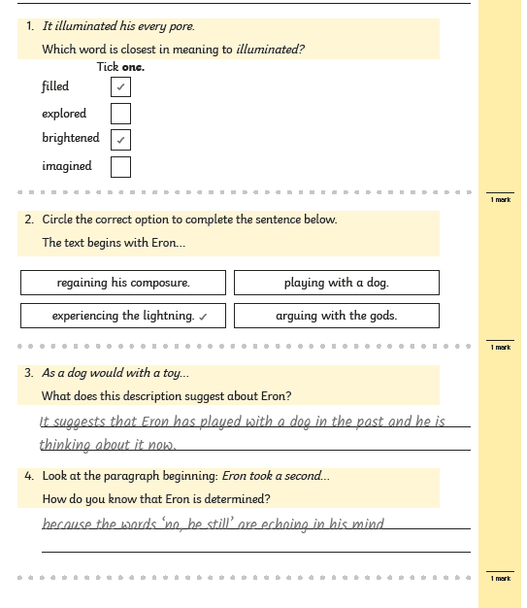
Tuesday’s English for Year 6
Be the teacher! Correct the reading assessment and check that the answers are correct.
What advice can you offer them?

Slide 4
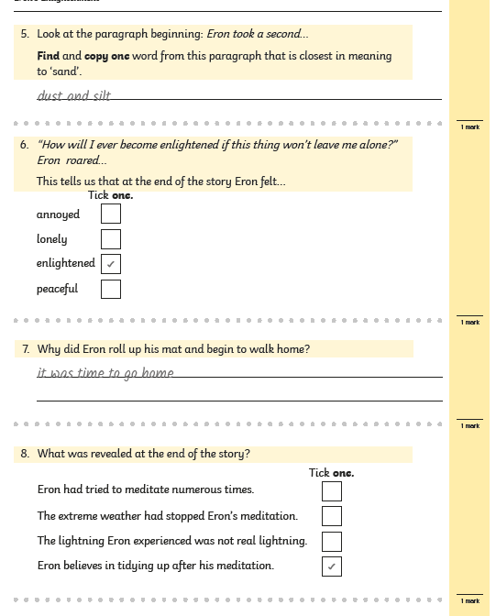
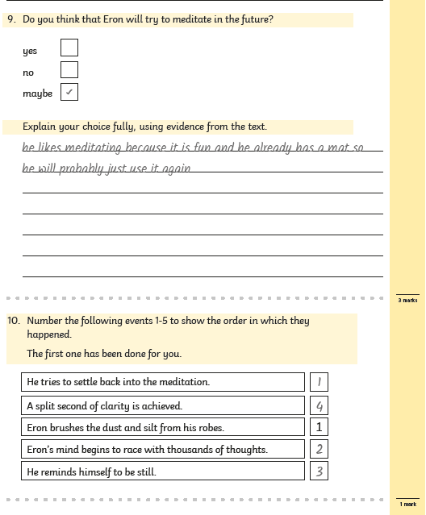
Tuesday’s English for Year 6
Be the teacher! Correct the reading assessment and check that the answers are correct.
What advice can you offer them?

Slide 5
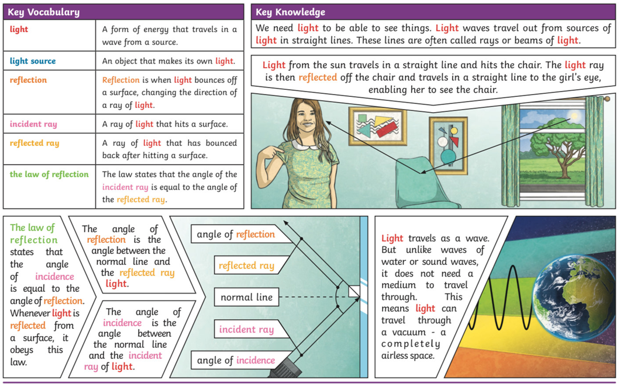
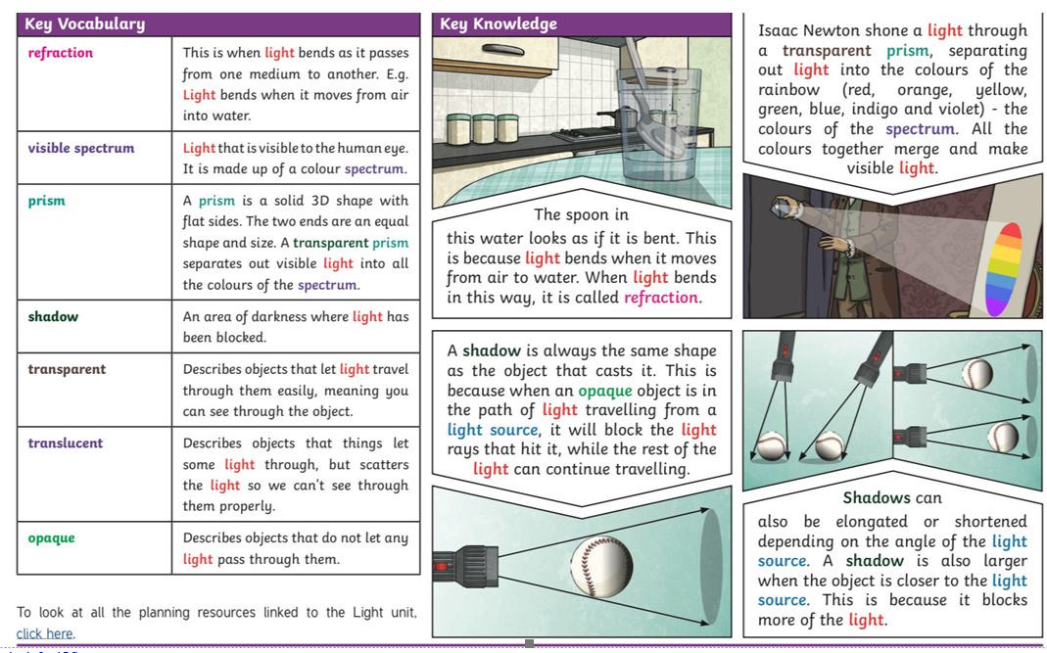
Today’s other activity:
Children have been learning about Light in Science this term. Can they create their own Knowledge Organiser for this subject to ‘show off’ their understanding of the subject. There is an example below. Please encourage your child to use their own language and add appropriate diagrams and images.

