Slide 1
Year 3 Home School Provision Daily Pack
The following slides will be split into 3 separate activities.
Each slide will be daily activities for you and your child to do at home.
We as a Year 3 team will update these slides daily.
Thank you for your understanding and on going support during these times.

Slide 2
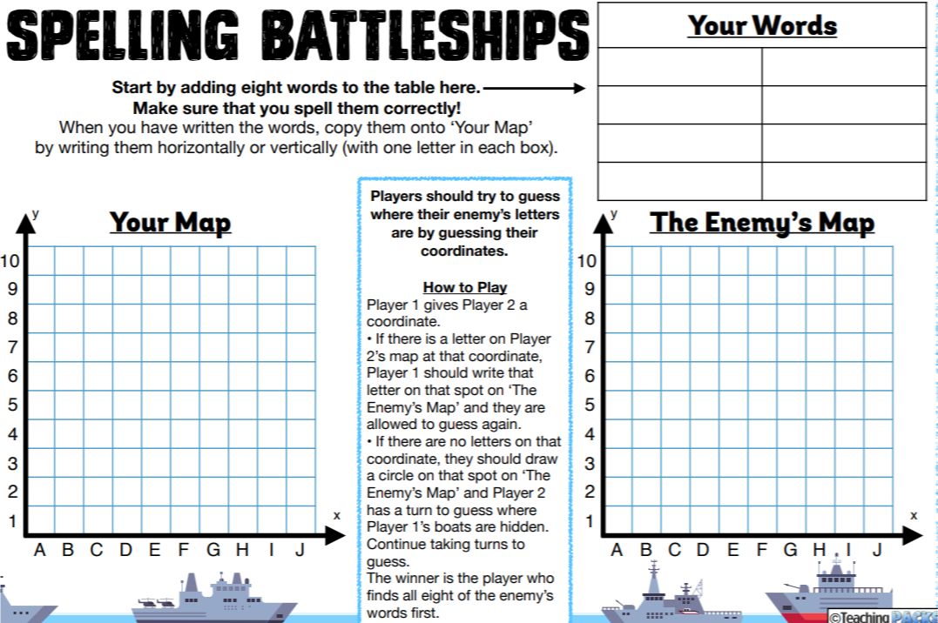
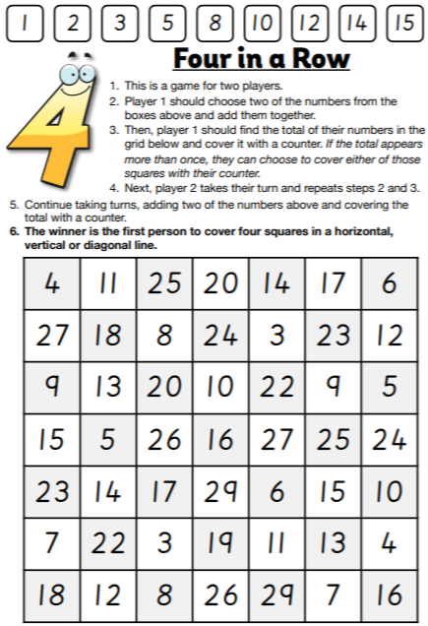
Daily Provision Pack - Day 1
Maths:
English:
door
accident
wild
accidentally
hold
actual
fast
actually
Other: Complete at least 20mins of TTRS, read chapter 3 of ‘Takeover’ on Fiction Express using your logins, and complete the comprehension quiz and please remember to vote before the end of today!

