Slide 1
Year 3 Home School Provision Daily Pack
The following slides will be split into 3 separate activities.
Each slide will be daily activities for you and your child to do at home.
We as a Year 3 team will update these slides daily.
Thank you for your understanding and on going support during these times.

Slide 2
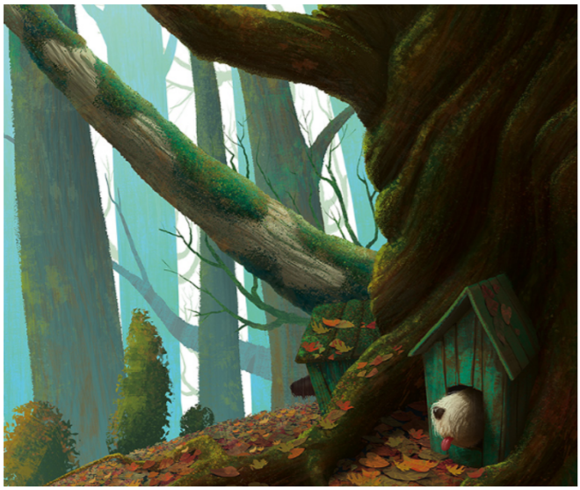
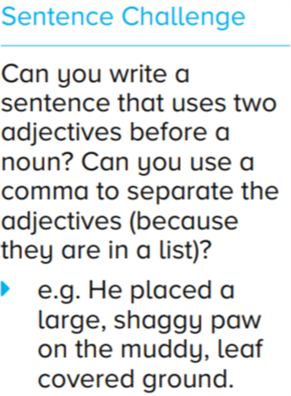
Daily Provision Pack - Day 6
Maths:
Measure 10 things in cm around the house and convert into mm.
Measure 10 things in mm around the house and convert cm.
Challenge:
Find some distances in km between major UK cities. Can you convert them to metres? Cm?
English:
PSHE:
What makes you ‘you’?
Write a personal fact file about yourself, including
A picture of you, full name, age, DOB, family members, a physical description, likes and dislikes, favourite hobbies and pastimes, pets, goals and dreams for the future.

