Slide 2
Monday’s Maths for Year 4
This week we will be focusing on Division.
The method which will help you solve the calculations is bus stop method.
You can look at the calculation policy for more help:
https://newportjuniorschool.org.uk/wp-content/uploads/2019/10/Calculation-Policy.pdf
* Please see attached calculations to complete in your book. 2 Digit with no remainders | ** Please see attached calculations to complete in your book. 3 Digit with no remainders | *** Please see attached calculations to complete in your book. 3 Digit with remainders

Slide 3
Monday’s English for Year 4
This week we will be focusing on Instructions. They are particularly useful when you are making or building something, are there any other uses for Instructions?
If you have any in your home it would be useful to use them for today’s task but not essential.
* Write a list of where you may find and use instructions. Ask other people in your house if they have used instructions recently? Can you find any to look at in your house? | ** and *** Write a list of where you may find and use instructions. Then make notes on: How are they presented? Are they different? What features are used to help ‘instruct’ people who use them? This could be presented as a mind map, a list or a summary.

Slide 4
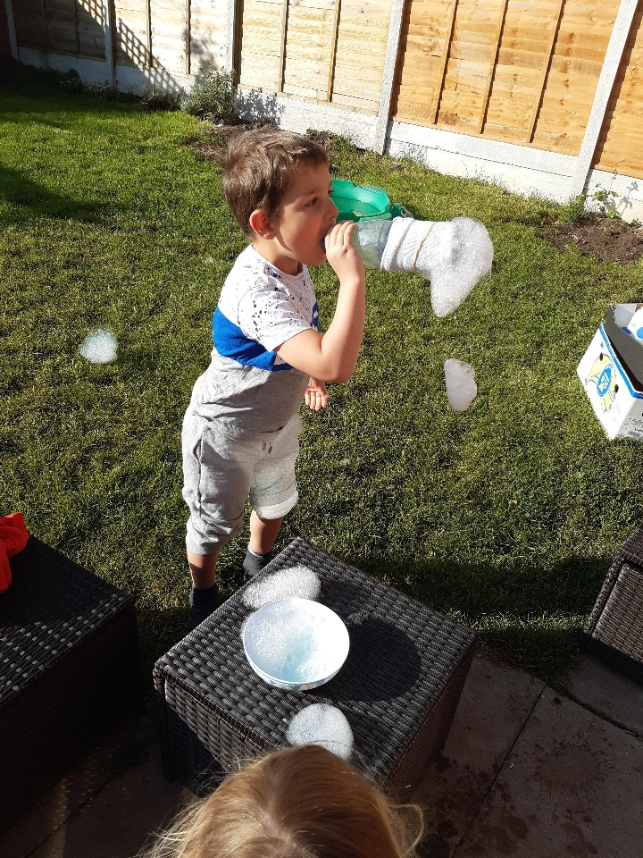
Todays other activity:
There are two choices for today, choose whichever suits you and your family the most.
Cut the bottom of a plastic drink bottle.
Put a sock over the end and hold it in place with an elastic band or a hair bobble.
Dip into washing up liquid and water.
Now blow… What is the longest bubble foam you can make?
Here is one of our
goes…
Thinking about bubbles, are they always round or can they be another shape?
Make a prediction and explain your reasons.
Now… research and find out!

