Slide 1
Instruction Examples

Slide 2
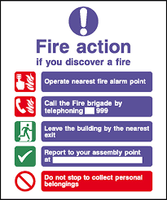

Slide 3
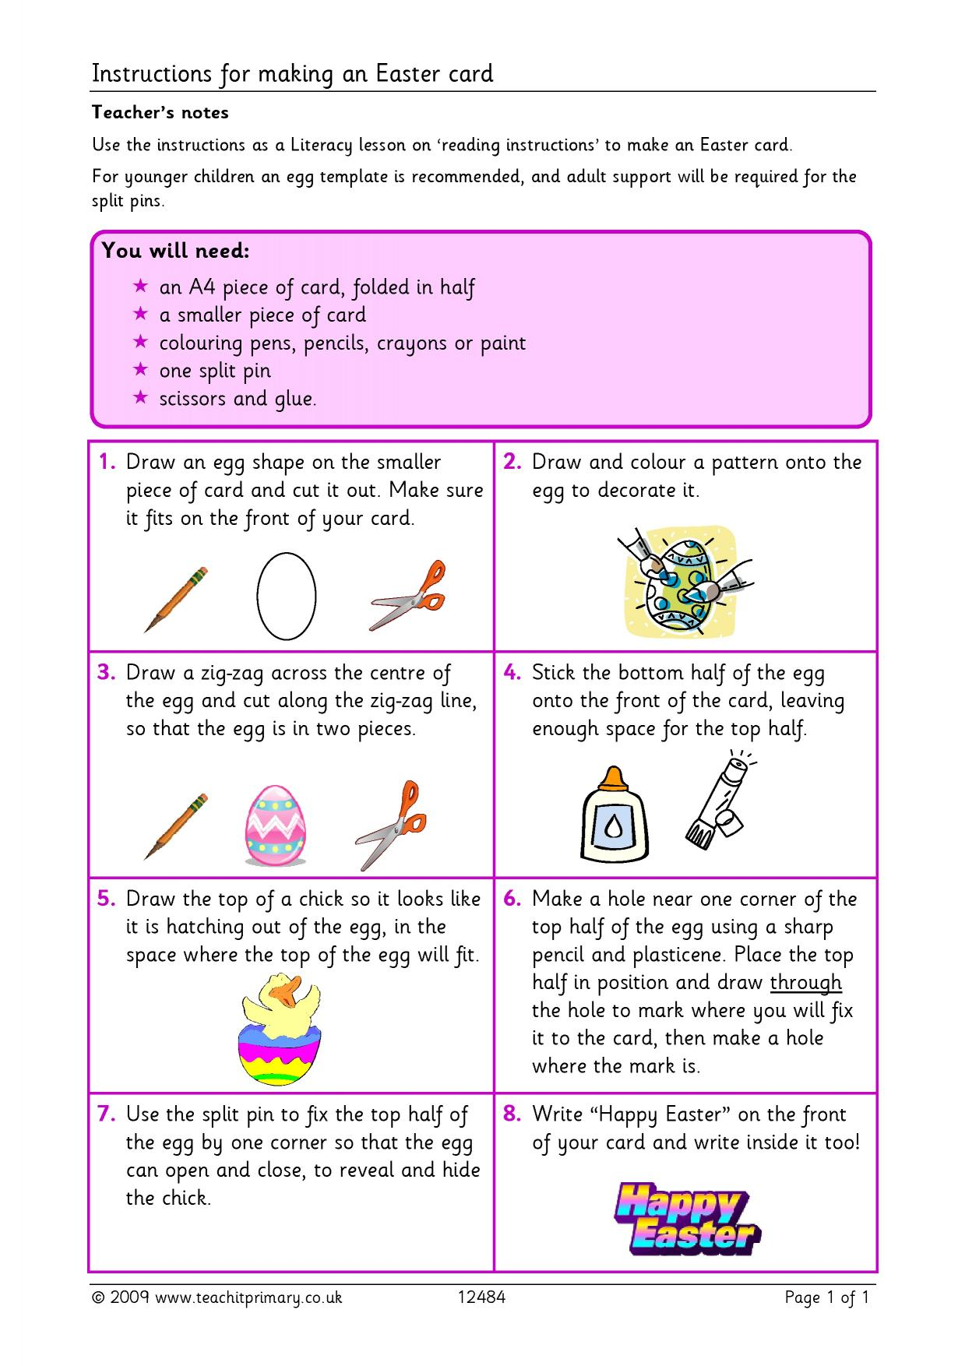

Slide 4
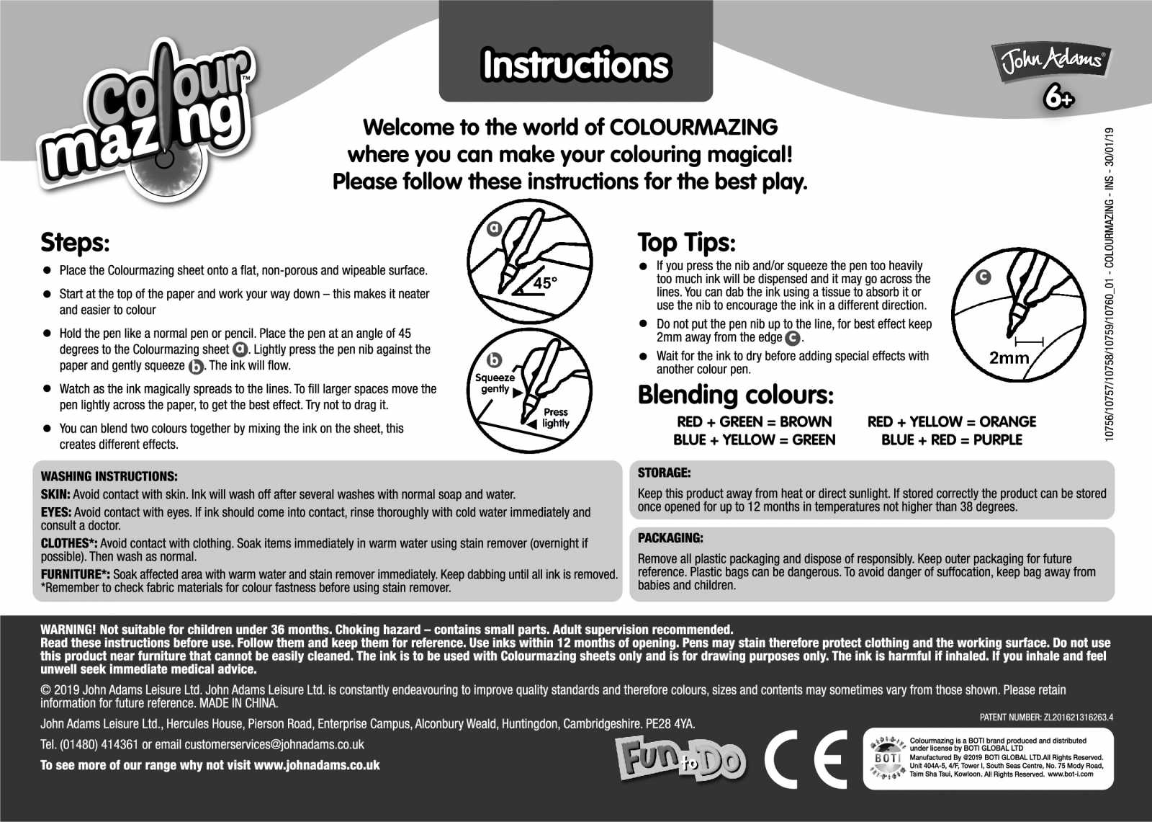

Slide 6
For Tuesday

