Slide 2
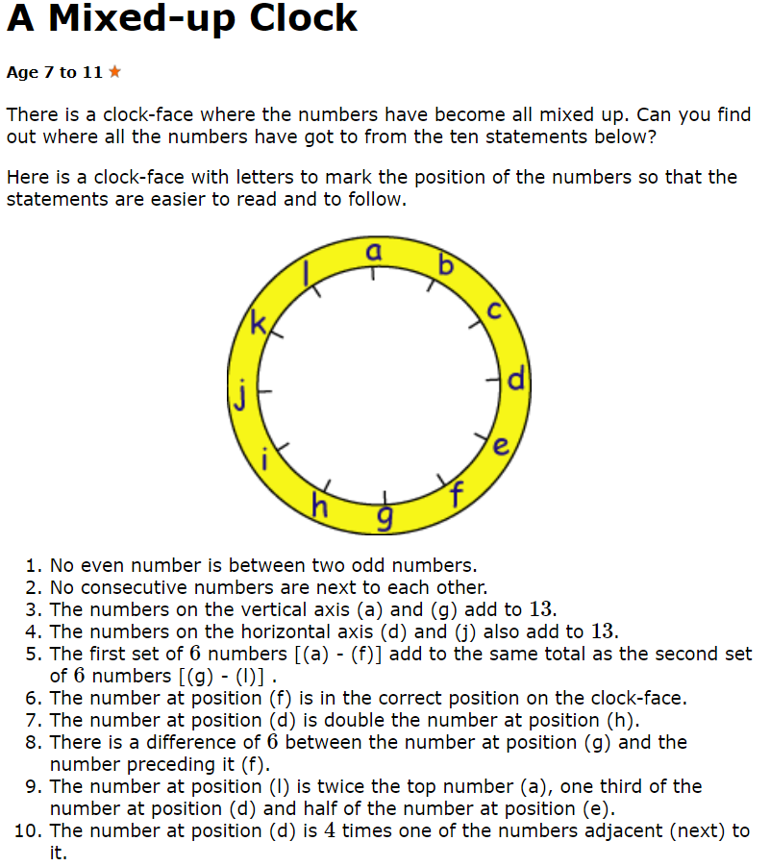
Day 4: A Mixed-Up Clock

Slide 3
Answers to A Mixed-Up Clock
A = 2,
B = 9,
C = 3,
D = 12,
E = 8,
F = 5,
G = 11,
H = 6 ,
I = 10 ,
J = 1,
K = 7,
L = 4

Slide 4
Thursday’s English for Year 6
Recognise correct use of apostrophe: contraction or possession
https://www.theschoolrun.com/what-is-an-apostrophe
Rewrite passage inserting apostrophes in the correct position and for the correct purpose.

Slide 5
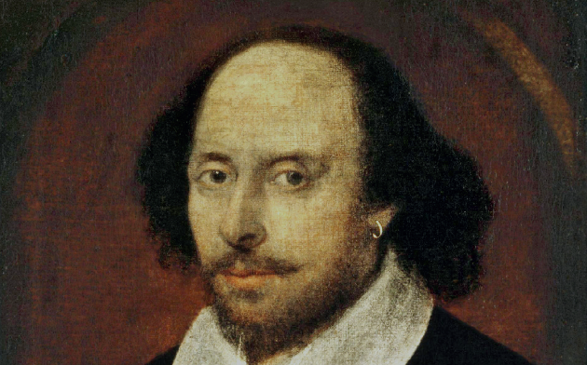
Today’s other activity:
To write a fact file on William Shakespeare
Research and write a fact file on William Shakespeare. He was born on 23rd April.
Who was he?
Where did he live?
What was his life like?
What was he famous for?
Why is he still famous today?
Who was he working for?
What legacy has he left? Explain the physical,
cultural and linguistic impact he has had.
.

