Slide 3
Some ways to do maths around the house…
Can you find an item (or items) of food that have a total weight of:
1kg
400g
850g
150g
2,500g
Can you find an item of food that takes the following times to cook:
More than 1 hour
Less than 300 seconds
Between 600 seconds and 20 minutes
Could you use some weighing scales to find items of food that have equivalent weights?
Send any pictures of your work to your class teacher ☺

Slide 4
Thursday’s English for Year 6
To complete a reading comprehension
Read the extract below from Charlie and the Chocolate Factory by Roald Dahl
The house wasn’t nearly large enough for so many people, and life was extremely uncomfortable
for them all. There were only two rooms in the place altogether, and there was only one bed.
The bed was given to the four old grandparents because they were so old and tired. They were so
tired, they never got out of it.
Mr Bucket was the only person in the family with a job. He worked in a toothpaste factory,
where he sat all day long at a bench and screwed the little caps onto the tops of the tubes of
toothpaste after the tubes had been filled. But a toothpaste cap screwer is never paid very much
money, and poor Mr Bucket, however hard he worked, and however fast he screwed on the caps,
was never able to make enough money to buy one half of the things that so large a family needed.
There wasn’t even enough money to buy proper food for them all. The only meals they could
afford were bread and margarine for breakfast, boiled potatoes and cabbage for lunch, and
cabbage soup for supper. Sundays were a bit better. They all looked forward to Sundays
because then, although they had exactly the same, everyone was allowed a second helping.

Slide 5
Thursday’s English for Year 6
Answers these questions, providing sufficient detail. Some questions may require a PEE response.
How do you know the family is poor?
Describe the house in your own words.
Why was Mr Bucket’s job so boring?
What meals were the family able to eat?
Who slept in the bed?
Describe these people in your own words.
Why did the family look forward to a Sunday?
What do you think the author (Roald Dahl) wants us to feel at this point in the story?
Why do you think he wants us to feel this way at the beginning of the book?

Slide 6
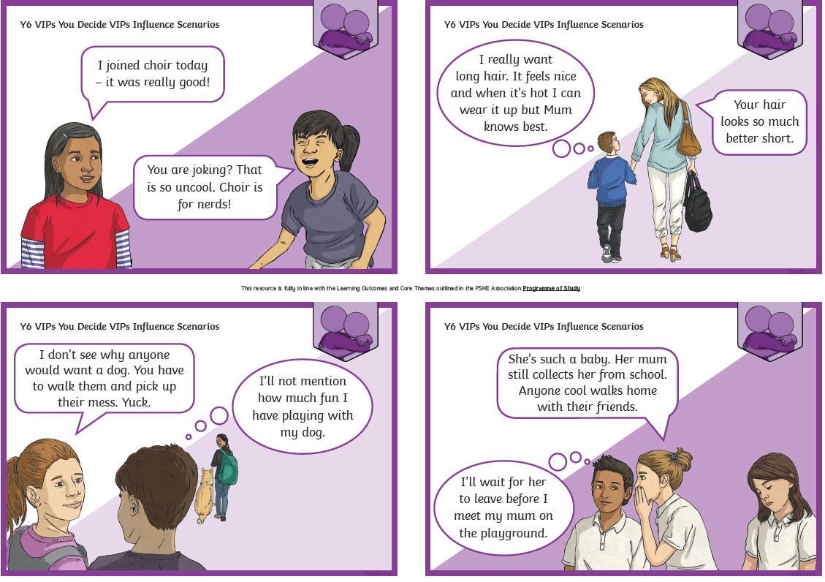
Today’s other activity:
Look at each scenario card. Write down what possible course of action each child should take that would have a positive outcome.

