Slide 2
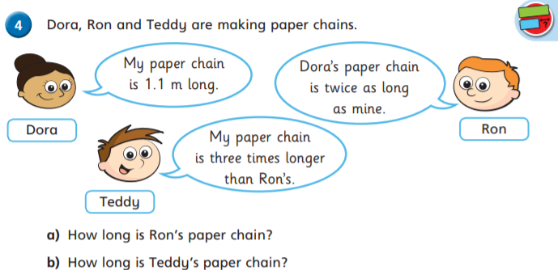
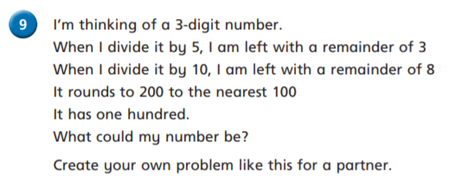
Follow this sheet to revisit a topic from year 6 maths. Complete as much as you feel confident doing.
Warm up
Day 2: Using division to solve problems.
Challenge
Time
Remember you can’t have part of a bus.. Or part of a cake.

Slide 3
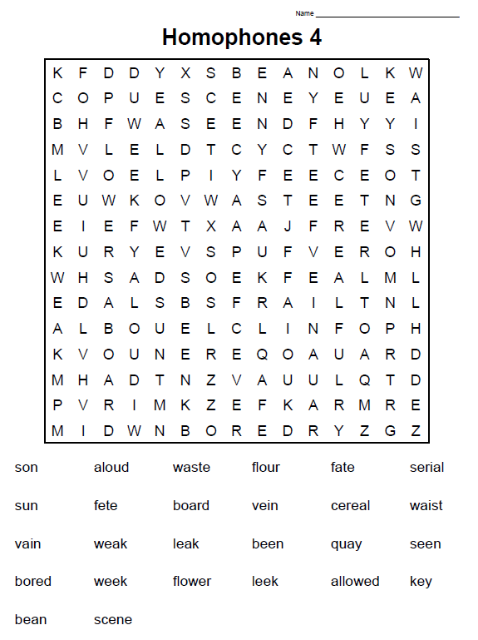
Tuesday’s English for Year 6
Spelling focus: To identify homophones
Find all the words in the wordsearch then write a list of the homophone for each word.
Homophones are each of two or more words having the same pronunciation but different meanings, origins, or spelling

Slide 4
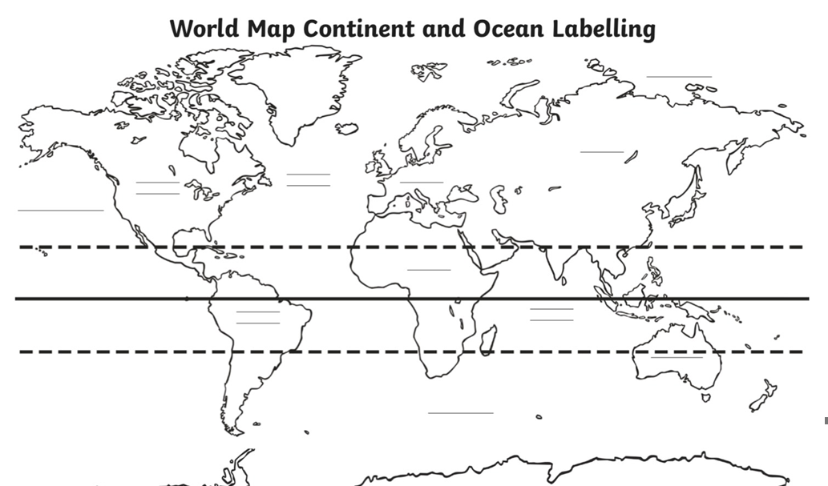
Today’s other activity:
To identify specific areas on a world map.
Using maps/atlases to name places/countries on a South American map.
To identify countries on a global map

Slide 5
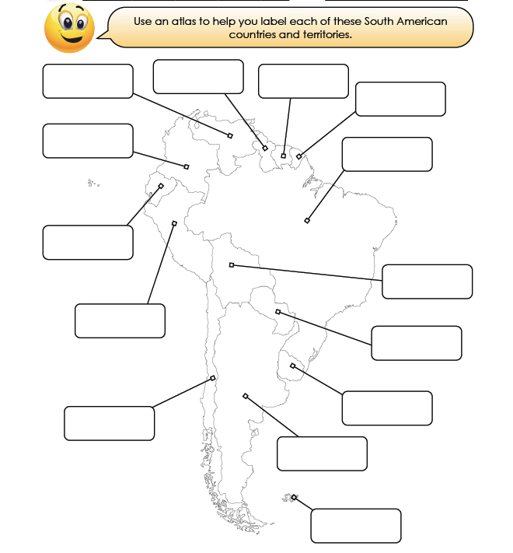
Geography – identifying specific areas on a world map.
Using maps/atlases to name places/countries on a South American map.
To identify countries in South America

