Slide 1
Year 3 Home School Provision Daily Pack
The following slides will be split into 3 separate activities.
Each slide will be daily activities for you and your child to do at home.
We as a Year 3 team will update these slides daily.
Thank you for your understanding and on going support during these times.

Slide 2
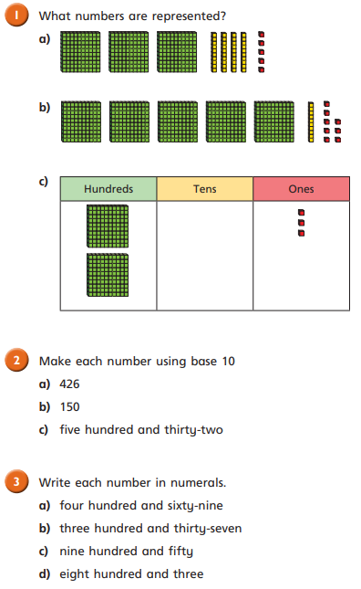
Daily Provision Pack - Day 10
Mats:
English:
Diary Writing
Write a diary about:
What you did yesterday
Imagine you are a character in your book- what did they do?
An explorer in the jungle.
A pet in a house
School Values:
Find a definition of each of our values and give an example of when you have used it. Illustrate if wanted.
Compassion
Community
Courage
READING: Fiction Express
Read Chapter 4 of ‘Takeover’ with your parents. Complete the online quiz.
Base ten = dienes. Ones, tens and hundreds. Draw in books.

