Slide 1
Year 3 Home School Provision Daily Pack
The following slides will be split into 3 separate activities.
Each slide will be daily activities for you and your child to do at home.
We as a Year 3 team will update these slides daily.
Thank you for your understanding and on going support during these times.

Slide 2
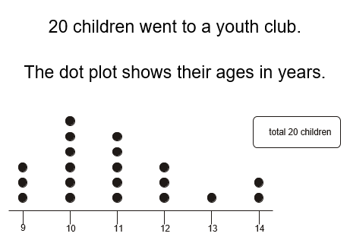
Daily Provision Pack - Day 11
Maths:
English:
Write a letter.
You can write your letter to:
A friend you miss
A relative you haven’t seen for a while
To your teacher
PE:
Go onto YouTube (with your parent’s permission).
Clear a space in front of your TV, and wear appropriate clothing.
Choose your favourite ‘Just Dance’ songs and dance along in your TV room for at least 30mins.
Have a 5 minute break and drink some water.
Now try another 30 minutes.
TTRS – play on this for at least 20 mins today.
Which was the most common age?
What is the difference between the amount of people who were;
10 and 14?
12 and 13?
9 and 13?
3) What is the least common age?
4) Write 3 of your own questions!

