Slide 1
Year 3 Home School Provision Daily Pack
The following slides will be split into 3 separate activities.
Each slide will be daily activities for you and your child to do at home.
We as a Year 3 team will update these slides daily.
Thank you for your understanding and on going support during these times.

Slide 2
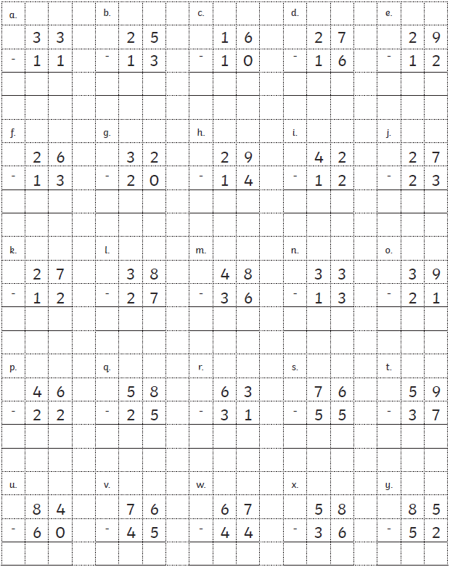
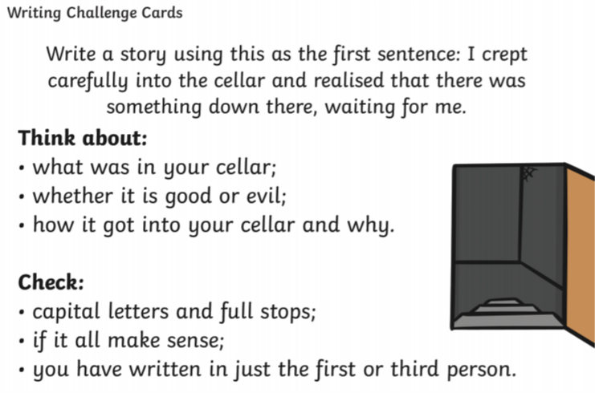
Daily Provision Pack - Day 17
Maths: (within HTU – HTU)
English:
Please complete the writing challenge card.
Computing:
Try: Minecraft Hour of Code again.
https://hourofcode.com/uk/learn
Complete an activity of your choice for 1 hour.
Alternative 1: U – U using objects to support. 9 pencils subtract 4 pencils =
Alternative 2: HTU – HTU
Alternative 3: HTU - TU

