Slide 1
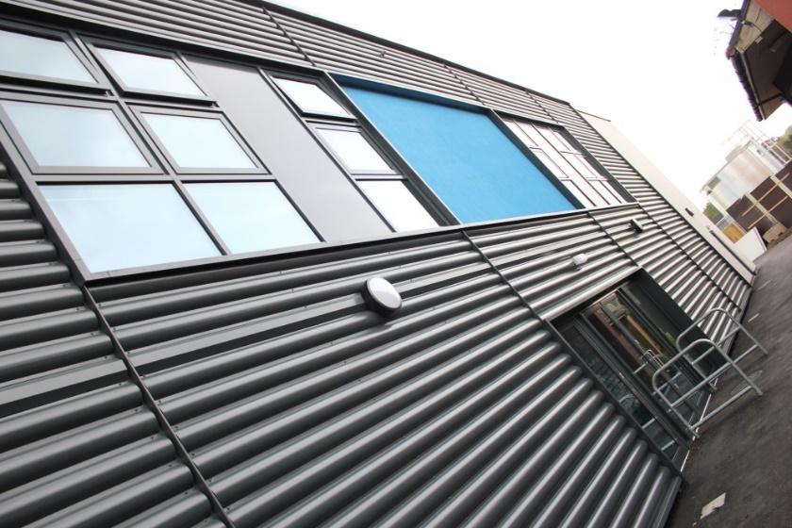
Burton Borough School Year 7 2020-21
Welcome to our school
information for students

Slide 2
Here to help you get excited about your big move!
Background to your new school
Starting school next September.
We’re sorry we haven’t been able to come out and see you at your primary schools but we have been thinking about you and we hope you enjoy reading about the Burton Borough and the exciting times ahead.
We are really looking forward to when we are back in school and can all get together. You will be hearing from us soon through the post and through your primary school website and the Burton Borough website. Keep checking for information from us. https://www.burtonborough.org.uk/parents/year-6-7-transition

Slide 3
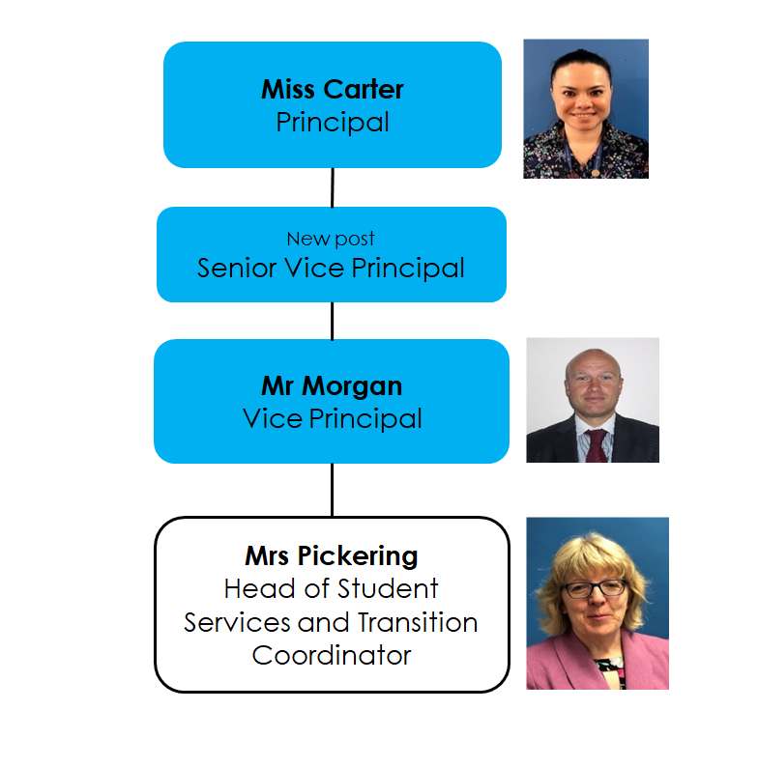
Introductions:

Slide 4
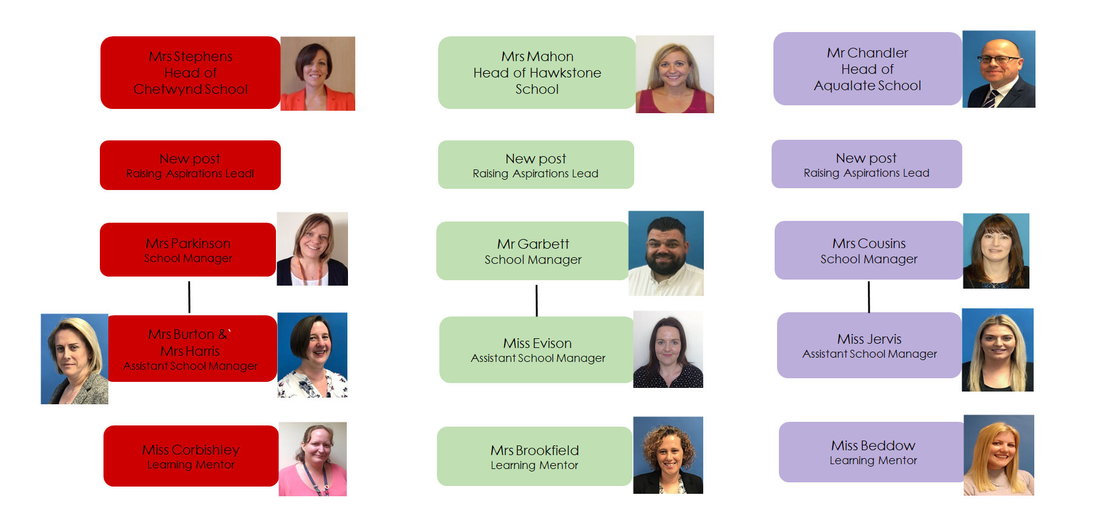
Three ‘Small Schools’ you will all be joining

Slide 5
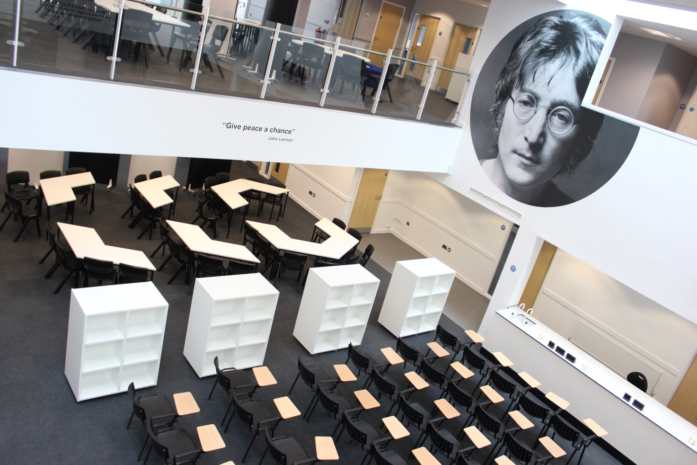
Our fabulous Open Learning Areas, bright and spacious downstairs...

Slide 6
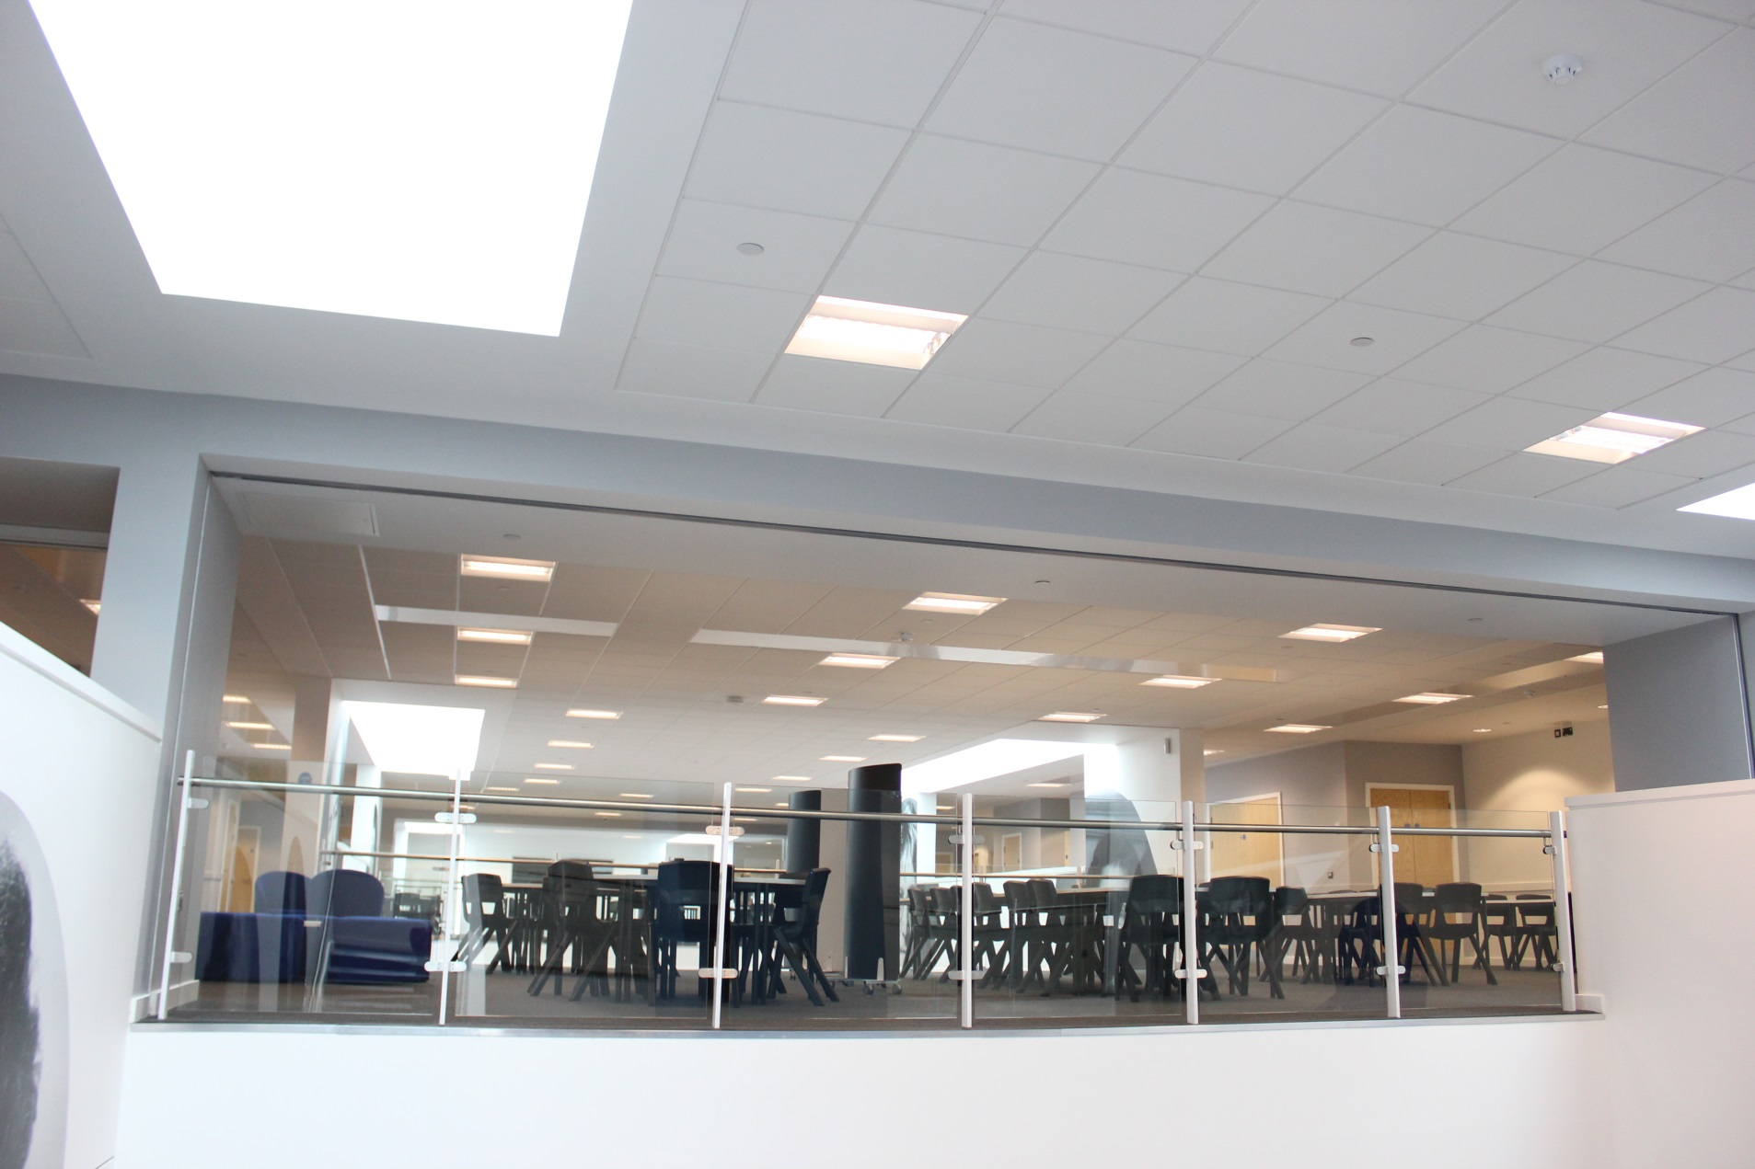
…and upstairs

Slide 7
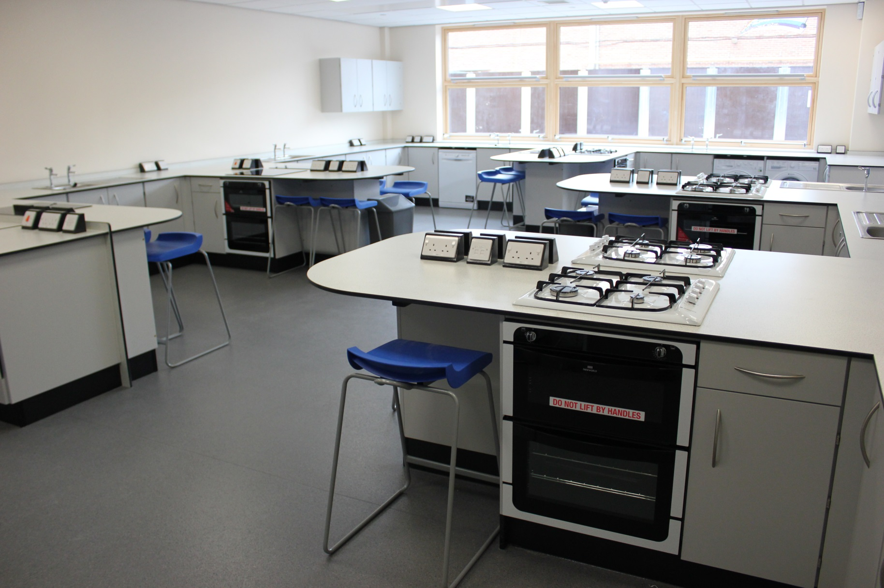
Who loves to bake? Especially in our bright DT food room

Slide 8
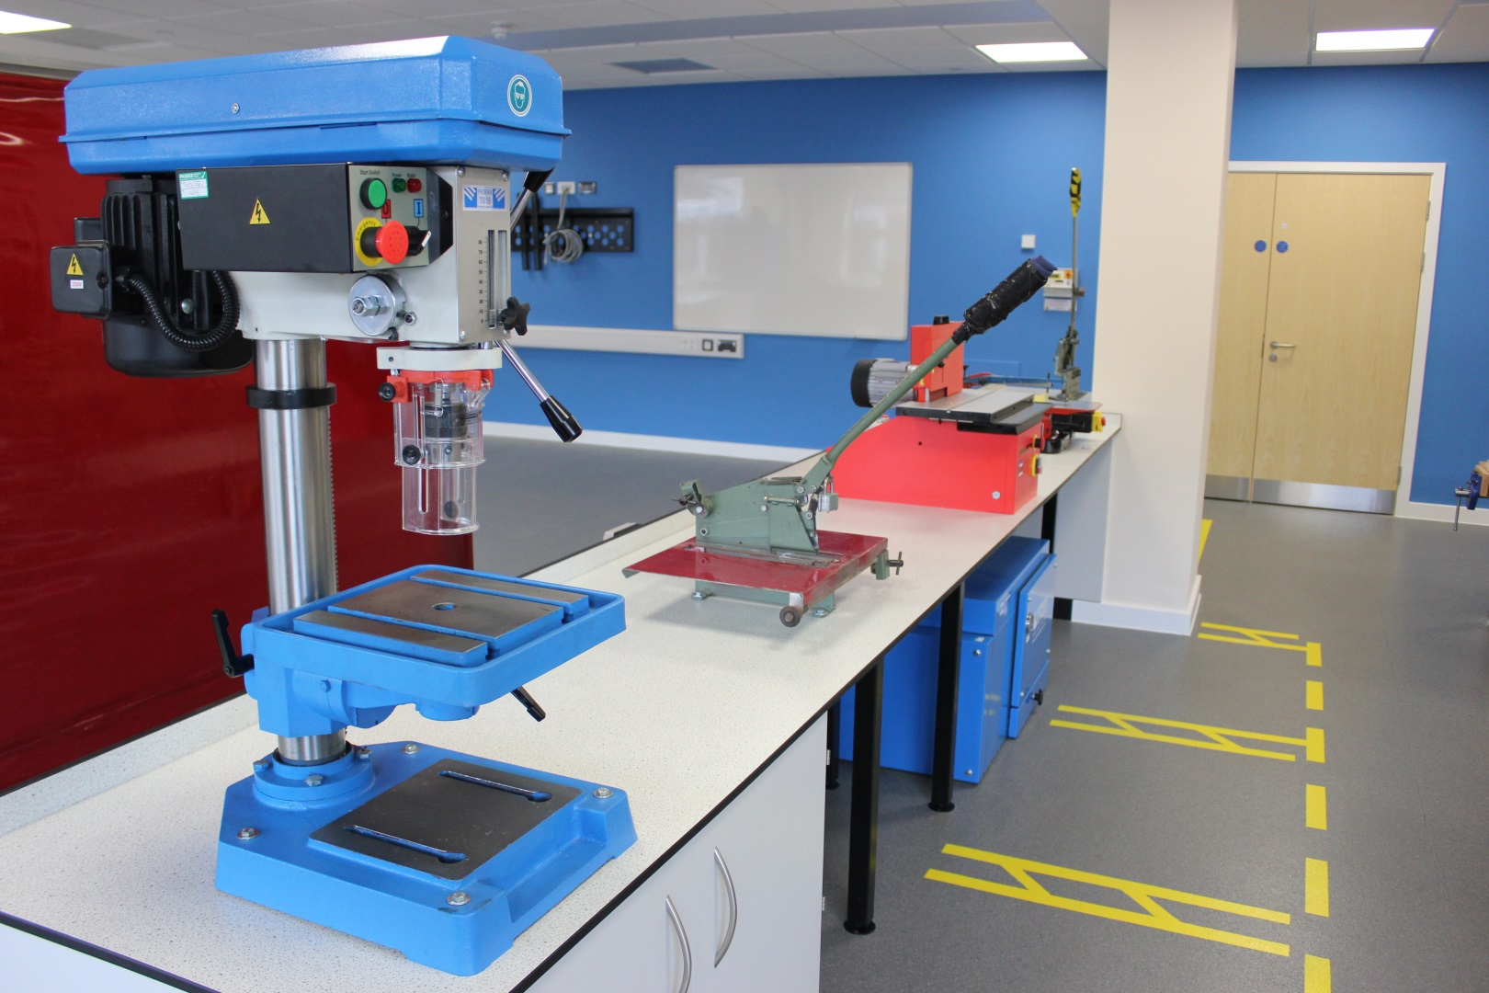
Just a small part of our fantastic Design & technology teaching space

Slide 9
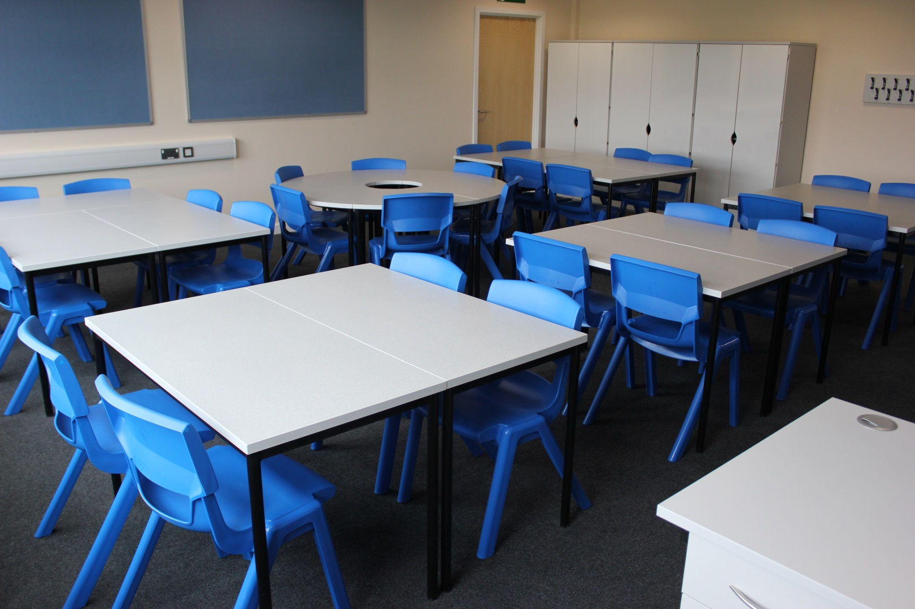
An example of one of our lovely bright classrooms and tutor bases

Slide 10
Our School Logo on your blazer and ties

Slide 11
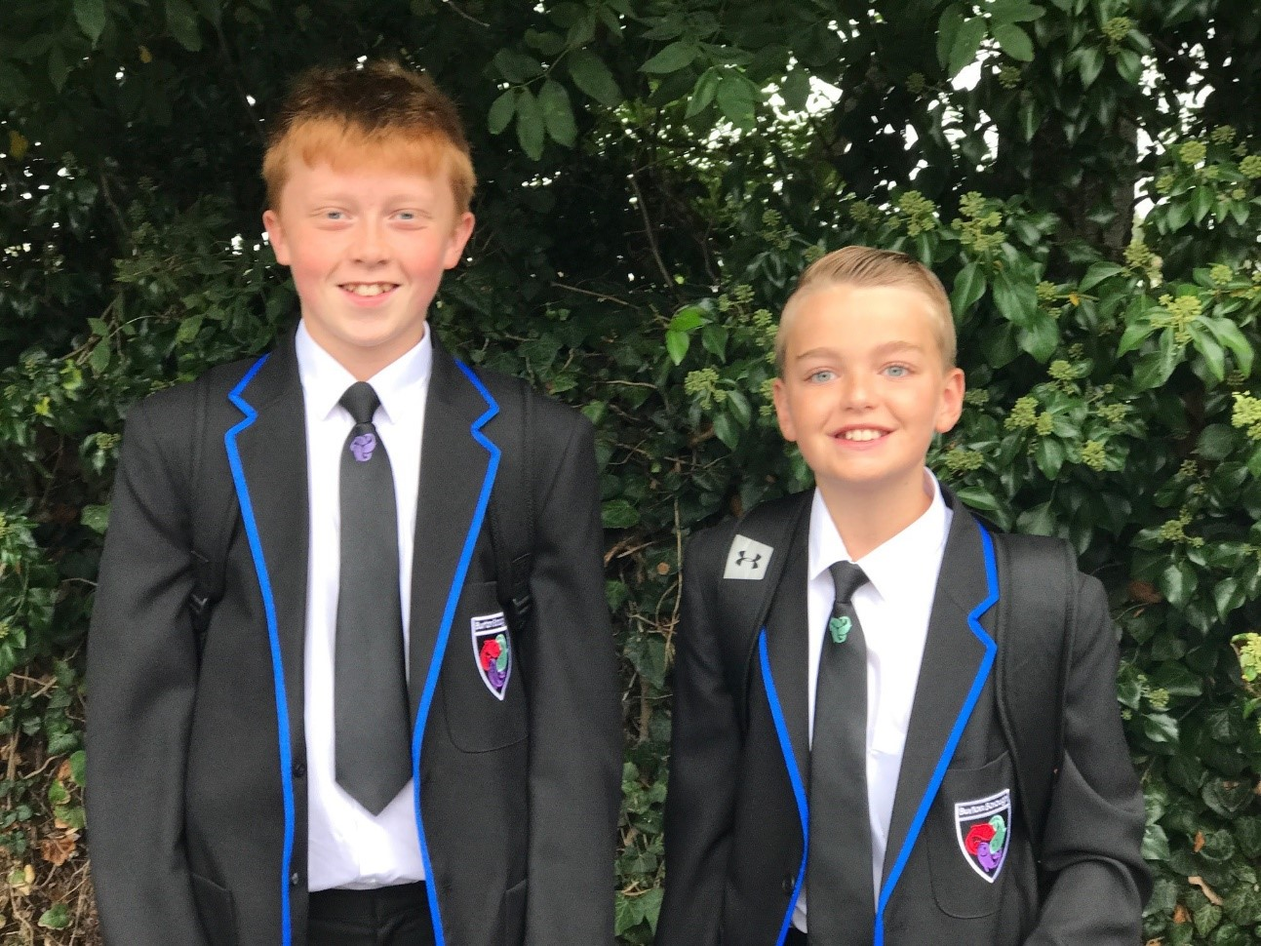
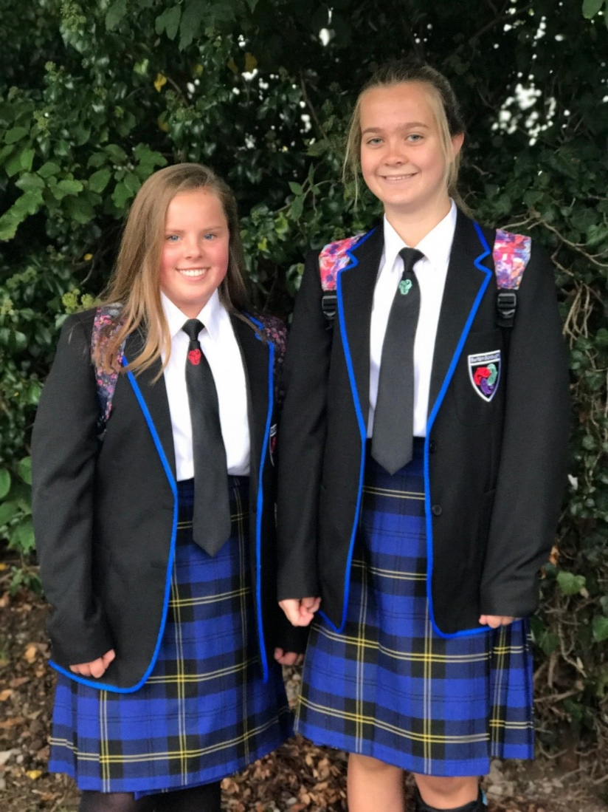
Our lovely smart uniform

Slide 12
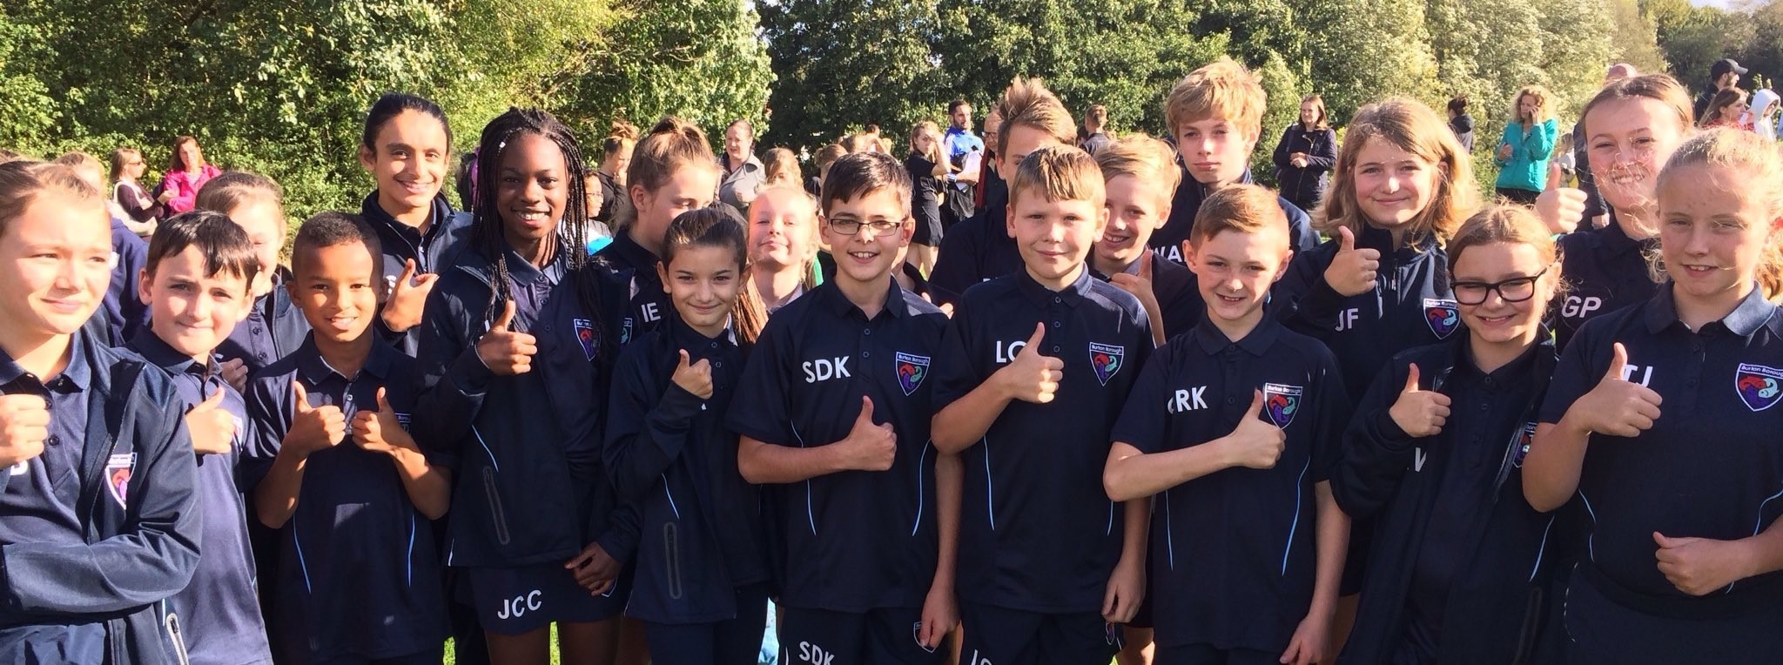
Our lovely new PE kit available from Newport Sports

Slide 13
Our School Motto – Be the difference
Get involved with clubs, societies and activities or start your own!
Try everything, especially something new you thought you would never do!
Do your best always

Slide 14
When you join us
Worried about getting lost….Relax…Year 10s have volunteered to be your hosts and buddies. They will be there for you until you feel ready to go off on your own.
You will find out which Small School you are in and meet your lovely Form Tutor and your brilliant Tutor Group

Slide 15
Lessons you will be having...
Art
Community Learning Lesson
Computing
Design and Technology
Drama
English
French
Geography
History
PSHE
Maths
Music
Physical Education
Religious Education
Science.
Spanish

Slide 16
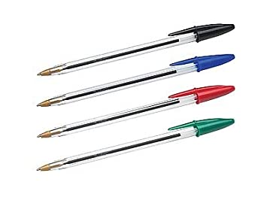
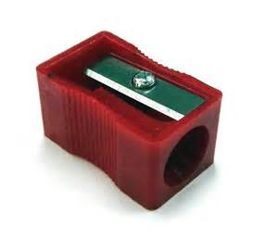
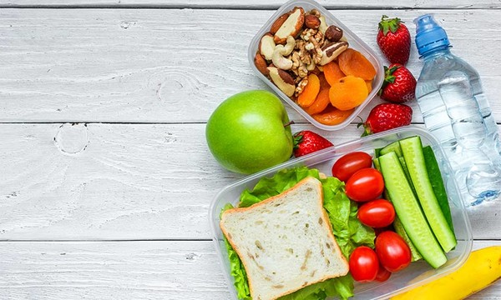
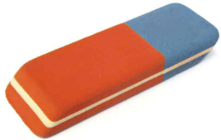
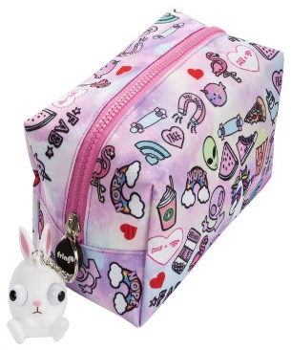
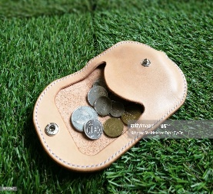
Equipment List for your first day We will give you Study Diaries and a Standards Card
Full details will be in your information packs.

Slide 17
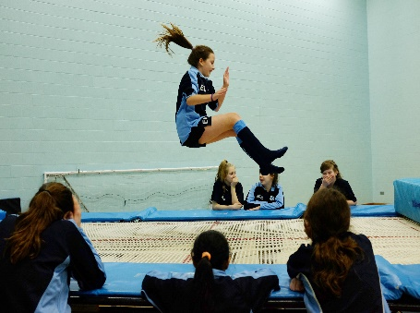
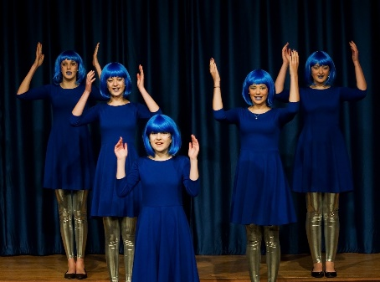
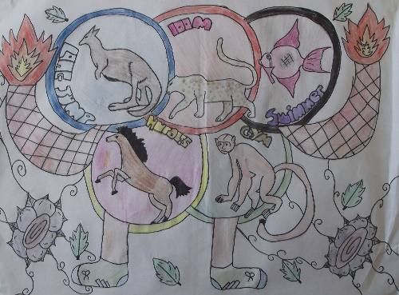
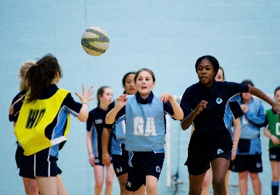
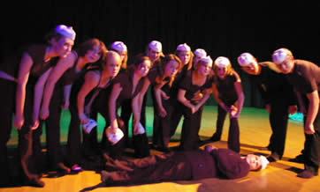
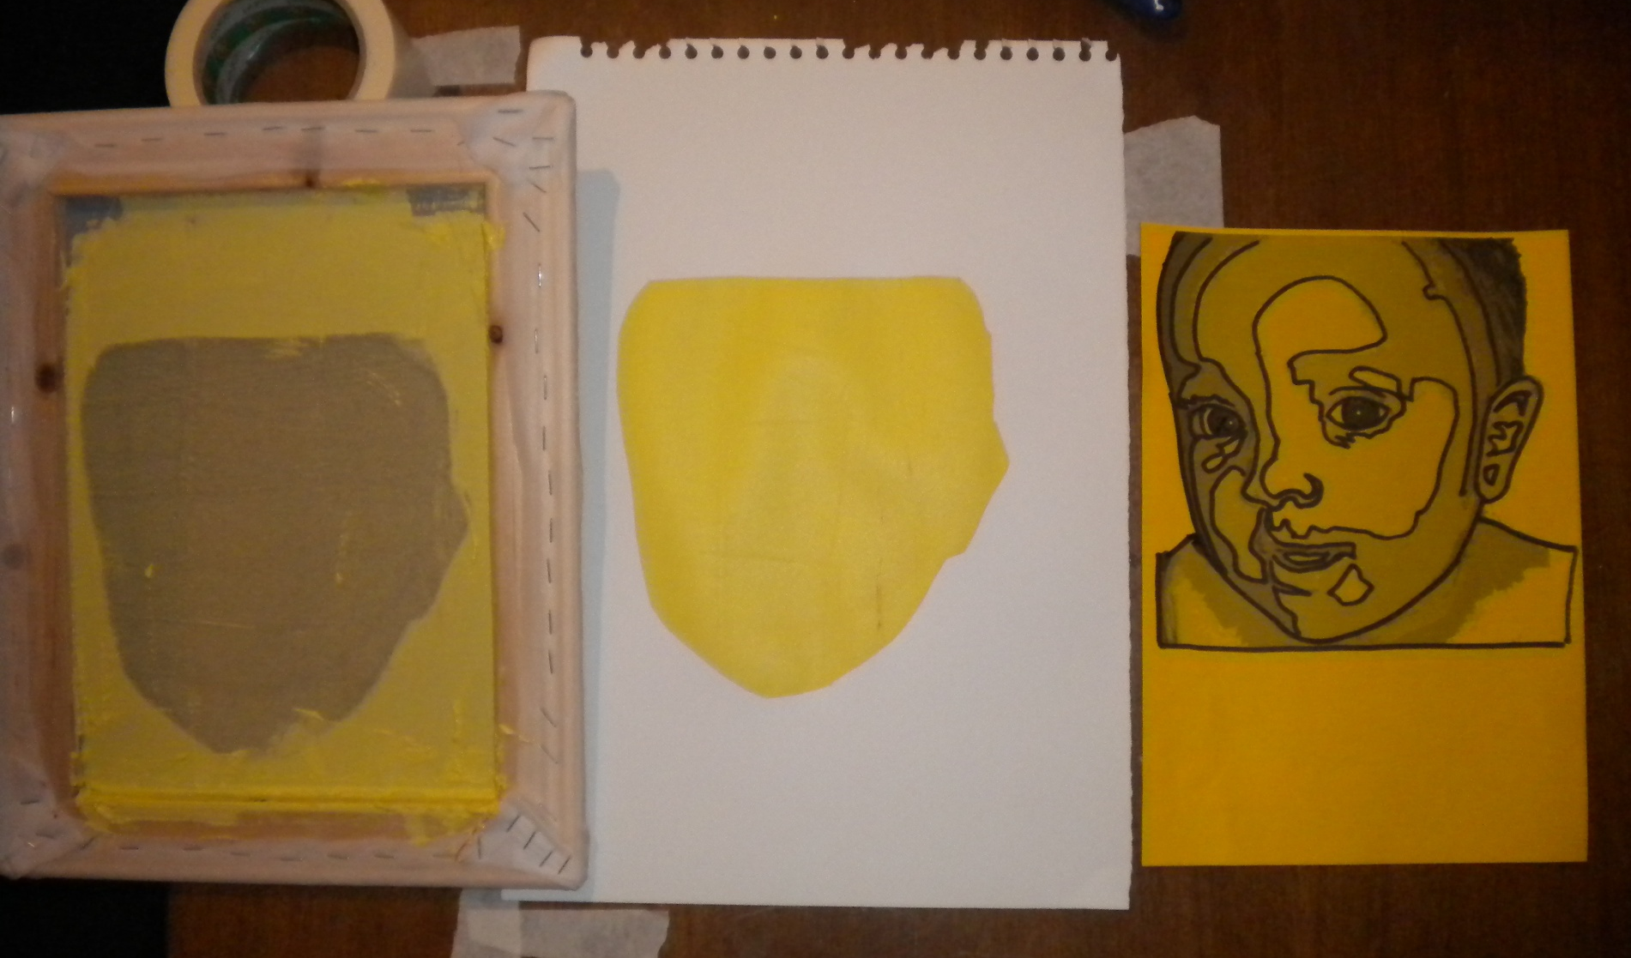
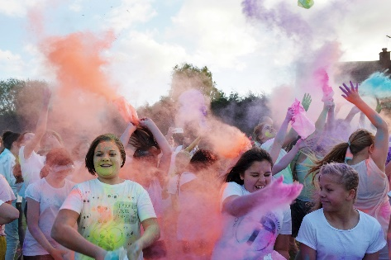
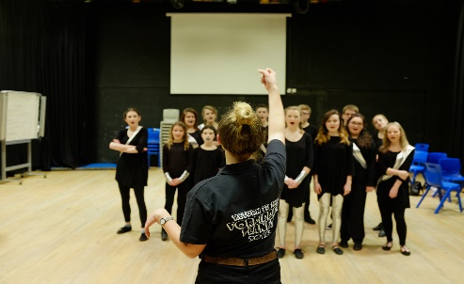
Just a few of the amazing clubs you will be able to join

Slide 18
Where to access your Homework
Homework – Homework Club
Show my homework – link from website.
https://theburtonborough.showmyhomework.co.uk/school/homeworks/calendar
And lots of other great places like Mathswatch and Bedrock

Slide 19
More Information and things for you to complete
There will be packs being sent out to you at home over the next couple of weeks.
Read them carefully with your parents and please ask your parents and carers to post or email all the forms back.
If you have any questions ask your parents to email us at
main.bbs@taw.org.uk

Slide 20
Thank you for reading through this. We are really looking forward to seeing you very soon.

