Slide 2
Maths Home Learing – W/C Monday 11th May 2020.
To help support children (and parents) with the home learning this week, we will be providing some video links that offer some support in how to complete each task.
Each day you will get a link to follow which will provide a video for the children to watch and refresh their memory.
If you feel confident without the video – then feel free to carry on by pressing ‘Get the Activity’
Have a good week.
Mr J
Monday Home Learning: To compare & order fractions.
Follow this link to access to the video and activity.
https://whiterosemaths.com/homelearning/year-6/
Select Week 3, Lesson 2, Compare & Order Fractions. Press ‘Get the Activity’ to see your task.
Answers are also provided.

Slide 3
Tuesday’s English for Year 6
Adverb starter
Watch the clip on BBC Bitesize:
https://www.bbc.co.uk/bitesize/topics/zwwp8mn/articles/zgsgxfr
After watching the clip, write a definition of what an adverb is and provide at least 10 different adverbs that would appropriately match the verb DANCE, WALK and SING.

Slide 4
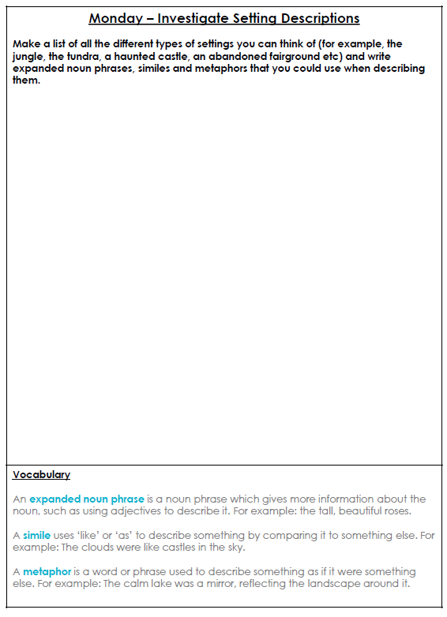
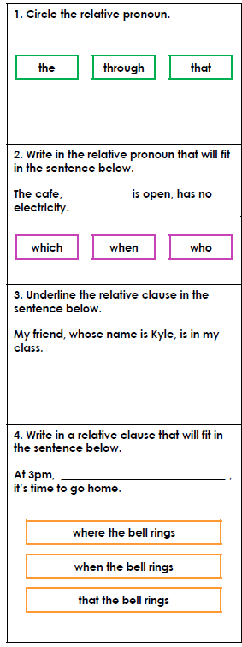
Extension Task: Review some SPAG features

Slide 5
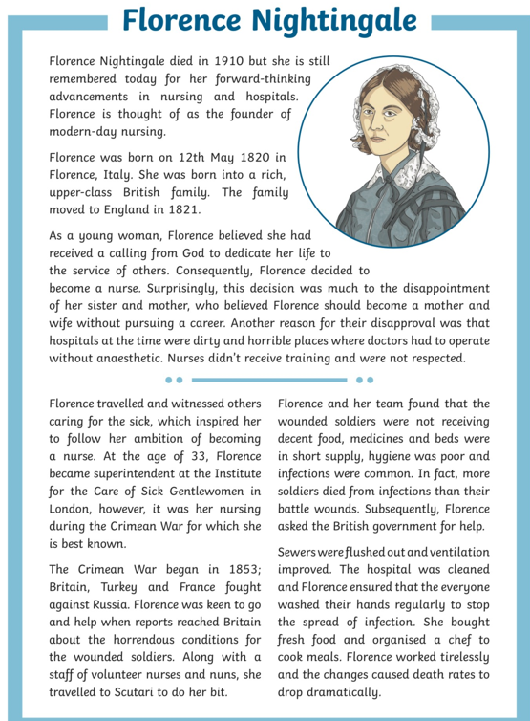
Today’s other activity:

Slide 6
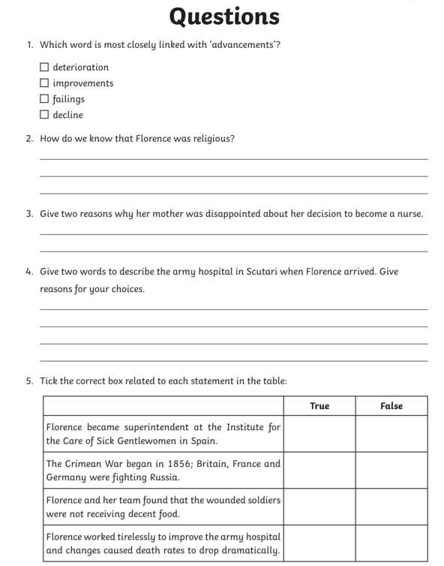
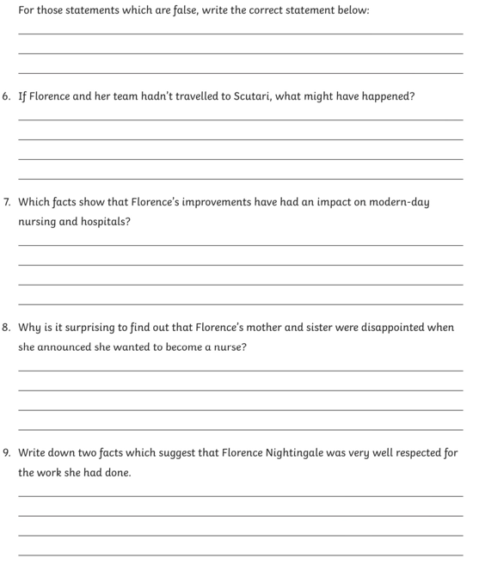

Slide 8
