Slide 2
Home Learning: To consolidate understanding of fractions.
Follow this link to access to the video and activity for each day of home learning.
https://whiterosemaths.com/homelearning/year-6/
Select - Week 1: Ratio (Scroll to the bottom of the page)
Monday – Using ratio language
Tuesday – Ration & Fractions
Wednesday – Introducing the ratio symbol
Thursday – Calculating Ratio
Friday – Using scale factor
Ratio has a natural link with fractions and is something used more commonly in life than children realise.
Efficient times tables are crucial to success in ratio.

Slide 3
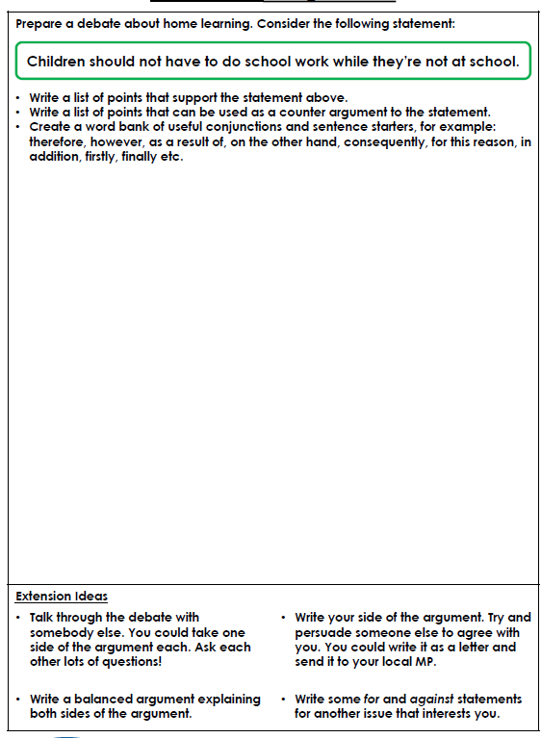
Wednesday’s English for Year 6
To prepare a debate
I am certain you will all be able to come up with multiple reasons for this question!!

Slide 4
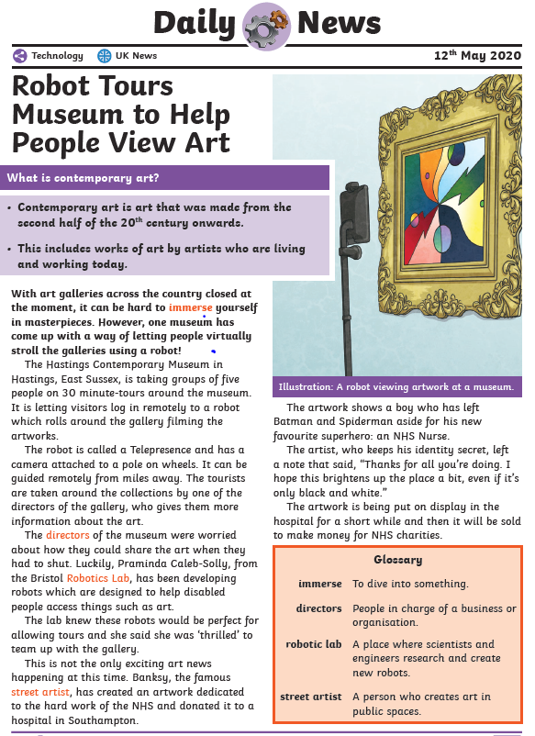
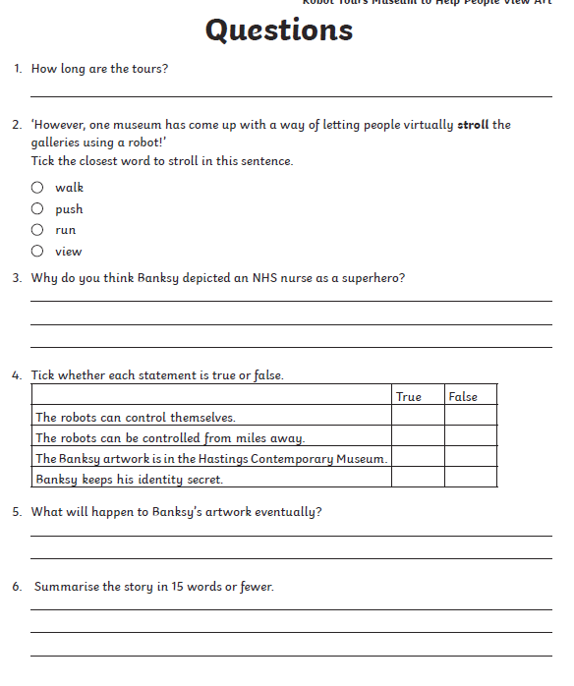
Today’s other activity:

Slide 5
