Slide 2
Maths Home Learing – W/C Monday 11th May 2020.
To help support children (and parents) with the home learning this week, we will be providing some video links that offer some support in how to complete each task.
Each day you will get a link to follow which will provide a video for the children to watch and refresh their memory.
If you feel confident without the video – then feel free to carry on by pressing ‘Get the Activity’
Have a good week.
Mr J
Monday Home Learning: To compare & order fractions.
Follow this link to access to the video and activity.
https://whiterosemaths.com/homelearning/year-6/
Select Week 3, Lesson 3, Add & Subtract Fractions. Press ‘Get the Activity’ to see your task.
Answers are also provided.

Slide 3
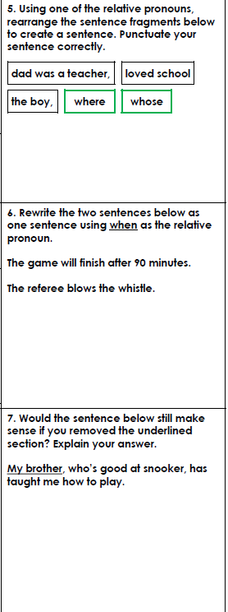
Wednesday’s English for Year 6
SPAG starter

Slide 4
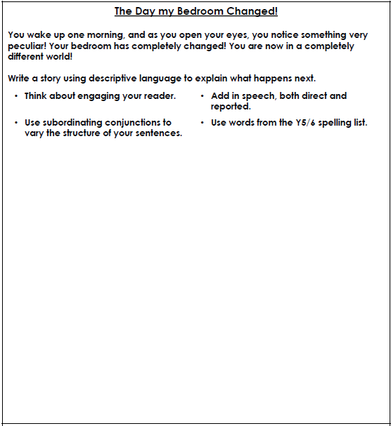
To write an imaginative story.
Use your own bedroom and create something very different.
Use strong language and vary sentences.
1* Create story as a comic strip, adding appropriate images to support the reader’s understanding of what is going on in the narrative.

Slide 5
Today’s other activity:
To design and make a roller coaster.
As all the theme parks are closed, use
your imagination and design an make
a junk model of your perfect roller
coaster. Think about what you want
to include – twists, turns, drops…
This activity is for Wednesday and
Thursday.

