Slide 2
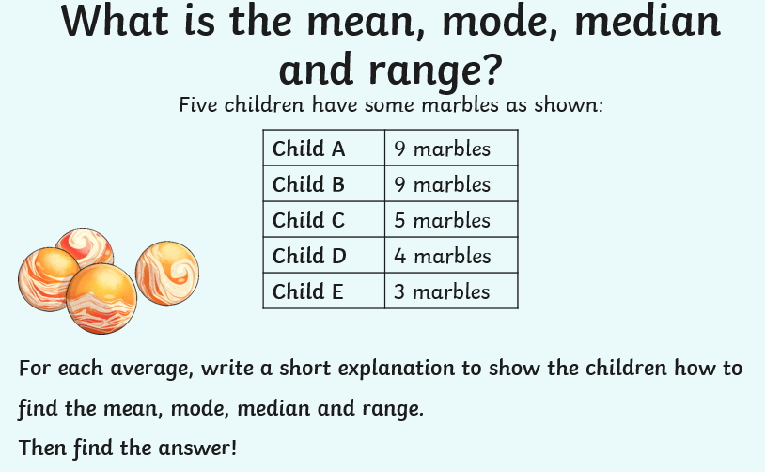
Home Learning: To solve problems using averages.
This week you have discovered how to find the mean, mode, median and range. I’ve added a little rhyme to help you remember each one!
Have a go at the problems below. Remember to read the problem carefully before finding your starting point.
Hey Diddle Diddle
The median’s in the middle.
You add and divide for the mean.
The mode is the one you see the most
And the range is the difference between!
Task 2… Marbles!
Task 1… Wipe out!

Slide 3
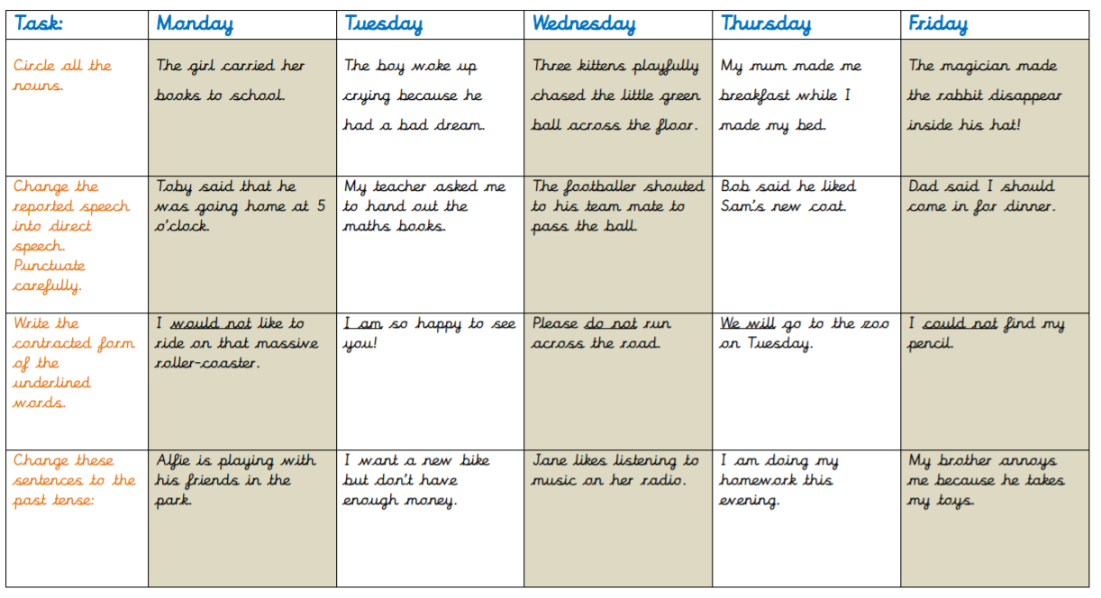
English Starter

Slide 4
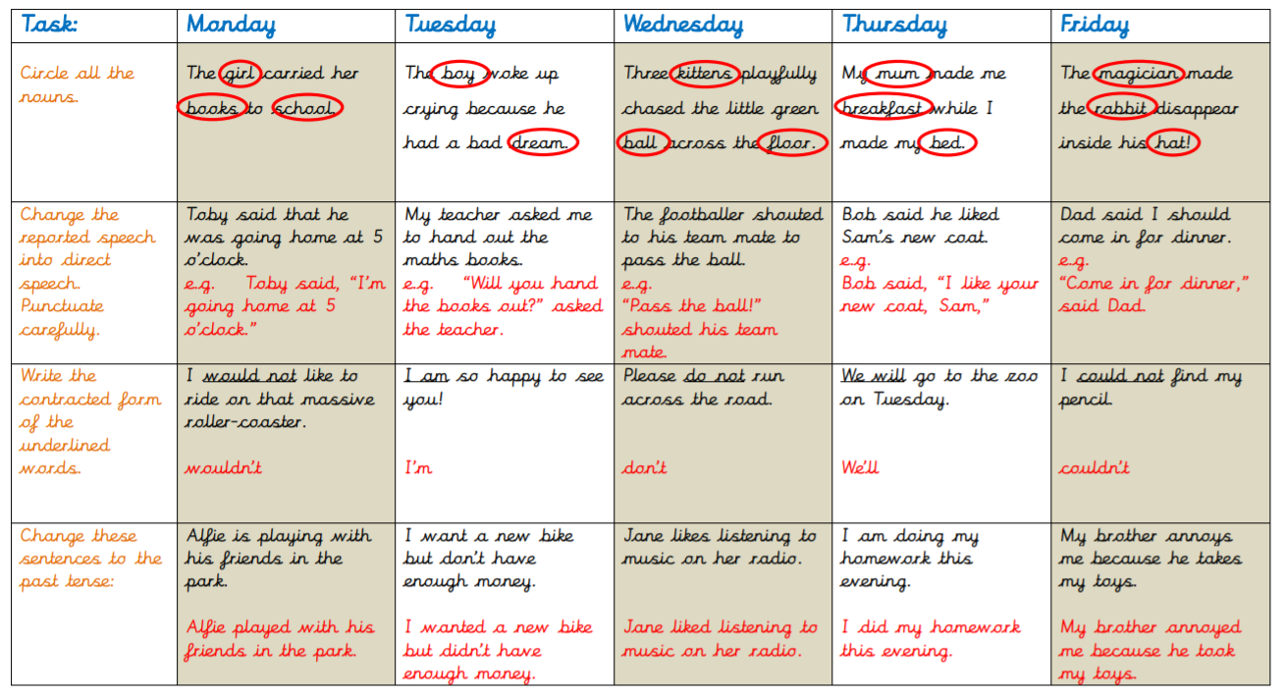
English Starter

Slide 5
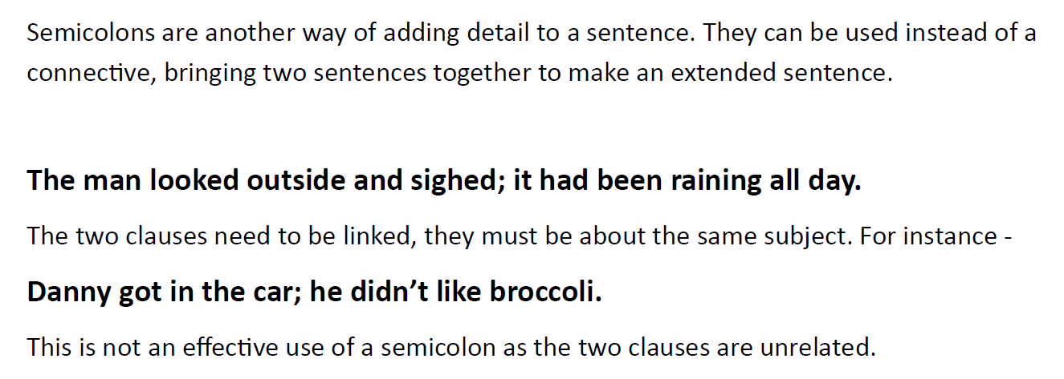
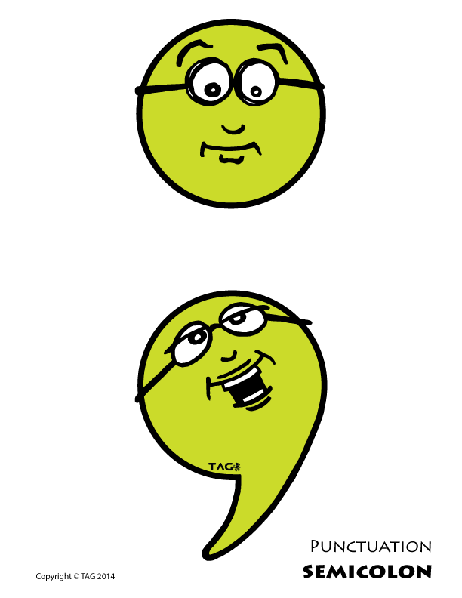
Friday’s English for Year 6
L.O: To use a semi-colon with accuracy.
HINT:
They often replace a FANBOYS conjunction
For
And
Nor
But
Or
Yet
So
Use the link below to watch a video on how to use a semi-colon!
https://www.bbc.co.uk/bitesize/topics/zvwwxnb/articles/zshfdxs

Slide 6
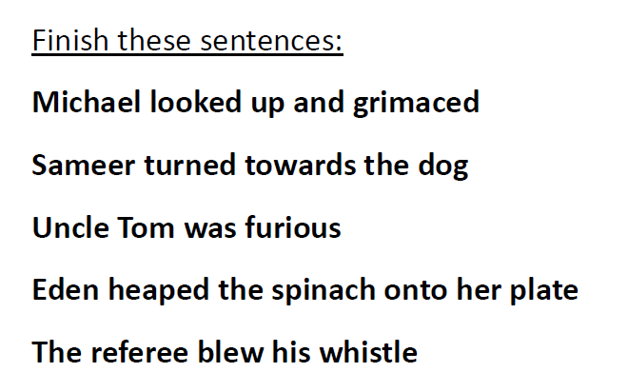
Task 1
Task 3
Choose one of the sentences that you finished.
Write a paragraph based on the sentence that you have created. You must include at least two semi-colons in your paragraph!
Task 2

Slide 7
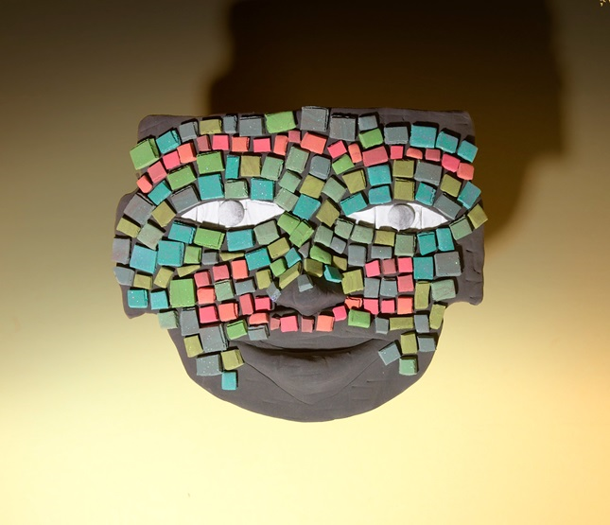
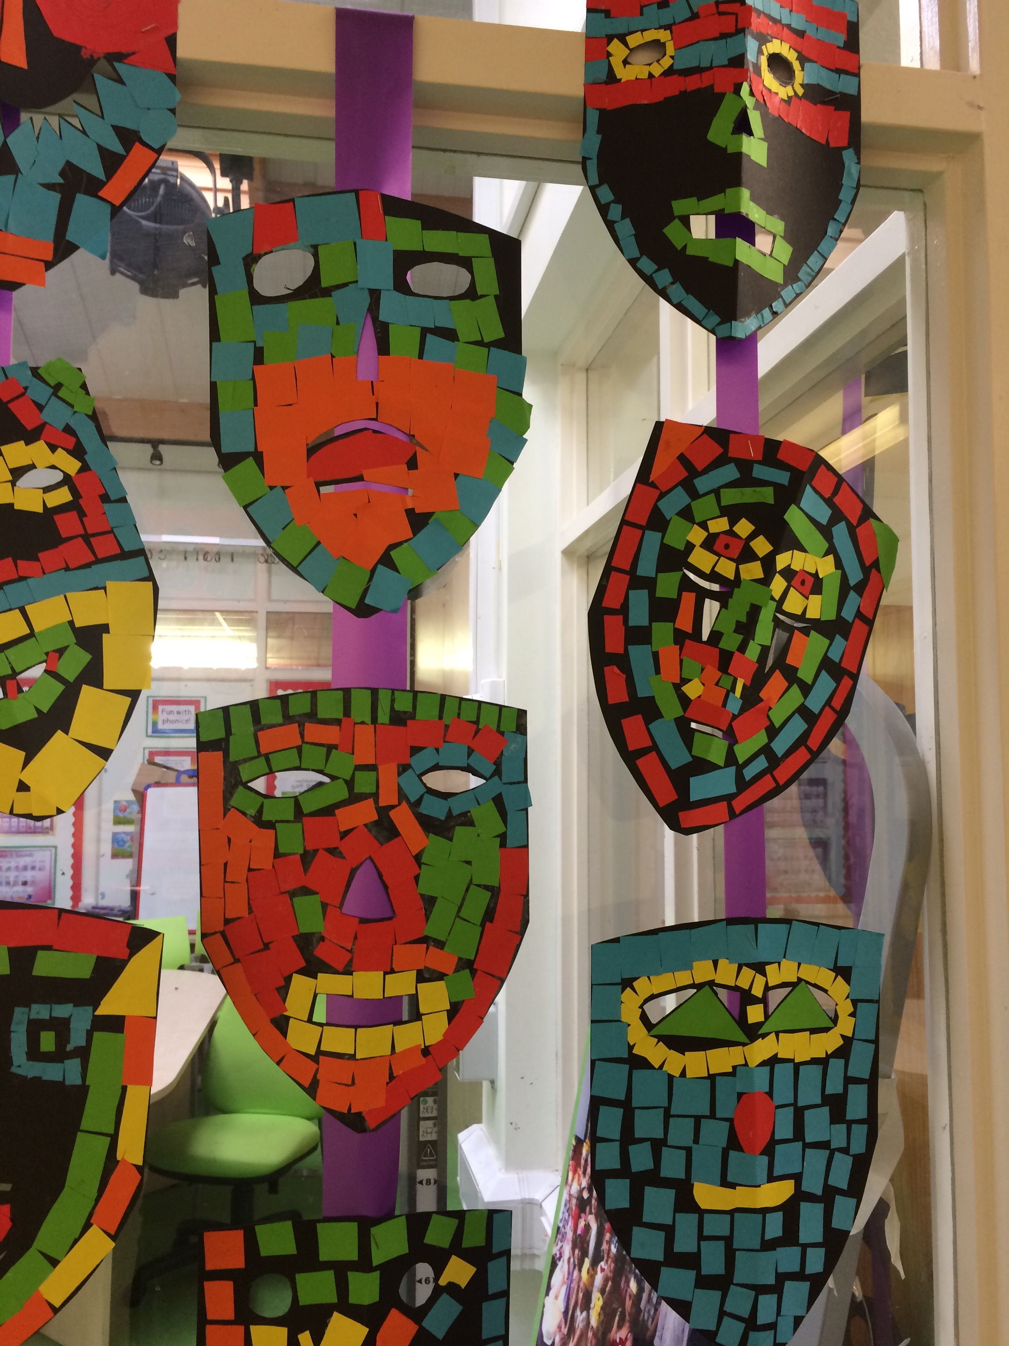
Today’s other activity:
L.O: To make an Aztec mask.
Yesterday you created an Aztec mask design. Today, I would like you to try and make it. You can be as creative as you like with your mask.
You can use any materials you wish!
I am looking forward to seeing the final products!
E-mail a picture to eloise.jones@taw.org.uk and I will pop them on the website to show them off!
Enjoy making your masks!

