Slide 2
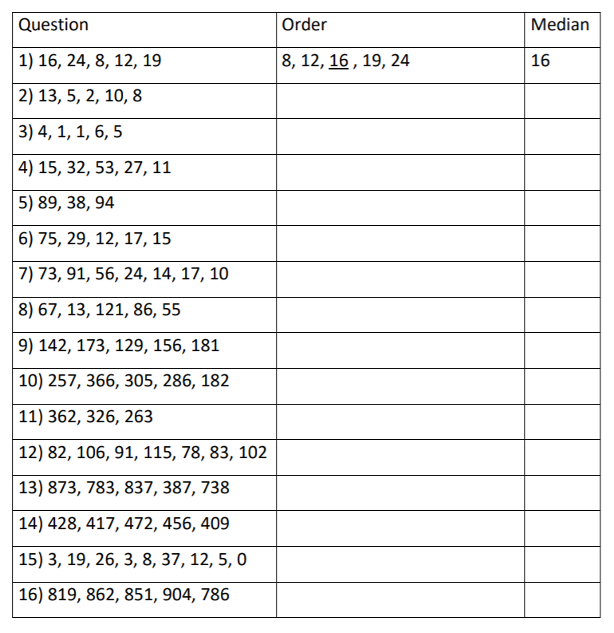
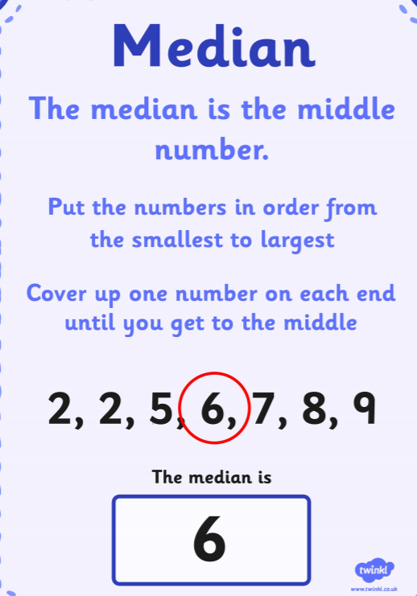
Home Learning: To calculate the median average.
This week you will start looking at averages. This includes the mean, mode, median and range. Today you will look at the median. Below is a simple explanation on how to find it.
HINT: If you order the numbers first. Then, cross one off each side (like on the example) until you are left with the median.
Note: If you end up with 2 numbers left. Divide them by 2 to find the median!
For each set of numbers, can you find the median..

Slide 3
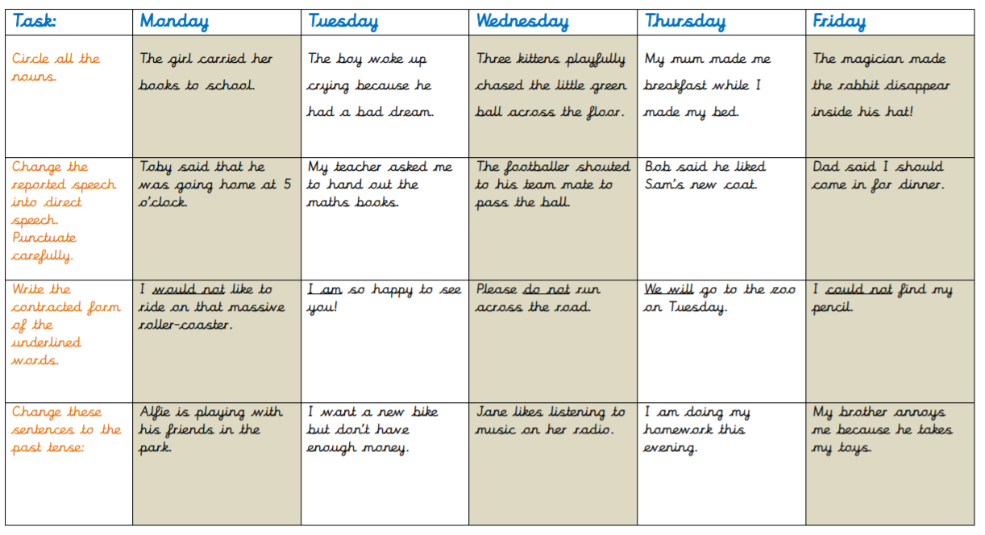
English Starter

Slide 4
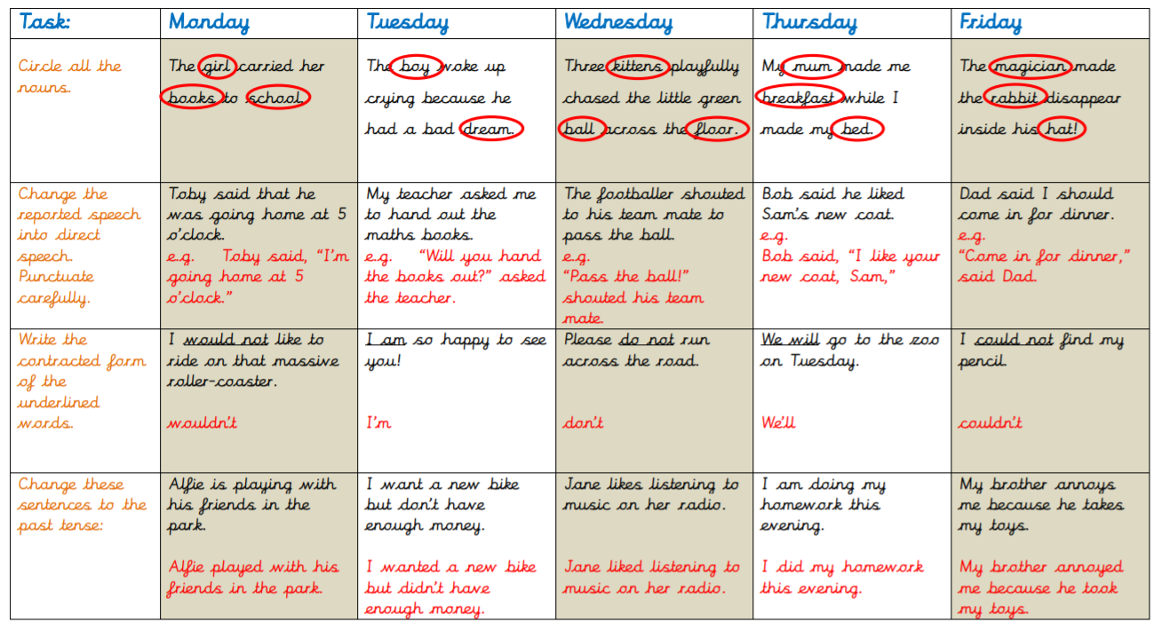
English Starter

Slide 5
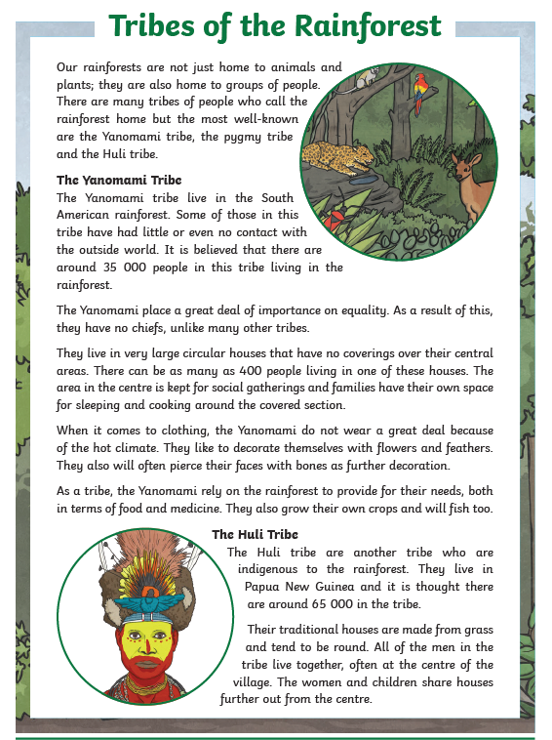
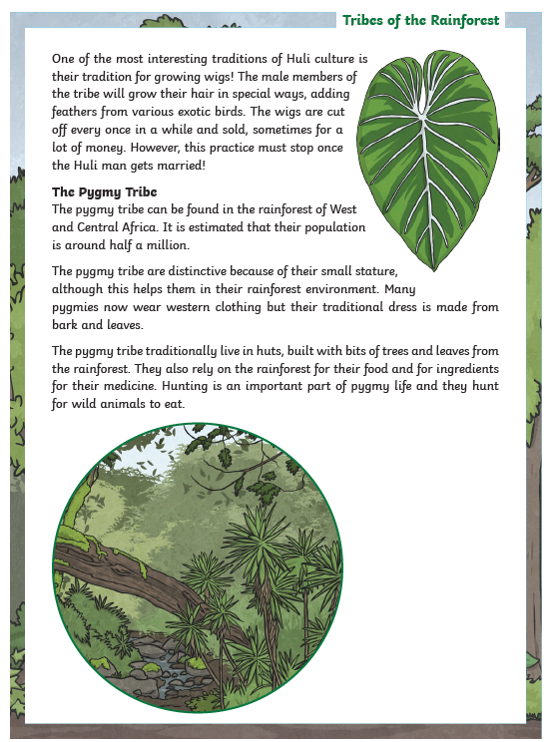
Thursday’s English for Year 6
L.O: To develop comprehension skills.
Follow the link on the website to ‘Tribes of the Rainforest’ comprehension. Choose 1, 2 or 3 star.
Make sure you read the text carefully before answering the questions.
The answers are also included in the document.

Slide 6
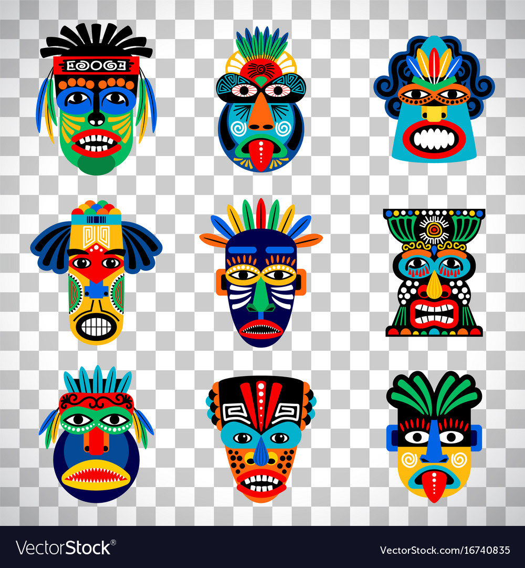
Today’s other activity:
L.O: To design an Aztec mask.
Yesterday, you reviewed some existing Aztec masks.
Today, you can design your own mask that you will try and make tomorrow.
Make 2 designs and then choose your favourite. Label your design with colour choices.
Finally, why did you pick this mask out of the two.
NOTE: Tomorrow, you will be tasked with building your mask. Think about what you can use in the house. E.g cardboard, recycling, paper etc.

