Slide 2
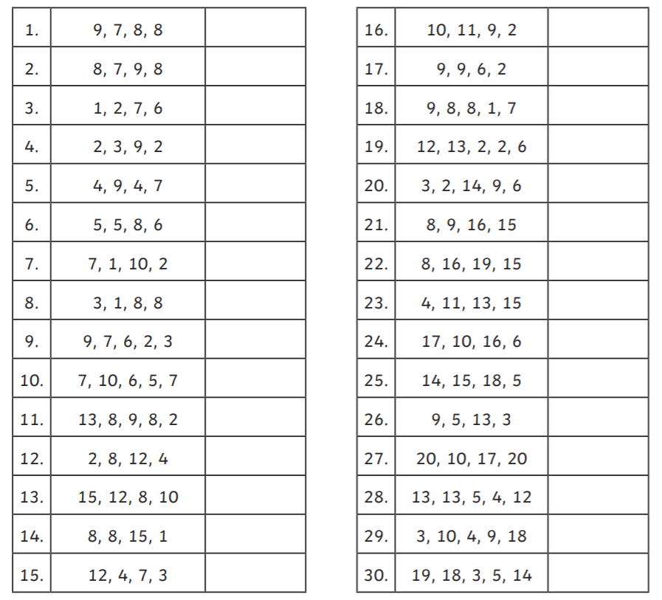
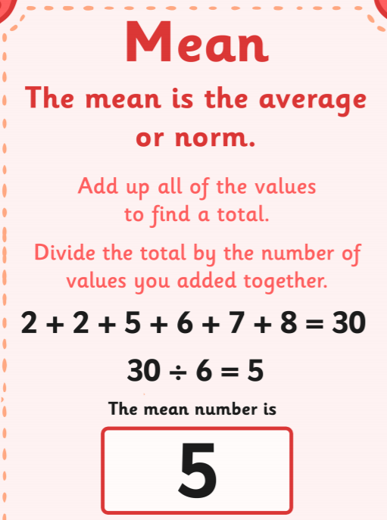
Home Learning: To calculate the mean average.
This week you will start looking at averages. This includes the mean, mode, median and range. Today you will start with the mean. Below is a simple explanation on how to find it.
For each set of numbers, try and calculate the mean.

Slide 3
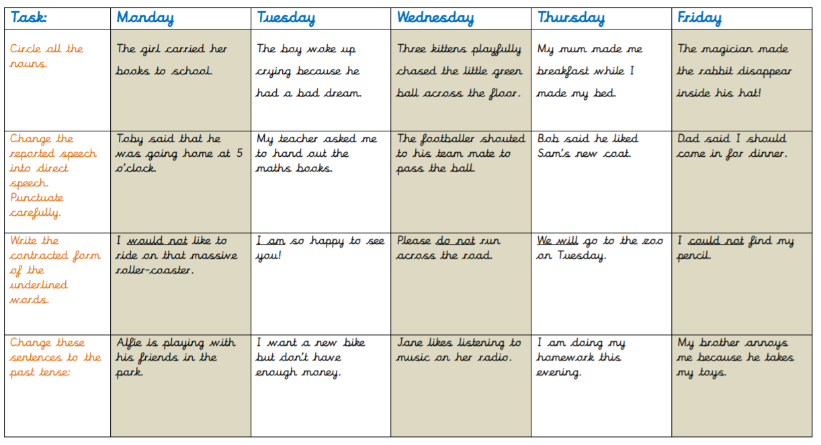
English Starter

Slide 4
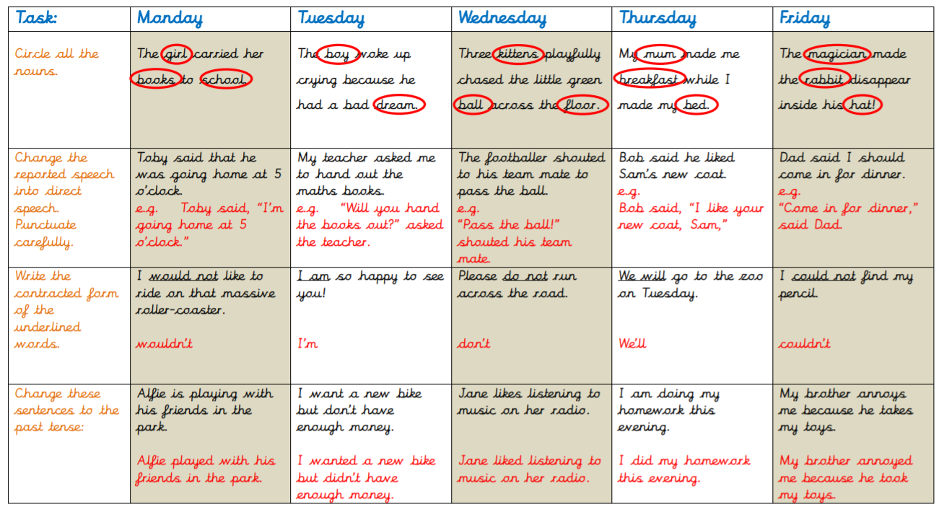
English Starter

Slide 5
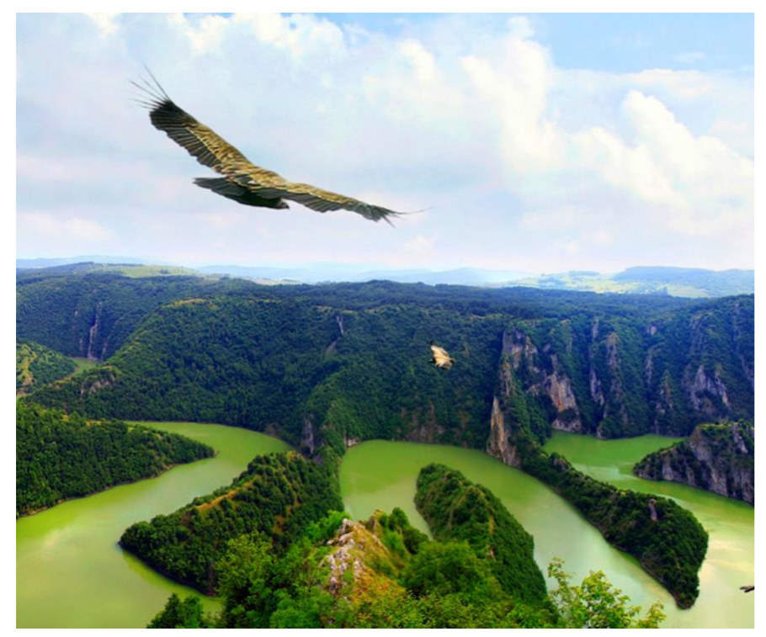
Tuesday’s English for Year 6
L.O: To plan a story from a point of view.
Imagine you are the bird in this picture. Plan a story from your point of view of your trip through the rainforest.
Make notes about your opening, journey and ending.
Think about:
What you might see?
What you might hear?
Where are you going to end up?
How does the smaller bird in the picture come into it?

Slide 6
Today’s other activity:
L.O: To understand the meaning behind Pentecost Sunday.
The following slides explain the story behind the Christian Celebration of Pentecost.
Read through each slide and then complete the following task.
Click on the flame symbol for more information or questions about what you have read.

Slide 7
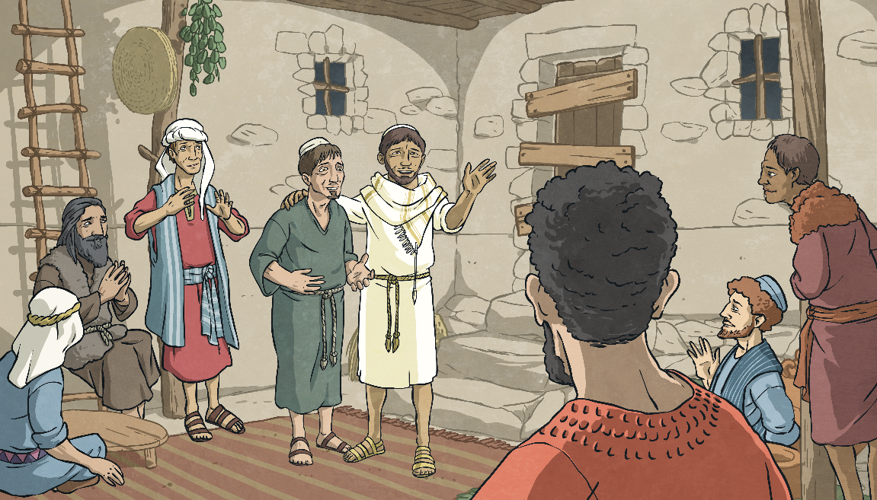
God’s Gift
After Jesus’ resurrection from death, after the crucifixion, he remained among his friends and family for forty days.
Think About It
Jesus gathered together the disciples, on a mountain, and told them that they would be sent a gift, which would help them with their task of spreading God’s message of love.
Why might the disciples need help spreading the message of God’s love?

Slide 8
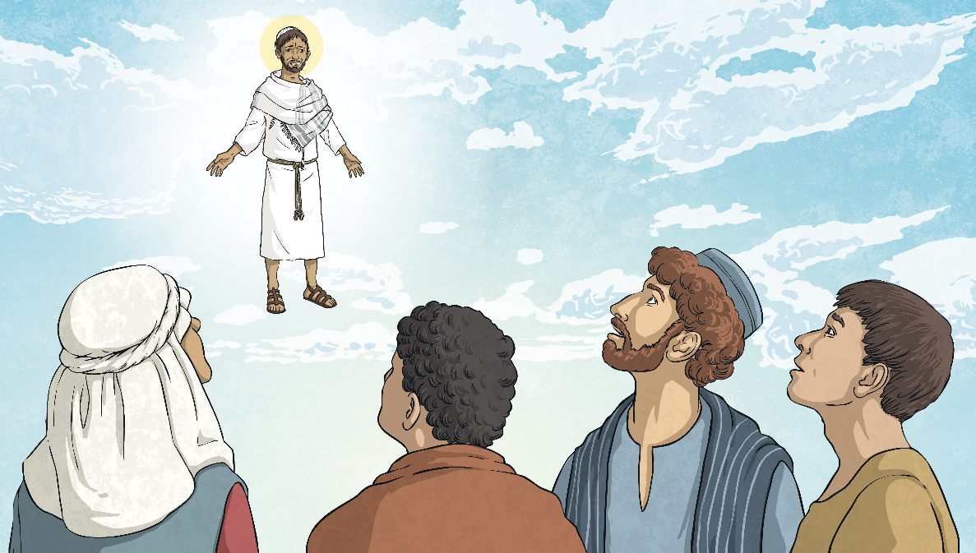
Waiting
While on the mountain, the clouds descended. Jesus left his disciples for the last time and ascended into heaven.
Discuss It
For the next ten days, the disciples would gather together to meet, talk and pray. They had no idea what this promised gift would be.
How might the disciples be feeling at this time? Why?

Slide 9
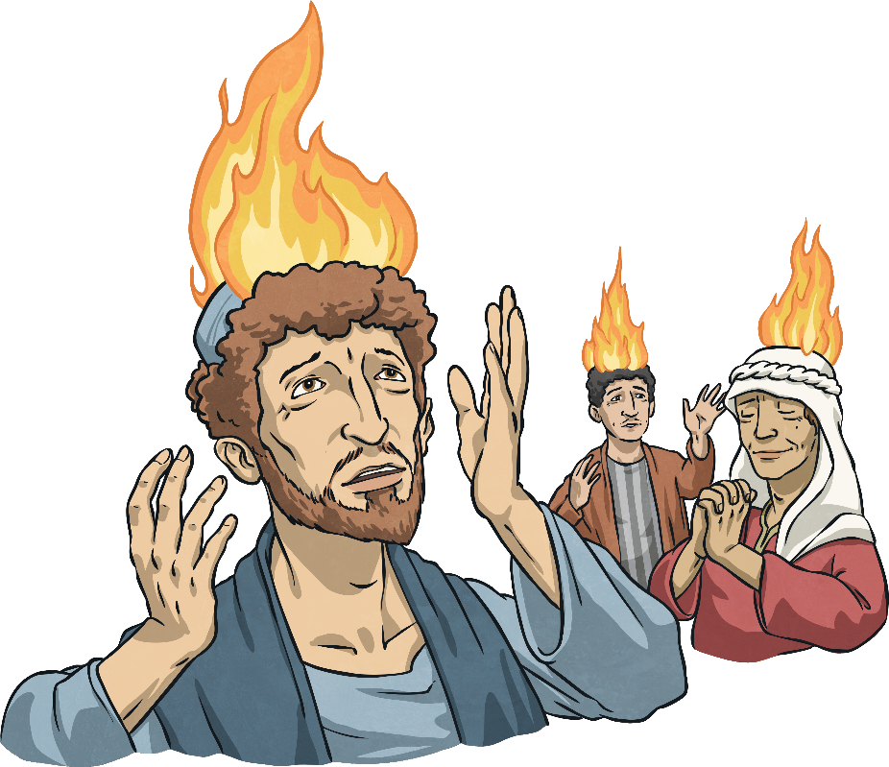
The Gift Arrives
Suddenly, the room was filled with the sound of a violent wind! Tongues of fire appeared, separated and came to rest above each person’s head, but no one was burned!
Each of the disciples were filled with the Holy Spirit.

Slide 10
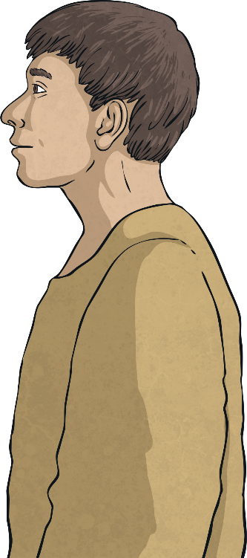
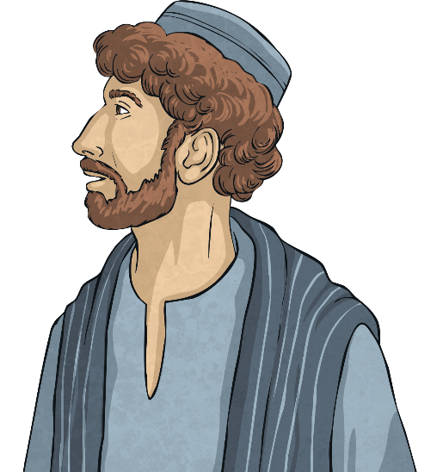
Spreading God’s Message
Suddenly, the disciples realised they could speak different languages! The Holy Spirit enabled them to speak different languages and they were amazed!
Hej!
Hola!
Γεια σου!
Bonjour!
Merhaba!
Discuss It
Why was it necessary for the disciples to be able to speak different languages to spread God’s message?

Slide 11
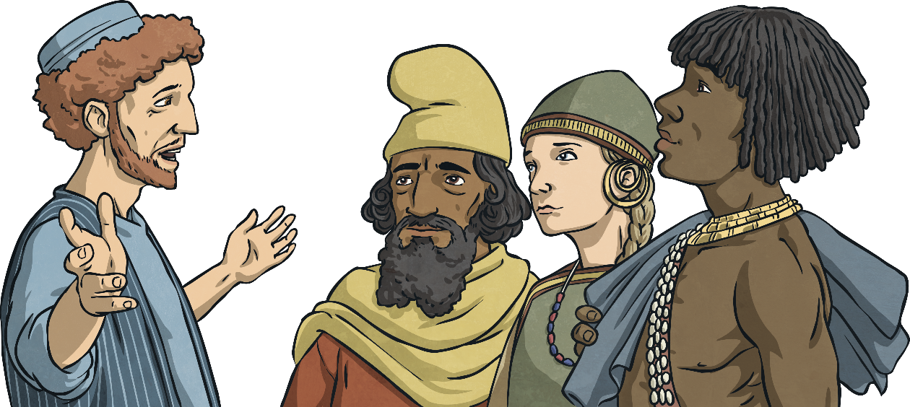
The Gift of the Holy Spirit
The disciples were talking away and their voices carried out into the streets. Jerusalem was full of people from many different countries at that time and they were amazed to realise that they could understand what the disciples were saying in their own language.
Fellow Jews and all who are in Jerusalem. Jesus was crucified and rose from the dead. You must all repent and be baptised for the forgiveness of your sins, then you too will receive the gift of the Holy Spirit!
Peter appeared and spoke to the people:
(Click on Peter)
Discuss It
How might the disciples be feeling at this time? Why?

Slide 12
Christian Beliefs About the Holy Spirit
Some Christians believe they receive the Holy Spirit when they accept Christ and are baptised as Christians.
Some Christians believe that the Holy Spirit is always with them, and therefore, God is always with them.
Some Christians believe that the Holy Spirit teaches them and takes care of them, helping them to make the right choices.
Many Christians believe that Pentecost is the birth of the Christian Church and is celebrated 50 days after Easter.

Slide 13
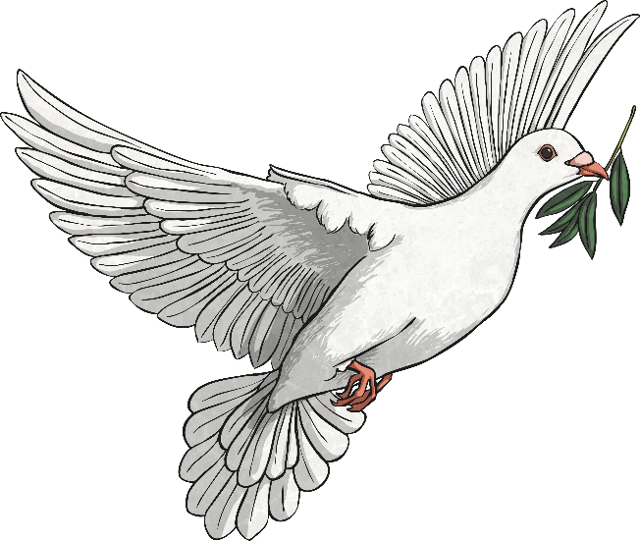
Symbols of Pentecost
(Click on the symbols)
The dove represents the Holy Spirit. When Jesus was baptised by his cousin, John the Baptist, a dove appeared, bringing the Holy Spirit to him.
The colour red is used in some Christian churches as a symbol of the flames appearing on the disciples’ heads.

