Slide 1
Year 3 Home School Provision Daily Pack
The following slides will be split into 3 separate activities.
Each slide will be daily activities for you and your child to do at home.
We as a Year 3 team will update these slides daily.
Thank you for your understanding and on going support during these times.

Slide 2
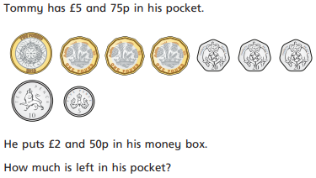
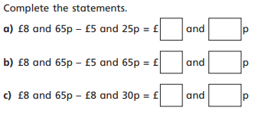
Daily Provision Pack – Day 22
Maths:
Objective: To subtract amounts of money
English: Reading activity
Objective: To summarise information, share your impressions about characters and predict what might happen next.
Today, you have a variety of reading activities. These activities will focus on a mixture of skills that are important to becoming a fantastic reader.
1*= complete activity one.
2*= activity one and two.
3*= complete all of activities.
French
Objective: To know French colours
Click on the link below:
https://pln.myvle.co.uk/files/sc3490/sc3490/79/%5b28781%5dHome_Learning-_French.pdf
Click on the activity in Stage 1 – colours.
Please ensure you have downloaded a QR scanner from an app store. Then, place it over the QR code and your phone or tablet should turn into a game!

Slide 3
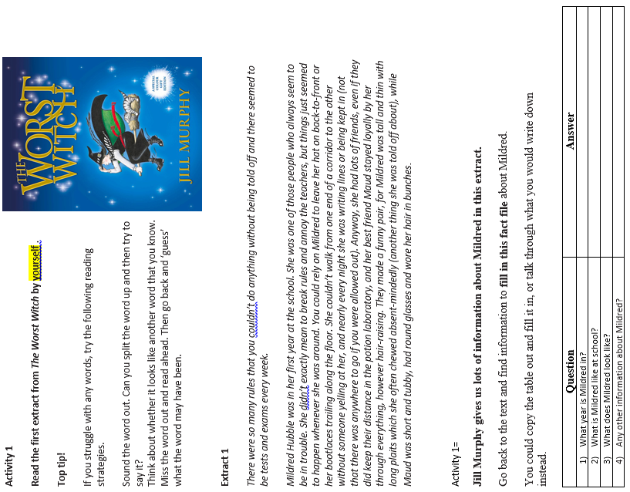

Slide 4
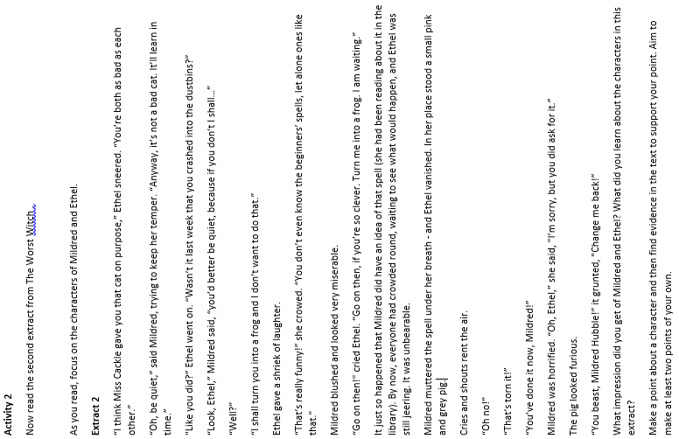

Slide 5
