Slide 1
Year 3 Home School Provision Daily Pack
The following slides will be split into 3 separate activities.
Each slide will be daily activities for you and your child to do at home.
We as a Year 3 team will update these slides daily.
Thank you for your understanding and on going support during these times.

Slide 2
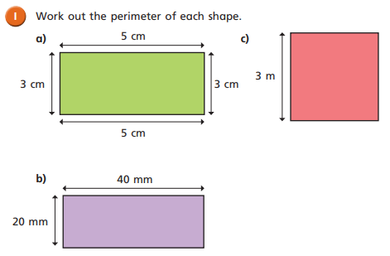
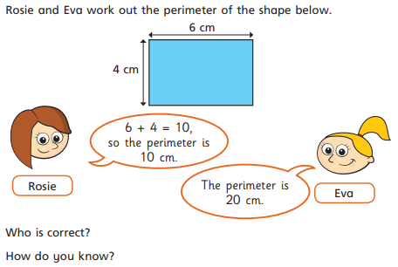
Daily Provision Pack – Day 25 – VE DAY!
Maths:
Objective: To calculate perimeter of shape
English:
Objective: to create a poster.
To celebrate VE day, you are going to create an eye-catching and amazing poster! You can do it in any particular style you wish- advertising a street party, a party invitation, a factual poster.
Yesterday, you learned about what occurred on VE day. Try your very best to think what you could include on your poster.
A popular dance to do at the time was the Lindy Hop. Perhaps you could advertise this too! See YouTube for more ideas.
History:
Objective: To develop knowledge and understanding of VE Day.
Celebrate with a few of these suggested activities. Remember, change, adapt them, make them your own, or do something different – just enjoy finding out about VE Day and celebrating it!
VE Day copy and make activities
You could try to make your own spitfire: https://northleeds.mumbler.co.uk/wp-content/uploads/2020/04/Spitfire-Colour-in-and-Cut-Out-Activity.pdf
(if this is too tricky, try making a paper plane, decorated with wartime camouflage!)
Or try to make some of these wartime recipes from the Twinkl Website:
Wartime Recipe Booklet
Whatever you do, have fun! If you can, send some pictures of yourselves to andrew.butler@taw.org.uk Nicholas.parker4@taw.org.uk Chloe.Watson@taw.org.uk
and we will do our best to publish them on the website. (Sending your picture in to us means that you give permission for it to be used on our website.)
EXT: Measure the perimeter of; a photo frame, a cereal box, your pencil case, a book, a piece of paper

