Slide 1
Year 3 Home School Provision Daily Pack
The following slides will be split into 3 separate activities.
Each slide will be daily activities for you and your child to do at home.
We as a Year 3 team will update these slides daily.
Thank you for your understanding and on going support during these times.

Slide 2
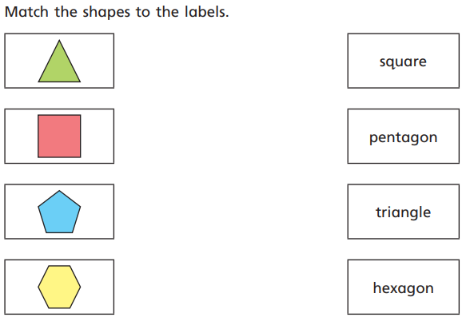
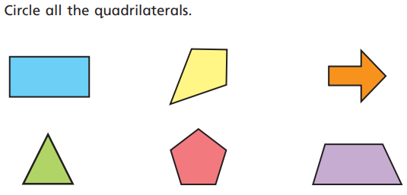
Daily Provision Pack – Day 26
Maths:
Objective: To recognise and describe 2D shapes.
English:
Objective: to develop retrieval and understanding skills in reading.
Today you will be reading the poem- ‘A Rain Song.’
First, read the poem.
After reading it a few times, try your best to really try and use a variety of voices and actions to help make your reading even more interesting and engaging for your audience. Please make this as fun as possible!
Once you have done this, answer the questions that follow.
TTRS: complete as many garage challenges as you can.
READING:
Objective: To develop fluency when reading aloud.
With your parents, and reading aloud, log in to Fiction Express and complete the reading of chapter 2 of ‘The Pampered Prince’. Remember to VOTE for what happens next by the end of today.
Try the online comprehension quiz about chapter 2.
Have a look at the online forum and post a comment about the chapter. What do you think of the book so far? Were you disappointed with the new chapter? Did your vote end up being what actually happened?

Slide 3
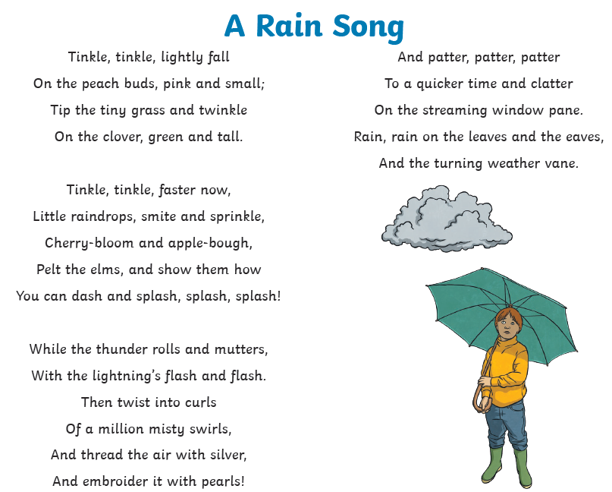

Slide 4
