Slide 1
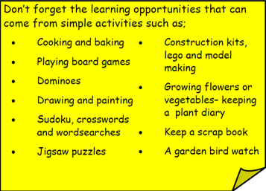
Year 3 Home School Provision Day 31
The following slides will be split into 3 separate activities. Each slide will be daily activities for you and your child to do at home. We as a Year 3 team will update these slides daily. Thank you for your understanding and ongoing support during these times.
Useful websites for Home learning
Year 2 and 3 free resources for parents for Home Learning: https://www.twinkl.co.uk/resources/parents/wellbeing-parents/school-closures-category-free-resources-parents
Classroom Secrets free resources – laptop or PC needed
https://classroomsecrets.co.uk/free-home-learning-packs/
BBC Bitesize - https://www.bbc.co.uk/bitesize/levels/zbr9wmn
Pobble365 – website with inspiring pictures for Storywriting or Art https://www.pobble365.com/
White Rose Maths – Home Learning activities – great for home learning as we use these ideas in school. https://whiterosemaths.com/homelearning/
Children also have logins in their homelink books for Shropshire Schools Library Service e-Library – books can be borrowed for up to 3 weeks at a time. https://shropshiresls.wheelers.co/

Slide 2
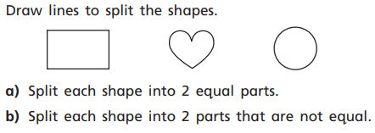
Daily Provision Pack – Day 31
Maths:
Objective: To identify equal parts (fractions)
English:
Objective: to create a Recipe for Dreams.
This is a lesson inspired by Roald Dahl’s- The BFG. Today, you are going to be creating a recipe for a dream!
You need to make a recipe for the perfect dream. Set it out like a cooking recipe with ingredients and a short description of the dream. Give a fun name! “The Golden Phizzwizard!”
Reading and TTRS
Objective: To retrieve, infer, summarise and explain ideas about a text, using the text to support my answers.
Make sure you read this week’s (ch.5) Fiction express to an adult - it’s the last chapter this week! Try the quiz too.
TTRS – I have set up a Year 3 Boys vs Girls battle, so have a go and try your best! The battle starts on 18/5/20 at 8am and finishes on 24/5/20 at 6pm.
Good luck!
EXT: Find 6 objects around your home you can split equally into 4 parts.

Slide 3
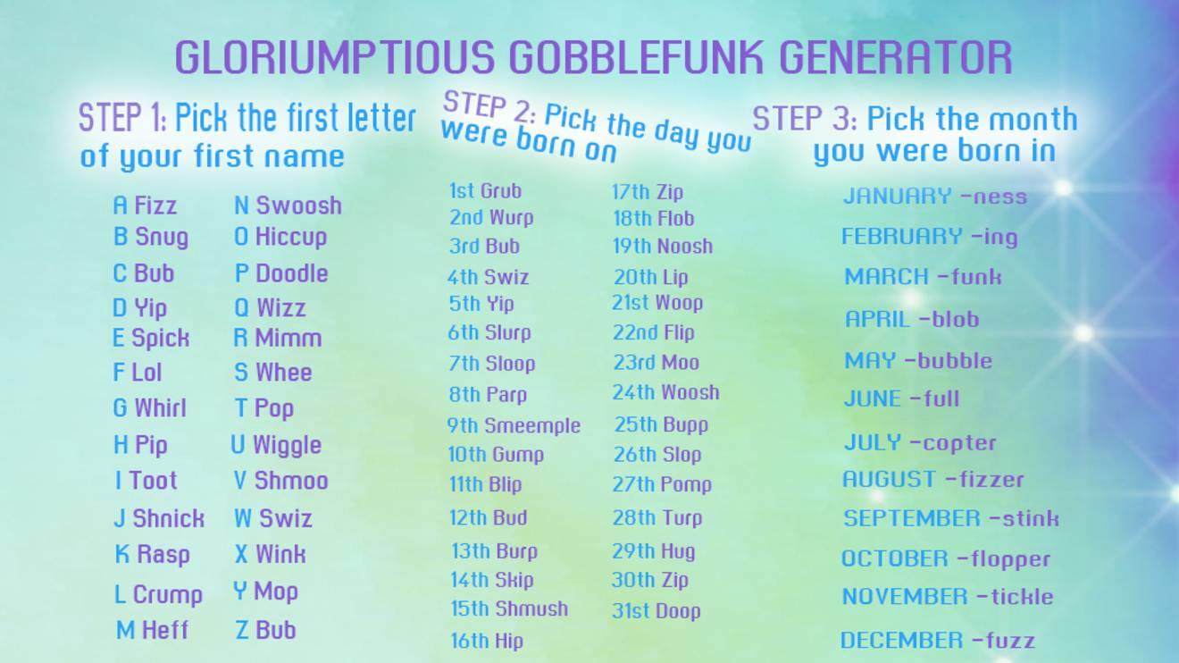
English lesson support:
You can use the picture if you are struggling to think of a weird and wonderful name for your dream recipe!
When all of your recipes have been created please draw fun pictures of your ingredients and the final product of your dream in a jar. It can be completed with crayons/paint/computer too.
I wish to create a small ‘cook book’ using all of your dream recipes. This will then be shared on our school website page AND printed out to present in our school library.
Please email your work to me at:
nicholas.parker4@taw.org.uk
Language to use:
A pinch of…
A drop of…
A teaspoon of…
A sprinkle of…
A tablespoon of…
A cup of…
A spoonful of…

Slide 4
Mr Parker’s dream recipe for a:
To make the perfect Sweet Popfizzer you must add:
A handful of lemon sherbets.
A spoonful of happiness.
A drop of tickles.
Half a cup of smiles.
A dash of laughter.
A sprinkle of jolliness.
A crack of pepper.
A spray of Paco Rabanne One Million.
3 Tablespoons of Nutella.
Sweet Popfizzer !

