Slide 1
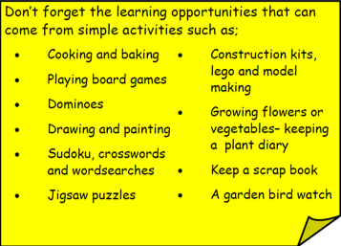
Year 3 Home School Provision Day 33
The following slides will be split into 3 separate activities. Each slide will be daily activities for you and your child to do at home. We as a Year 3 team will update these slides daily. Thank you for your understanding and ongoing support during these times.
Useful websites for Home learning
Year 2 and 3 free resources for parents for Home Learning: https://www.twinkl.co.uk/resources/parents/wellbeing-parents/school-closures-category-free-resources-parents
Classroom Secrets free resources – laptop or PC needed
https://classroomsecrets.co.uk/free-home-learning-packs/
BBC Bitesize - https://www.bbc.co.uk/bitesize/levels/zbr9wmn
Pobble365 – website with inspiring pictures for Storywriting or Art https://www.pobble365.com/
White Rose Maths – Home Learning activities – great for home learning as we use these ideas in school. https://whiterosemaths.com/homelearning/
Children also have logins in their homelink books for Shropshire Schools Library Service e-Library – books can be borrowed fro up to 3 weeks at a time. https://shropshiresls.wheelers.co/

Slide 2
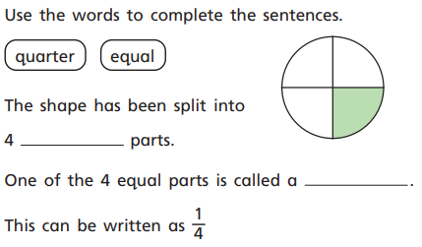
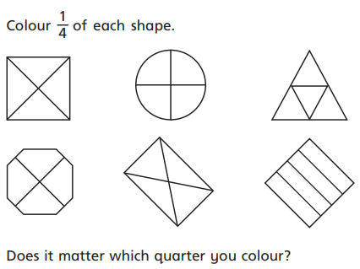
Daily Provision Pack – Day 33
Maths:
Objective: To recognise a quarter.
English:
Objective: To write imaginatively and creatively for an explanation text.
Today, any idea you write is a great! There are no wrong or silly ideas. Be as fun and creative as you can be!
You need to think of an imaginative explanation as to how animals got their specific and recognisable traits!
You could write about and explain:
How did an elephant get its trunk?
How did a giraffe get its long neck?
How did a leopard get its spots?
How did the salt get into the sea?
How did the rabbit get long ears?
How did a zebra get its stripes?
French
Objective: To know months of the year and say which month my birthday is in.
Click on the link below:
https://pln.myvle.co.uk/files/sc3490/sc3490/79/%5b28781%5dHome_Learning-_French.pdf
Click on the activity in Stage 1 – Months. Start with the red ‘K’ for knowledge, then try the ‘A’ (Activity) and ‘V’ (vocab). You may need to have Microsoft PowerPoint (free) downloaded on mobile devices for these. The Activity section requires a QR scanner. With most phones, simply point your phone camera at the QR code. The camera should automatically flag a webpage to click on. Alternatively, download a free QR code scanning app. Enjoy!
Questions continue on the next slide

Slide 3
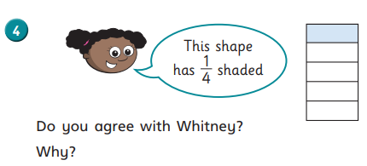
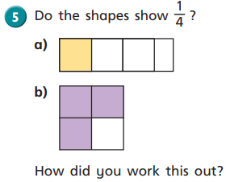
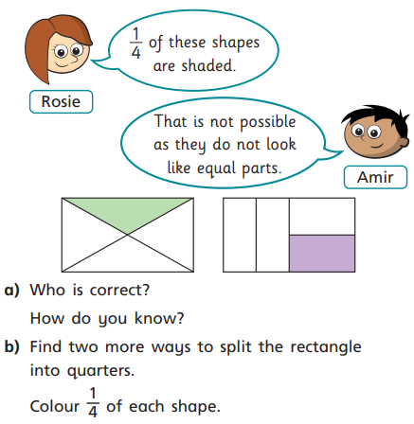

Slide 4
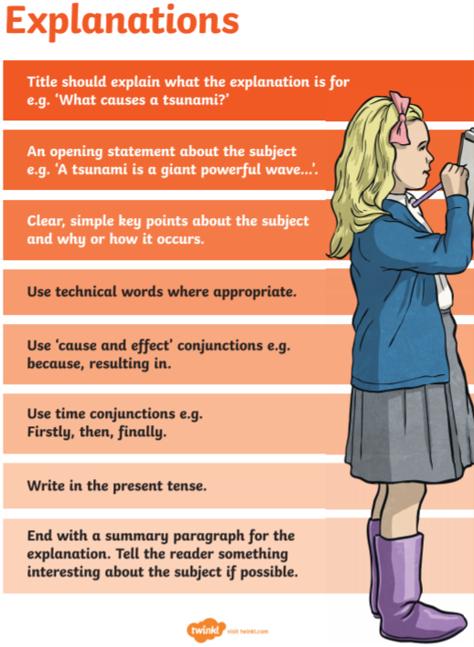
English support resources:

Slide 5
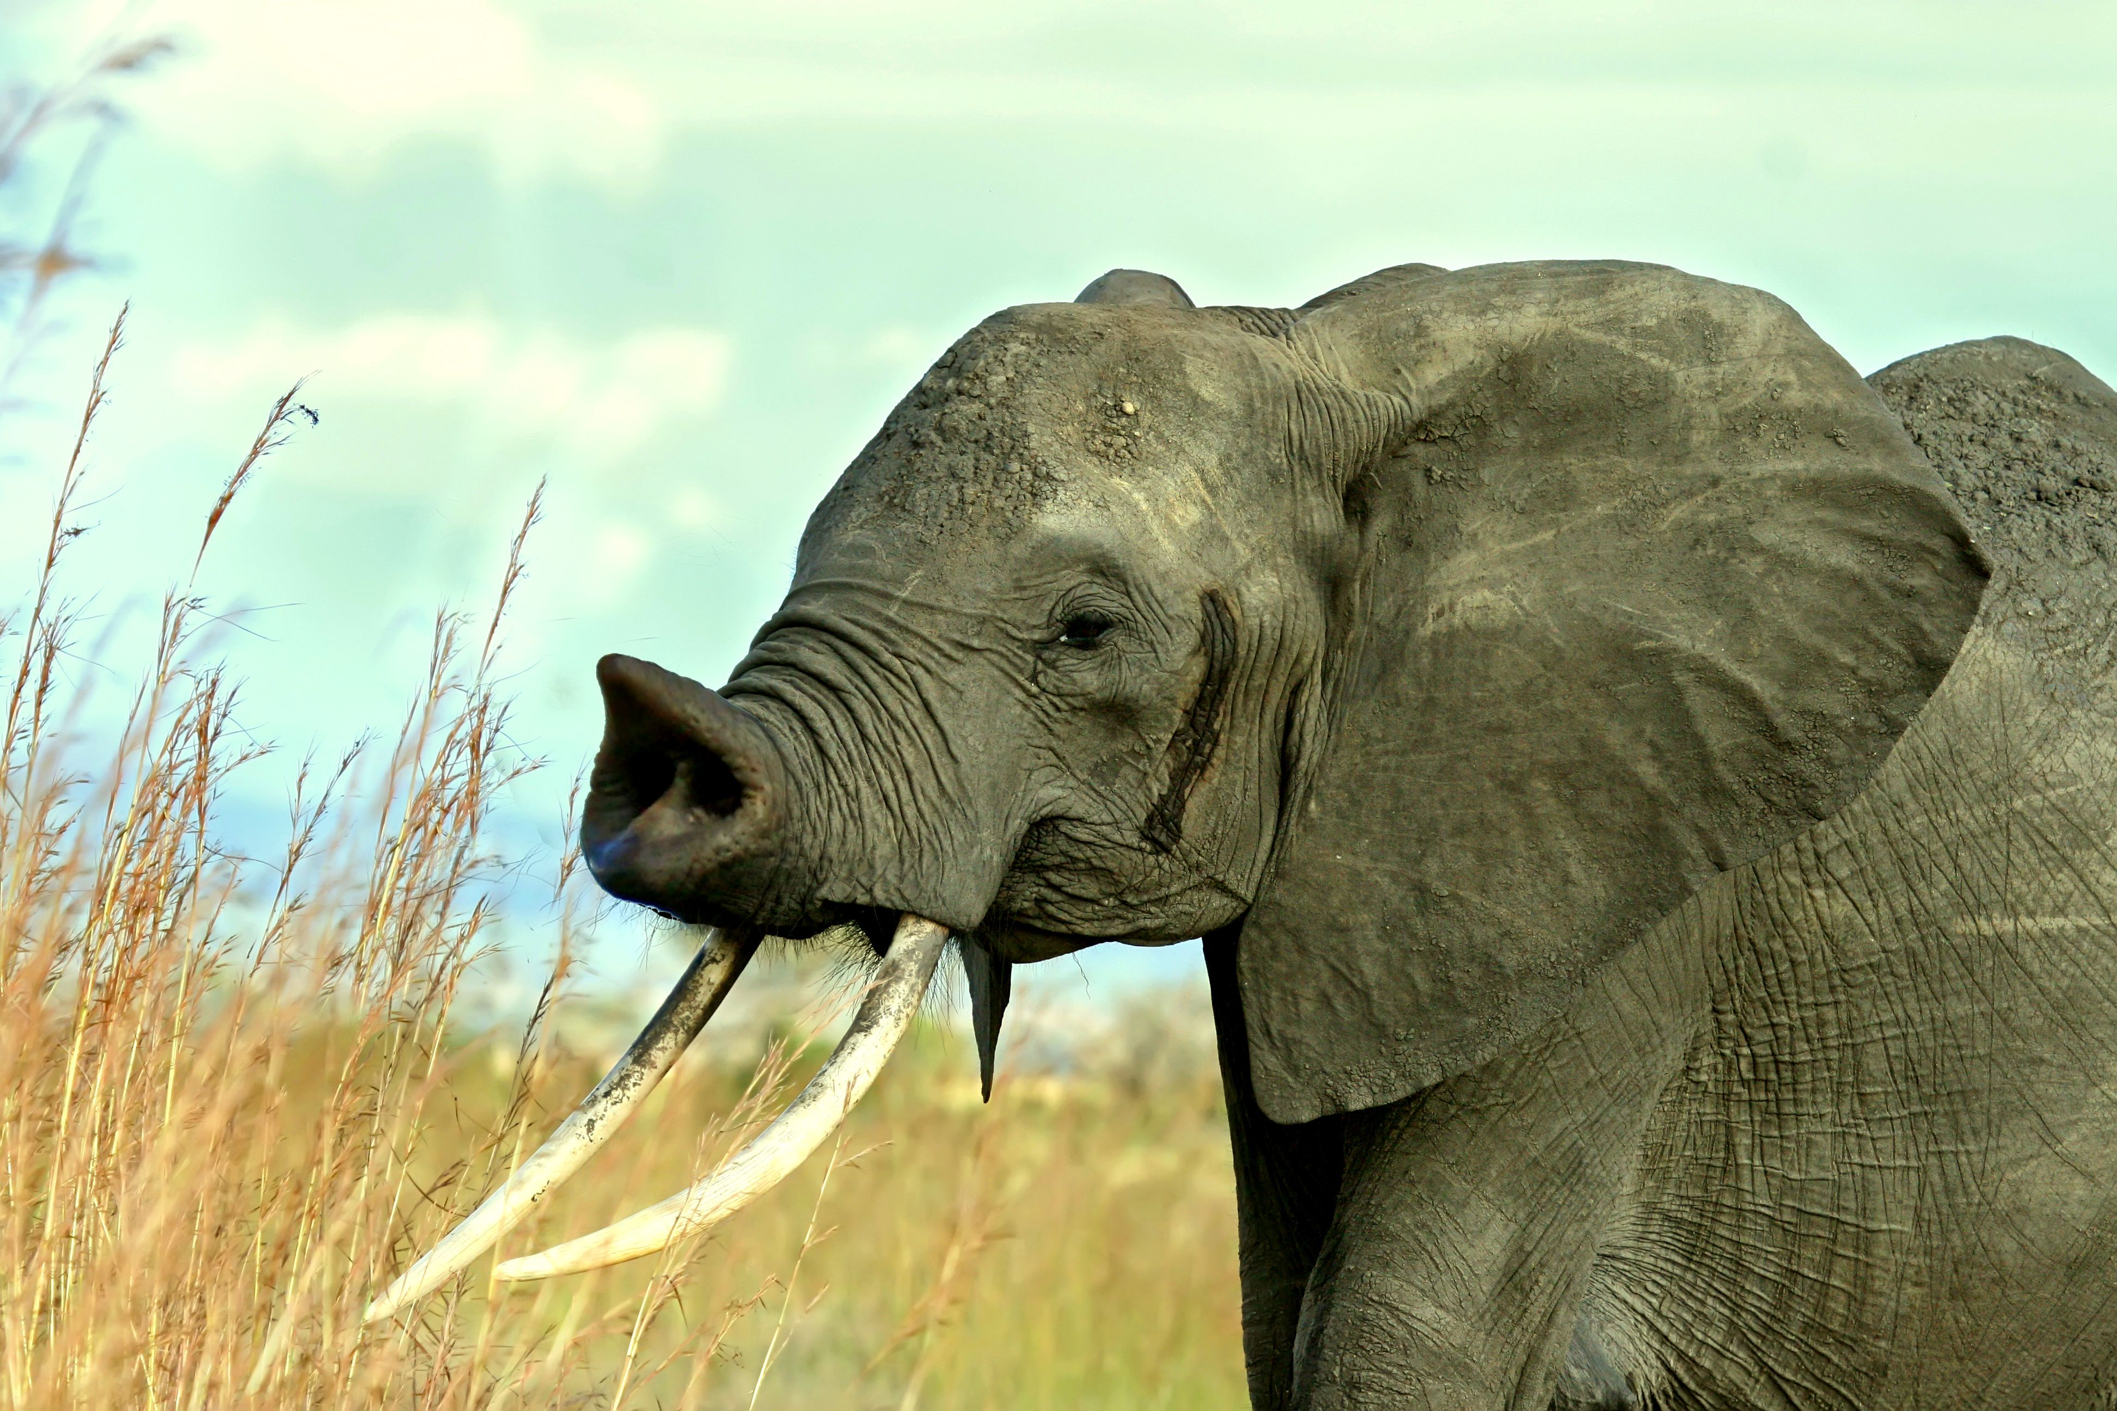
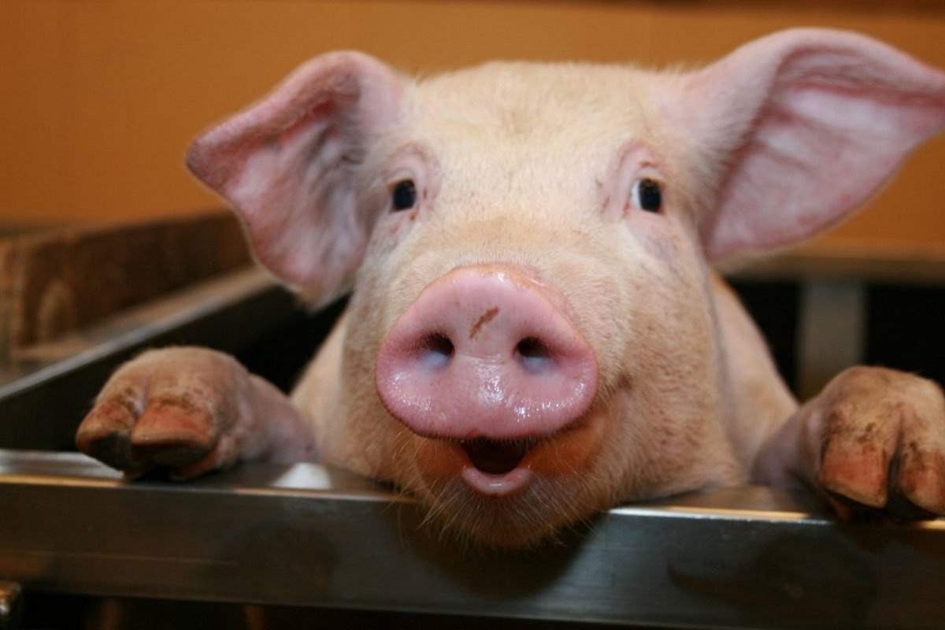
Mr Parker’s English example.
How did an elephant get its trunk?
This explanation text will explain to you how an elephant got its trunk.
There are many different rumours and many scientists have tried to find the answer to this long pondered question. Today, you will discover the truth.
Elephants are part of the same family that pigs belong to. Just like pigs, they used to have short noses and these noses are used to smell.
However, as elephants grow, they use their noses for more and more jobs to help them get food or to aid in doing other jobs.

Slide 6
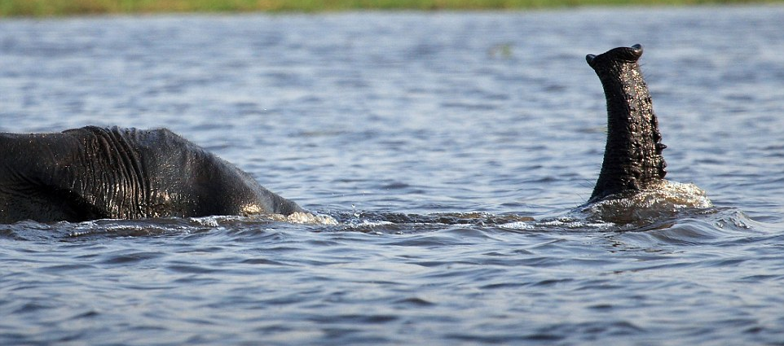
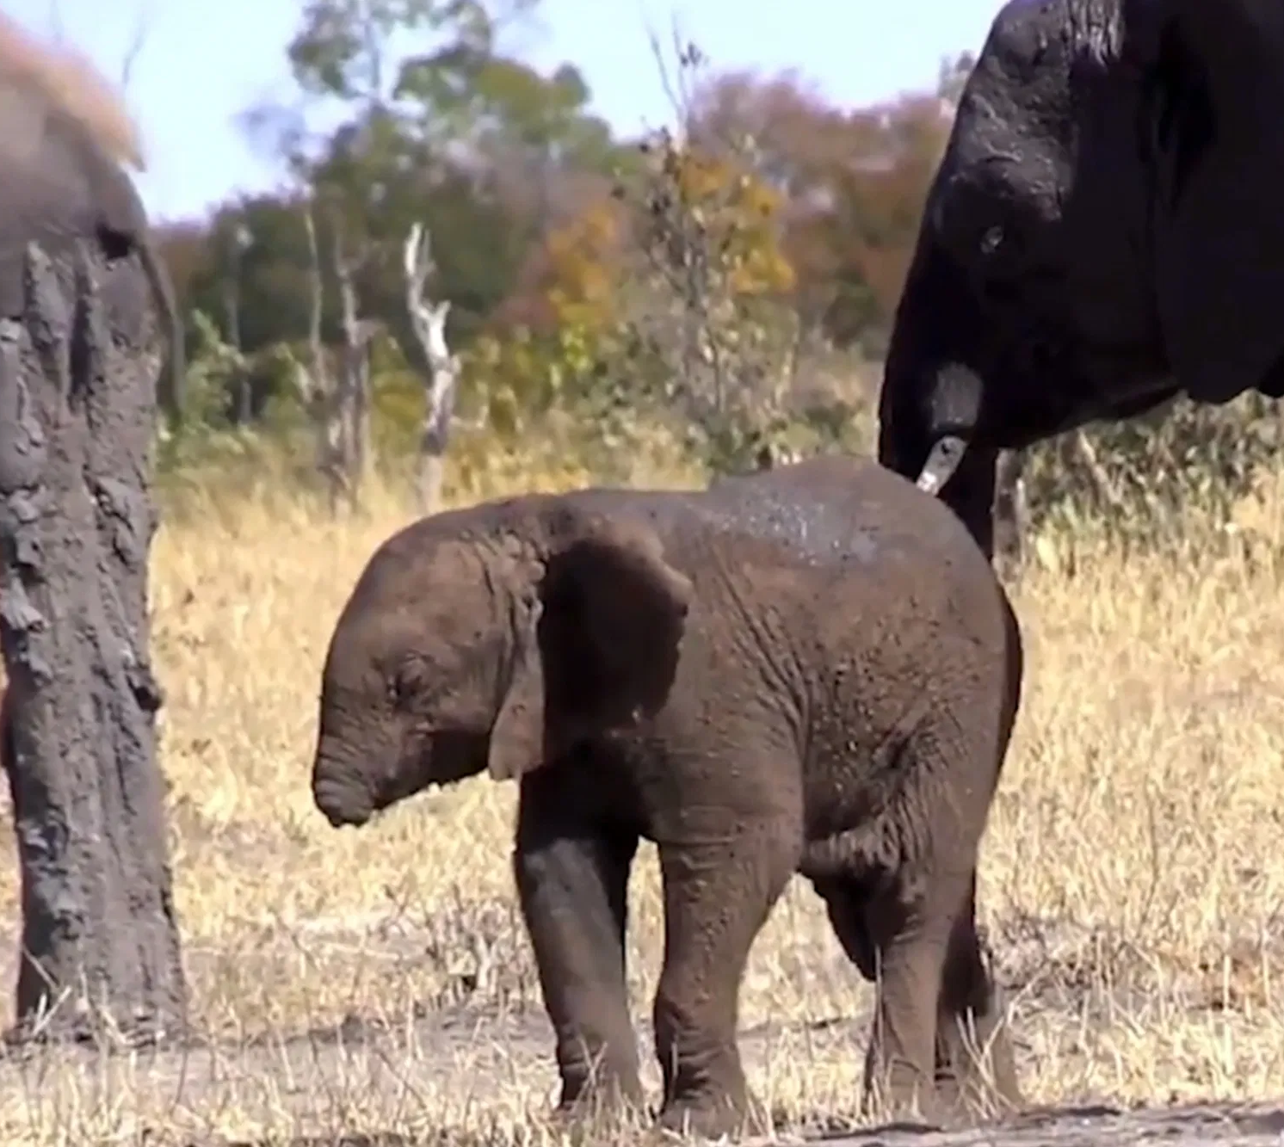
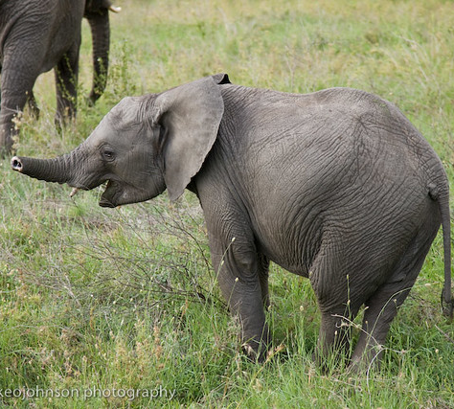
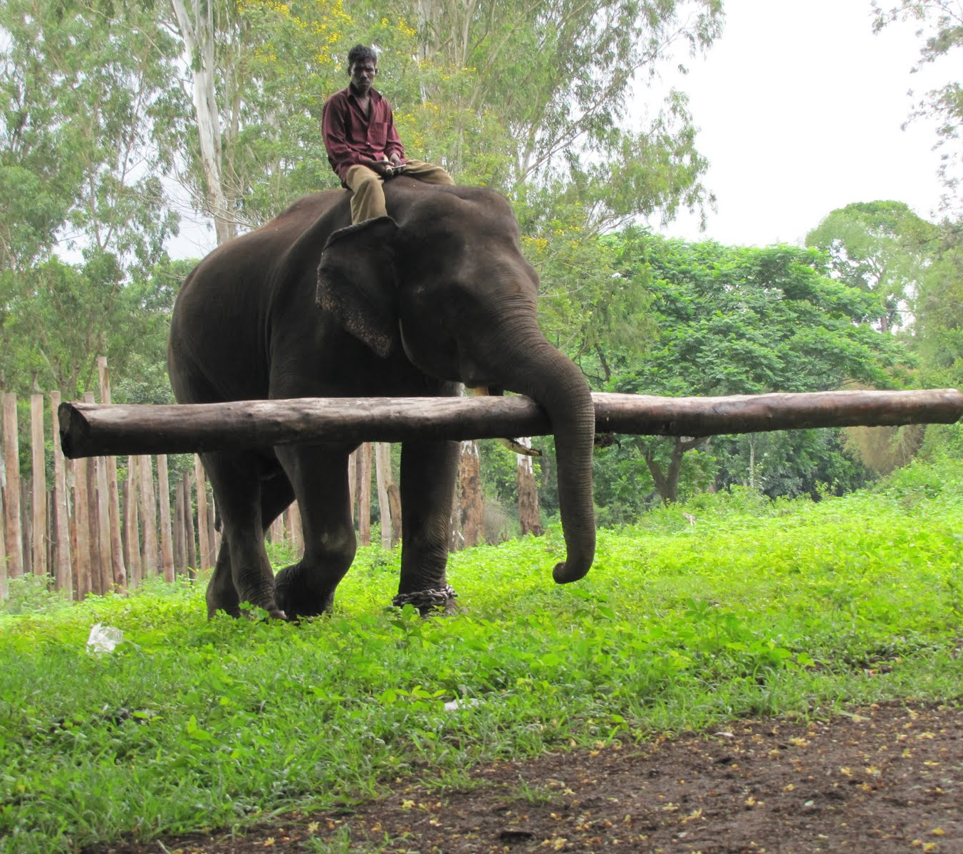
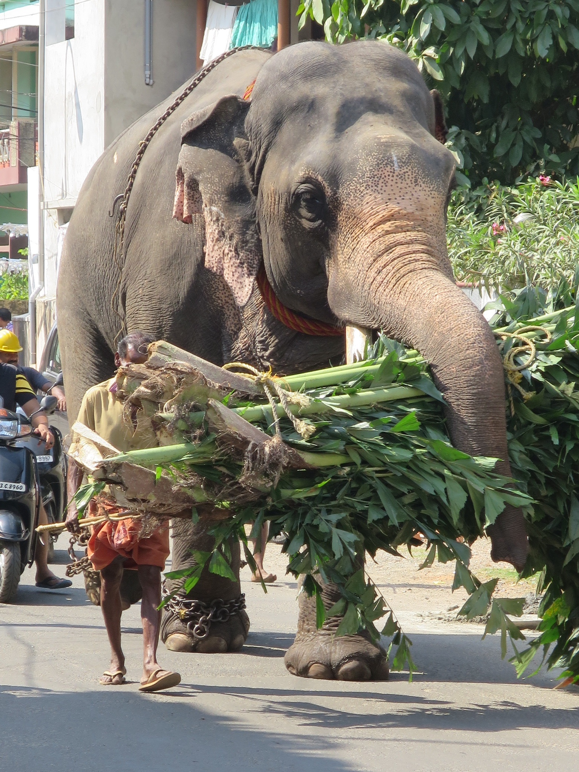
Did you know?
Did you know that an elephant’s trunk is able walk under water? They use their trunks by holding them in the air and use it to breathe whilst walking along the riverbed!
When elephants are 10 months old, they begin to use their noses for these jobs as they learn. However, if they lift too much their noses eventually start to become longer and longer. Eventually, having used their noses for so much and lifting heavy objects they begin to get longer and not shrink back to its original size. The nose is now up to 15x larger now and is called a trunk.
In conclusion, if the elephant never lifted anything with its nose then they would still be short- just like when they are young!

