Slide 1
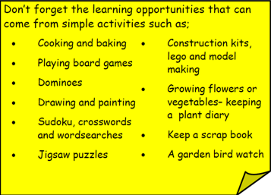
Year 3 Home School Provision Day 35
The following slides will be split into 3 separate activities. Each slide will be daily activities for you and your child to do at home. We as a Year 3 team will update these slides daily. Thank you for your understanding and ongoing support during these times.
Useful websites for Home learning
Year 2 and 3 free resources for parents for Home Learning: https://www.twinkl.co.uk/resources/parents/wellbeing-parents/school-closures-category-free-resources-parents
Classroom Secrets free resources – laptop or PC needed
https://classroomsecrets.co.uk/free-home-learning-packs/
BBC Bitesize - https://www.bbc.co.uk/bitesize/levels/zbr9wmn
Pobble365 – website with inspiring pictures for Storywriting or Art https://www.pobble365.com/
White Rose Maths – Home Learning activities – great for home learning as we use these ideas in school. https://whiterosemaths.com/homelearning/
Children also have logins in their homelink books for Shropshire Schools Library Service e-Library – books can be borrowed for up to 3 weeks at a time. https://shropshiresls.wheelers.co/

Slide 2
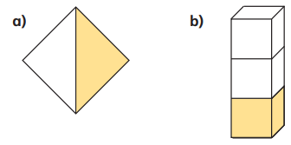
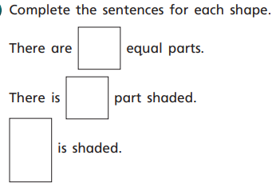
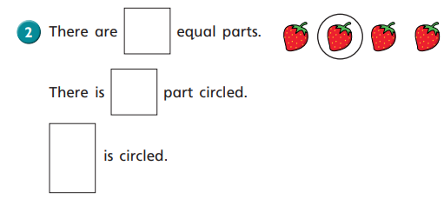
Daily Provision Pack – Day 35
Maths:
Objective: To identify and write unit fractions knowing until fractions have 1 as the numerator.
English:
Objective: To participate in discussion about both books that are read to them and those they can read for themselves.
On Thursday, Mr Parker read chapter 2 of Harry Potter and the Philosopher’s Stone- The Vanishing Glass. (if you haven’t seen it yet, it is on the Newport CE Junior School Facebook or YouTube page).
Today, you will be completing various activities related to that chapter. Please see the slides below for your English activities.
If you would prefer, you can also read chapter 2 by yourself or with a grown up.
Music:
Objective: To listen to a piece of music that describes something.
Listen to this piece of music:
https://www.youtube.com/watch?v=f1nVDoCnsNk
L’Elephant is a piece of music from Carnival of the Animals by Camile Saint-Saens. He is the man in the picture to the right and he was French.
His piece of music describes lots of different animals through music. This is the song for the Elephant.
Maths continued on next slide.

Slide 3
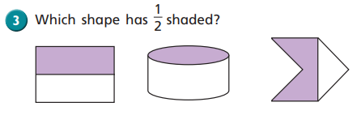
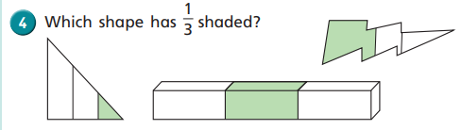
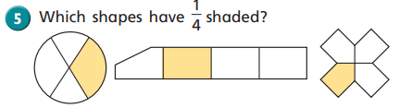
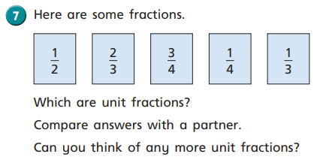
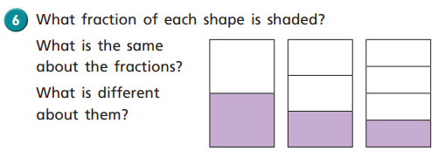
Remember about equal parts!
Numerator: The amount of shade parts in the shape
1
3
Denominator: To total amount of parts in the shape
If you need any support or would like to show any examples of your child’s work please email your class teacher ☺

Slide 4
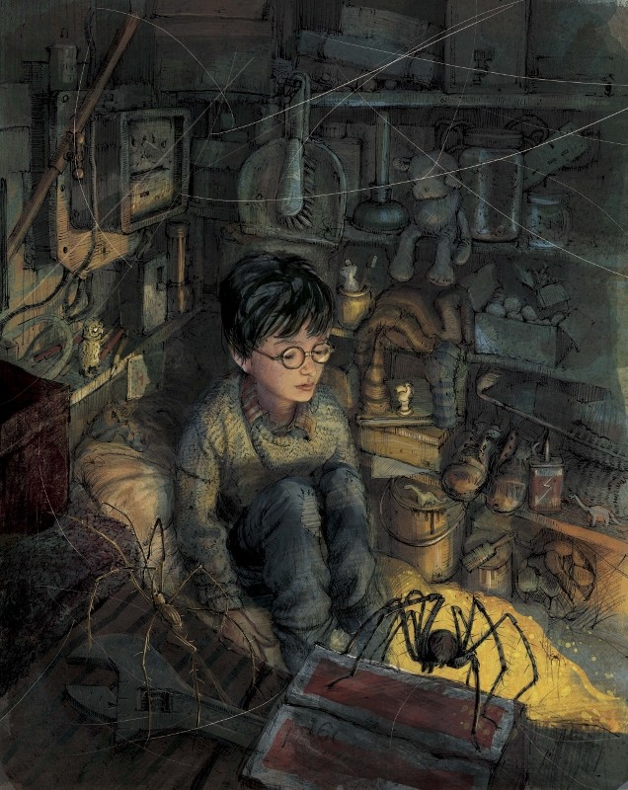
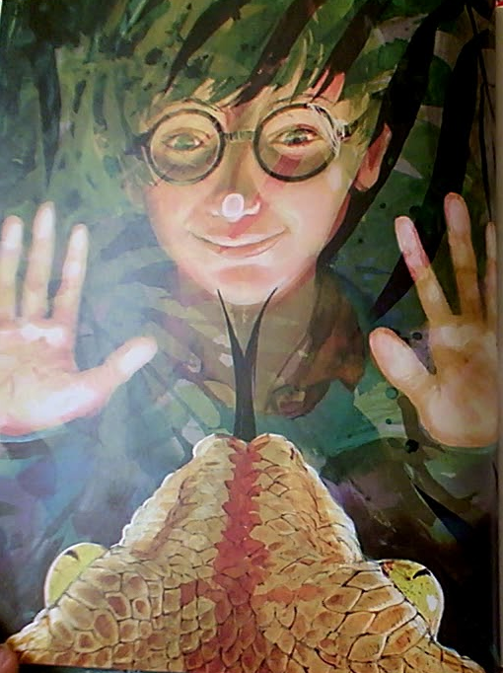
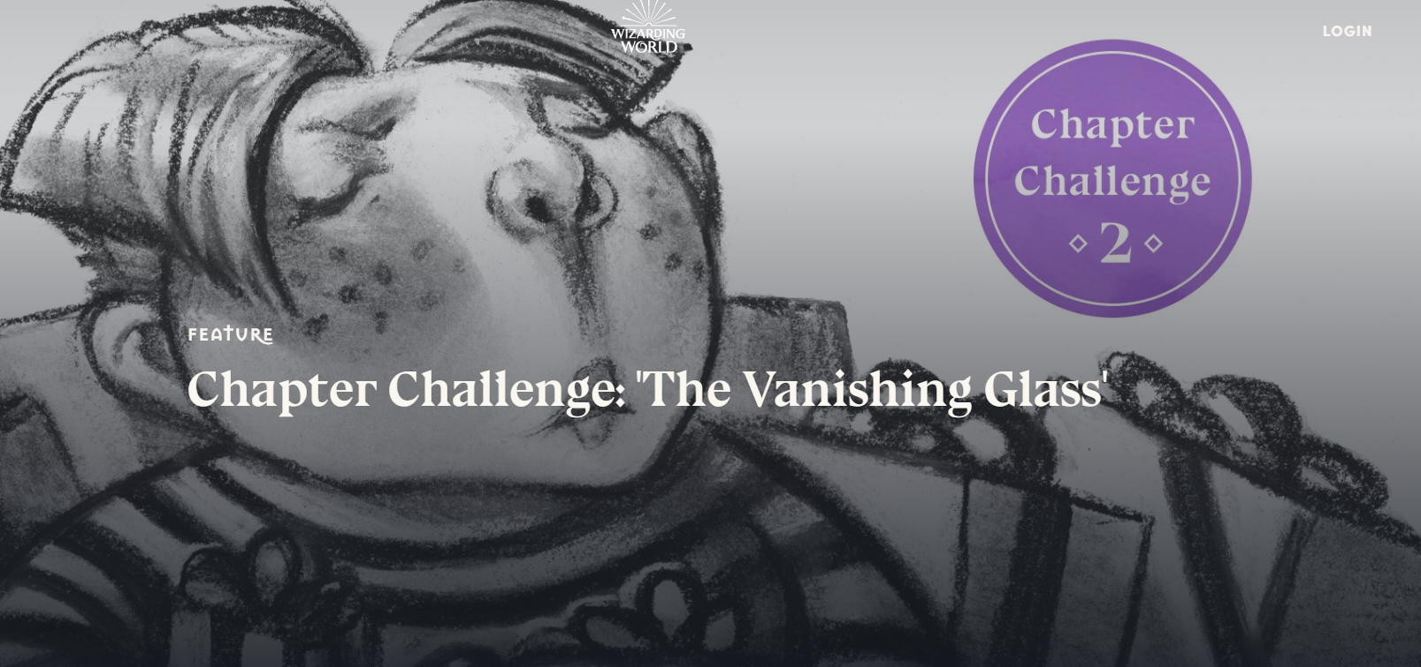
English activities:
Write down which character you think is the most horrible to Harry in Chapter Two and write a short description of them.
Draw Harry Potter as he is described in the chapter or how he is shown on the illustration. Don’t forget to include the scar on his forehead!
Prediction time- do you think the Dursleys will always make Harry sleep in the cupboard under the stairs? Why / why not?
In this chapter, a boa constrictor escapes from its enclosure. Pretend you are the zookeeper who looks after the snakes in the reptile house. Imagine what happened after the snake escaped (Did you help catch it? How far did it get? Did you have to help Dudley out of the enclosure? What happened? Did the Dursleys say anything?)
As a plenary, you can do the Chapter Two Quiz by clicking the blue link or the picture when on slideshow .
https://www.wizardingworld.com/quiz/chapter-quiz-chapter-two-five-questions

Slide 5
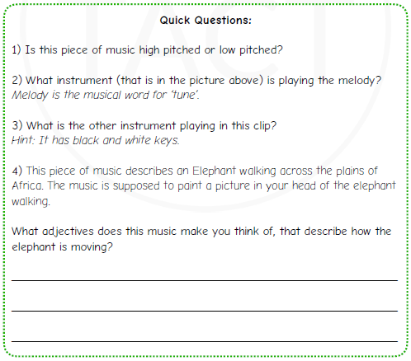

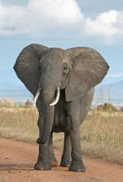
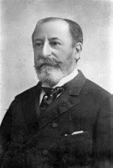
MUSIC follow-up:

