Slide 1
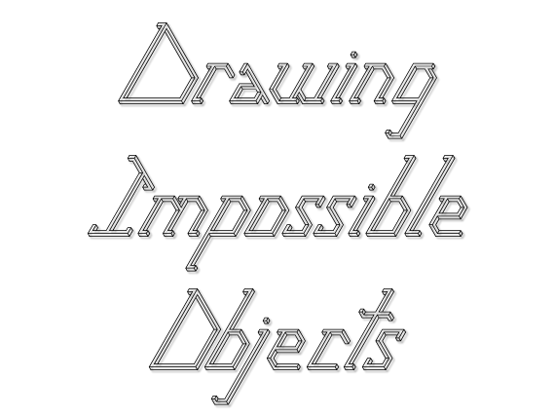
Notes:
Fonts: Illusion Letters, Times New Roman, Calibri

Slide 2
The Penrose Triangle – Could you have a go at drawing one? The last slide has some tips.

Slide 3
Is this lego structure lying on the table, or is it in the air?

Slide 4
Is the top corner in mid air or flat on the table?

Slide 5
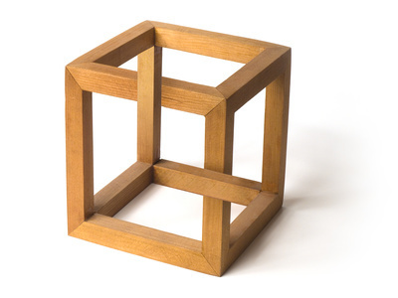
How can wood bend?

Slide 6
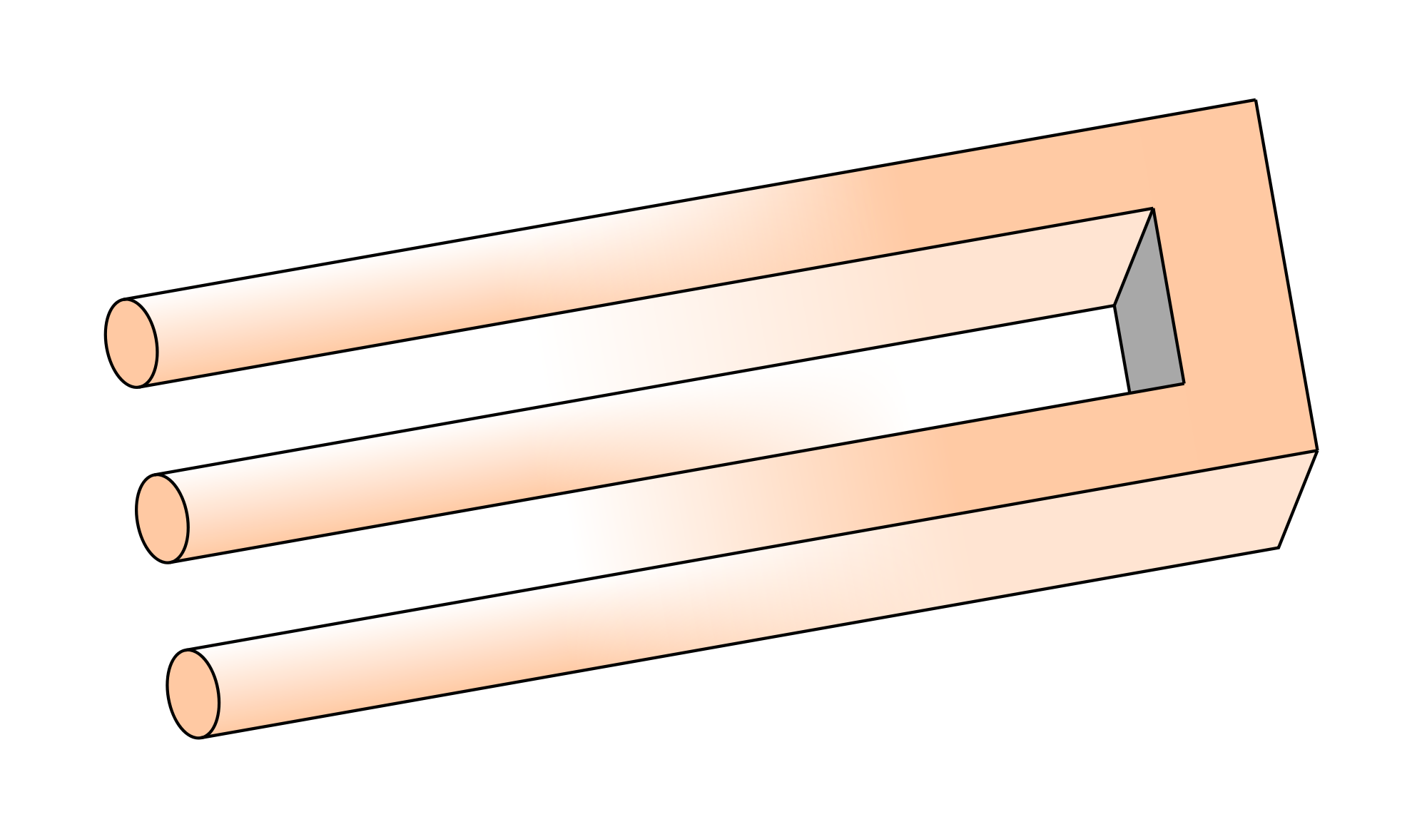
Where is the middle cylinder coming from?

Slide 7
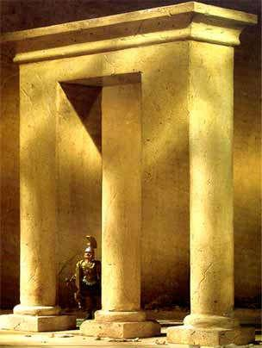
Is the middle column in line with the other 2, or is it behind?

Slide 8
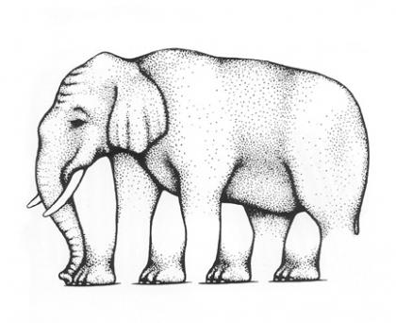
How many legs can you spot? Look closely at the feet..

Slide 9
How many pencils? How many rubbers?

Slide 10
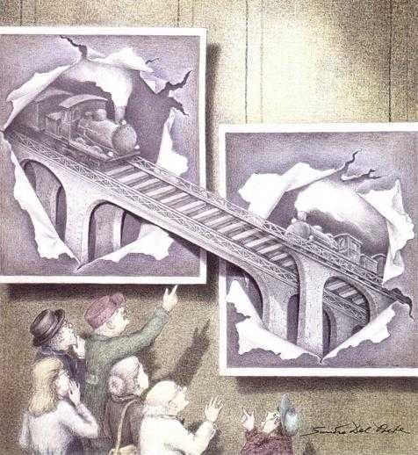
Are these trains about to crash?

Slide 11
Now to construct your own
The following instructions are taken from the SMP 11-16 booklet entitled ‘Impossible Objects’, and are reproduced with the kind permission of the Cambridge University Press.

Slide 12
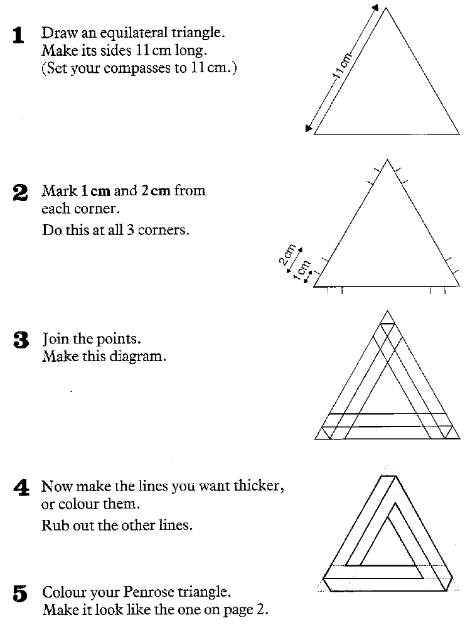
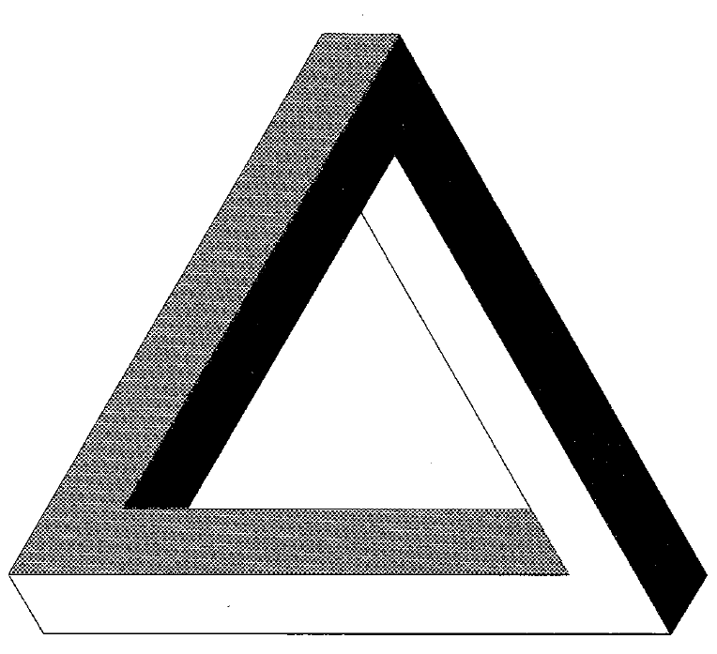
© Cambridge University Press 1985

Slide 13
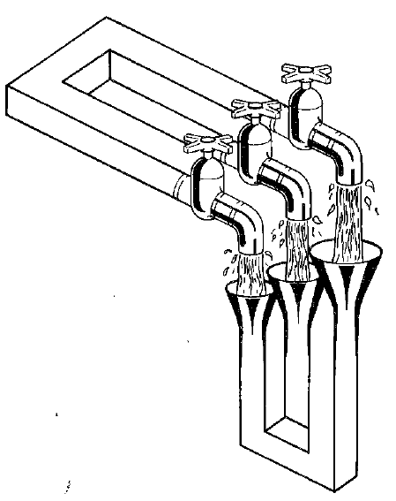
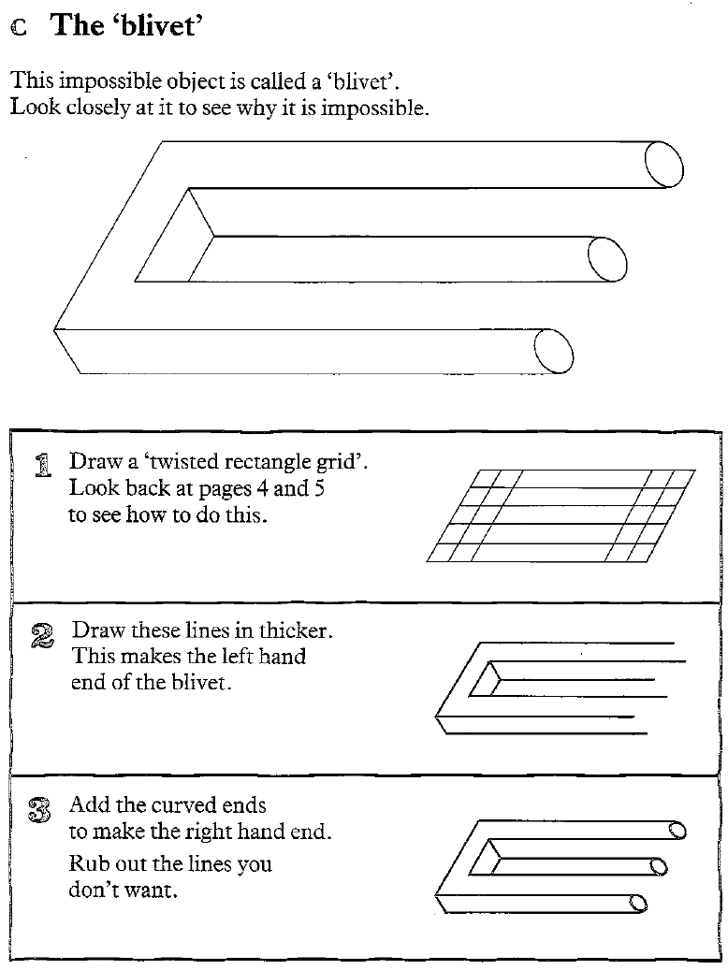
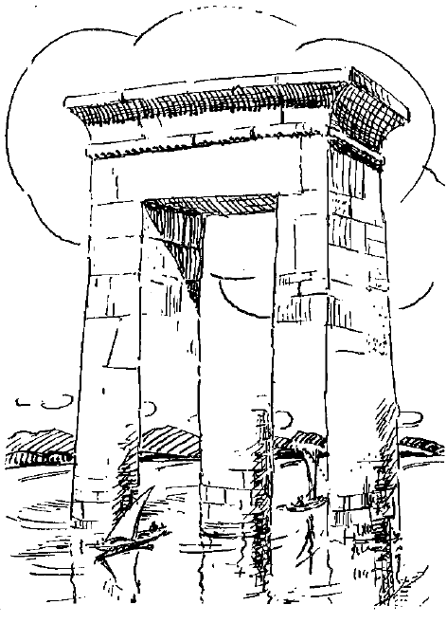
© Cambridge University Press 1985

