Slide 2
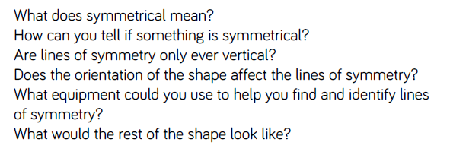
Fridays’s Maths for Year 4
Carrying on with the theme of shape today we will be looking at symmetry
https://newportjuniorschool.org.uk/home/key-info/policies/
Symmetry is when a shape is divided into two by a dotted or dashed line that separates one side from the other that is exactly the same shape. We can check this by using tracing paper or by using a mirror. Use the power point to remind yourself of what symmetry is. Think about these questions before starting work today: Once you are happy with your understanding choose the one, two or three star option for your work today. If you are proud of your work please e mail it to me – caroline.sisson@taw.org.uk.

Slide 3
Friday’s English for Year 4
This week we have be doing some English work around the theme of refugees as this week is Refugee week.
Watch the power point again outlining what being a refugee means.
Today you are going to be completing some comprehension work about refugee week. Choose one star, two star or three star and answer the questions as fully as you can in complete sentences. Read the passage carefully first until you understand all it tells you and always refer back to it when answering questions to make sure you have included all the information in your answers.

Slide 4
Todays other activity:
Art
Following on from your maths I would like you to design a picture with a line of symmetry on it. This could be horizontal or vertical.
You may choose to design an abstract design using some squared paper.
The important thing to remember is that it must be designed around a line of symmetry.

