Slide 1
Burton Borough School
Year 6 transition September 2020. Information for Parents

Slide 2
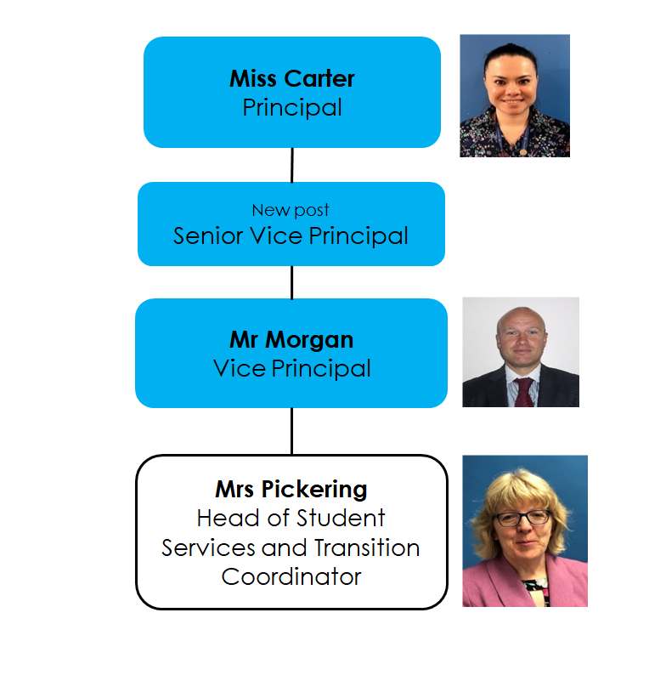
Introductions:

Slide 3
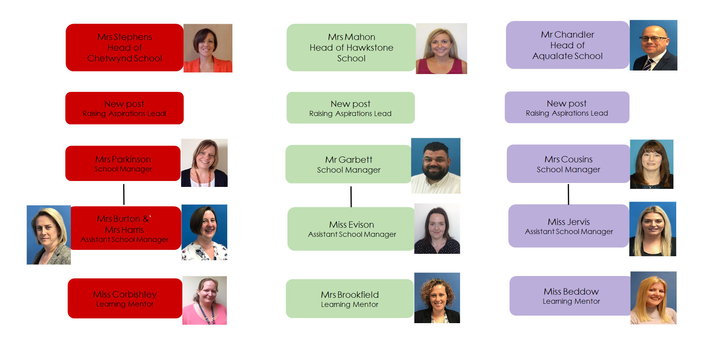
Three ‘Small Schools’ you will all be joining

Slide 4
Who to contact when your child starts with us in September
Form tutor -First contact for all general concerns and enquiries. (E-mail or note in PSD).
School Manager – for pastoral and welfare concerns.
Head of School – for specific pastoral issues and academic progress.

Slide 5
The School Day
Bell and gates close | 8.45
Period 1 Tutor Time | 8.45-9.15
Period 2 | 9.15-10.15
Period 3 | 10.15-11.15
Break | 11.15-11.35
Period 4 | 11.35-12.35
Period 5 | 12.35-1.35
Lunch | 1.35-2.10
Period 6 | 2.15-3.15

Slide 6
Our contact with you
Autumn term – Form tutor “Meet & Greet” after school session
Two progress reports
Annual report
One parents’ evening to meet with subject teachers.

Slide 7
Attendance
Phone or email the school as soon as possible to inform us if your child is absent attendance.bbs@taw.org.uk 01952 386554
Absences not due to illness are only ever authorised in exceptional circumstances. Please check the school website
https://www.burtonborough.org.uk/our-school/school-policies

Slide 8
Student Wellbeing
This is very important to us at Burton Borough and we will support your Child’s Wellbeing in a number of ways:
Student Wellbeing Mentors
Staff Wellbeing Mentors
Units covering Wellbeing in PSHE
Wellbeing themed EEL days
School counsellors/Anger management intervention/Mental Health Nurse Practitioner
Interventions to support Wellbeing
ELSA trained staff to support individual students.

Slide 10
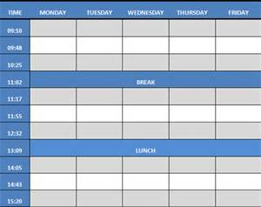
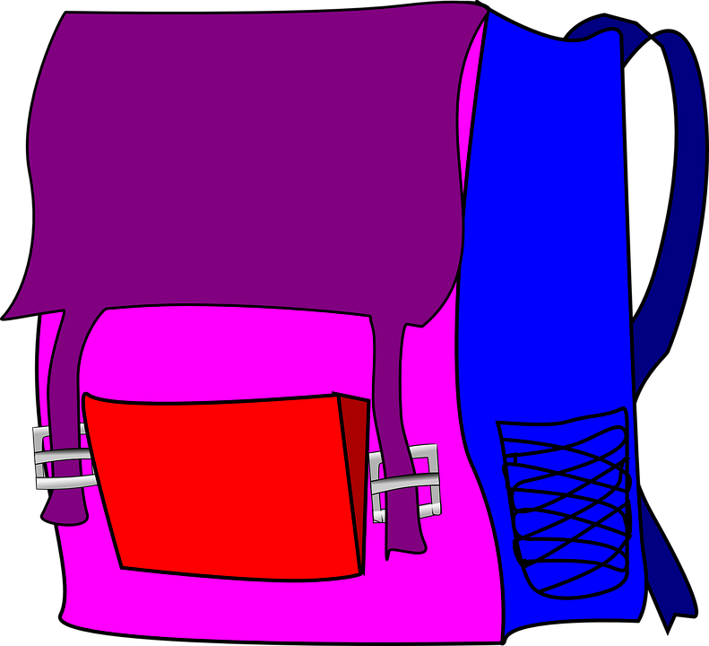
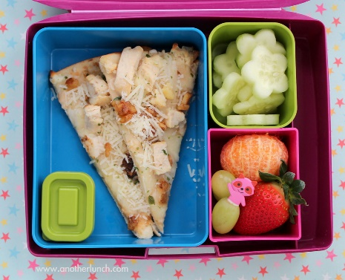
Students may need your support with being prepared…

Slide 11
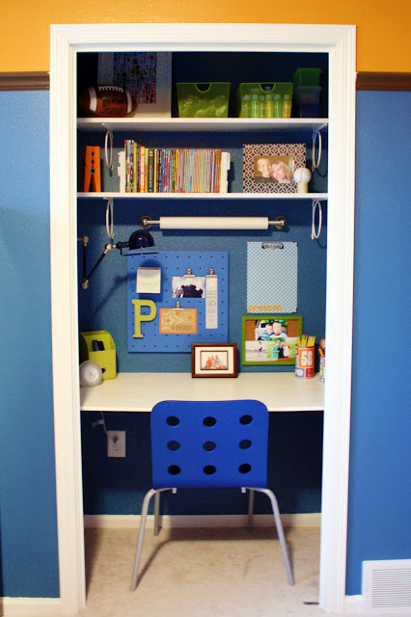
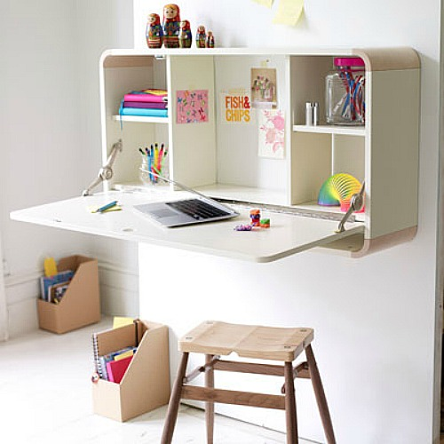
Over the summer help them prepare a work place for school …

Slide 12
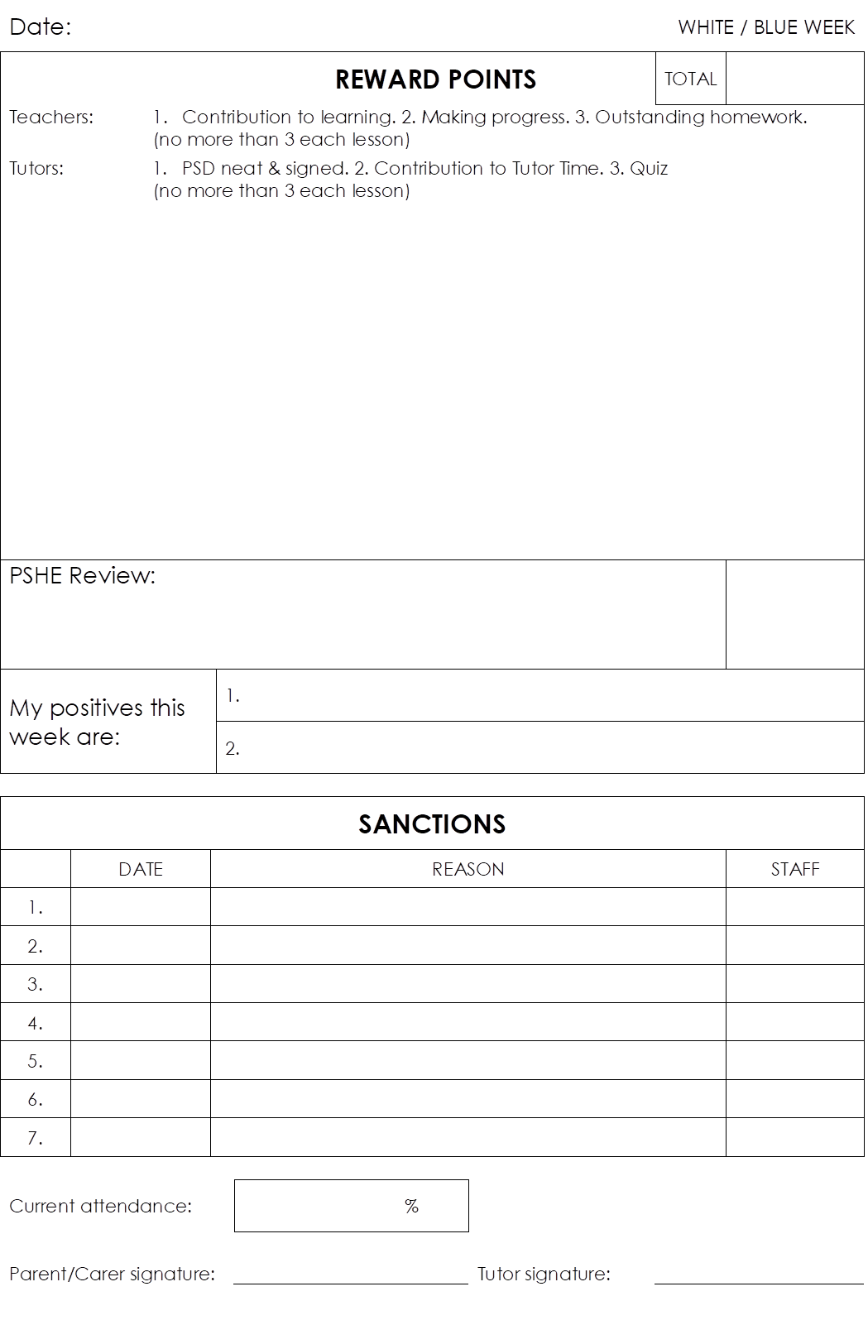
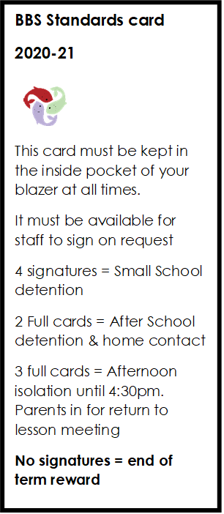
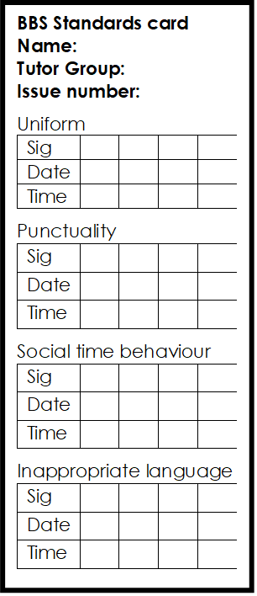
We will give your child a Personal Study Diary and a Standards card when they start

Slide 13
Homework
Homework – Homework Club
Homework online resources - links from School website - https://www.burtonborough.org.uk/
Show my homework https://theburtonborough.showmyhomework.co.uk/school/homeworks/calendar

Slide 14
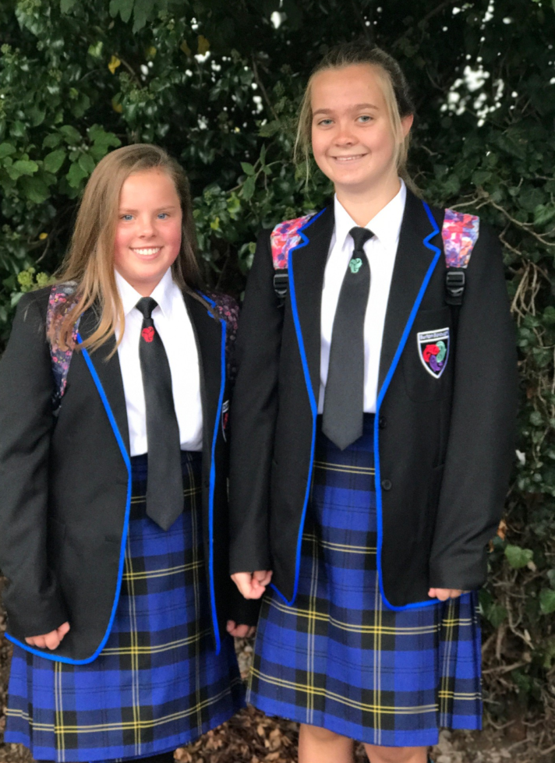
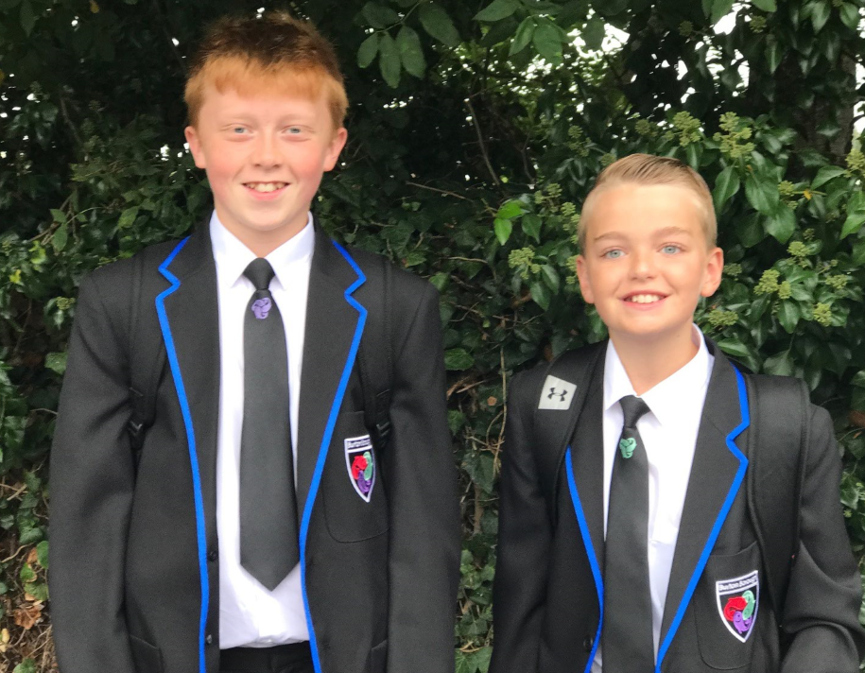
Uniform…
Chetwynd – Red
Hawkstone – Green
Aqualate – Purple
Available from Bakers in Wellington and
Tots & Teens in Newport

Slide 15
Mobile Phones…
In the school buildings (including the cafeteria) phones are to be:
Switched off.
Out of sight in a bag or pocket.
Teachers may allow students to use phones in lessons for learning only.

Slide 16
Mobile Phones…
In Social Time:
Be responsible
Be kind
In an emergency, students need to contact their small school, who will then contact home

Slide 17
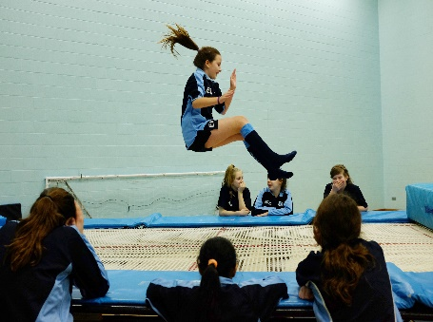
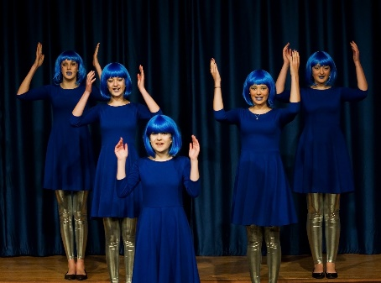
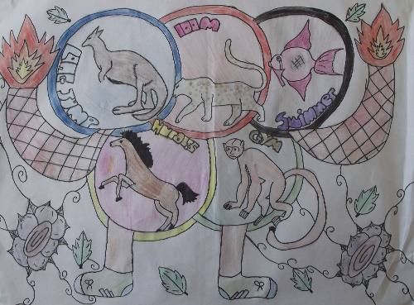
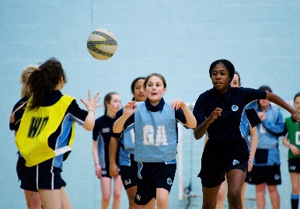
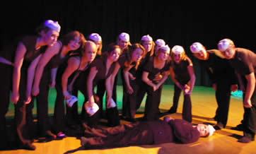
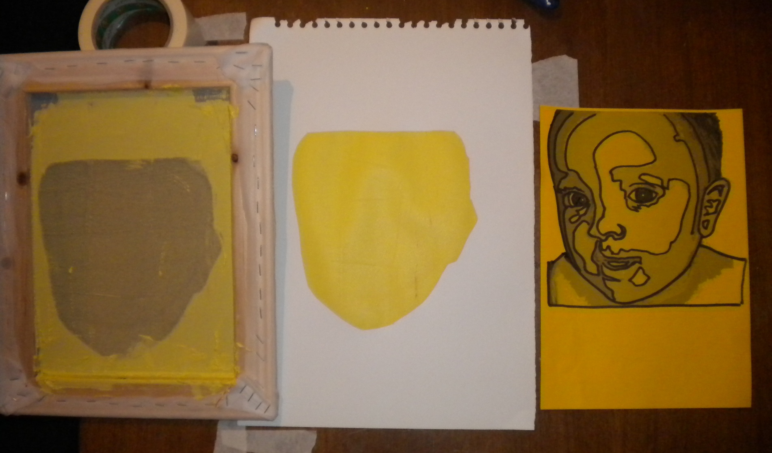
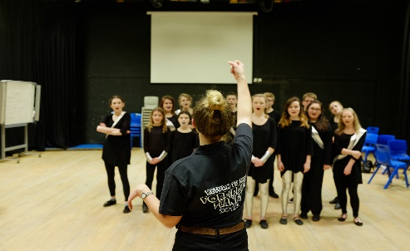
Just a few of the amazing clubs your children will be able to join

Slide 18
Support available for our SEN and more vulnerable students

Slide 19
Engage
A very bespoke and personalised provision for
students who are unable to fully access the
mainstream classroom.
This may be for cognition and learning needs,
Social, emotional and mental health needs or
sensory needs.
Engage is run by Ms Slatcher a specialist teacher and
Mrs Tarr an experienced HLTA.

Slide 20
Intervention | Description
Maths intervention | Overlearning of basic maths skills taught in class Problem solving activities Repetition and recall of basic facts Focus on numeracy life skills including time, money and measurements.
English intervention | Repetition and recall of spelling, punctuation and grammar rules Descriptive writing Word classes Reading comprehension Phonic decoding
Dyslexia intervention | Spelling patterns Reading and writing strategies Memory games Processing support
Touch Typing | Online tool to increase typing speed and keyboard familiarity
Autism intervention | Social skills Social communication Empathy Managing emotions
Speech and Language | Letter and word pronunciation Instigating and maintaining conversation Implementing Speech and Language resources provided by therapist
Lego Build to express | Using Lego as a tool to express themselves

Slide 21
Thank you for taking the time to read through this – we look forward to meeting you all see you in the months ahead.
In the interim if you have any further questions please email main.bbs@taw.org.uk and mark your query Transition

