Slide 1
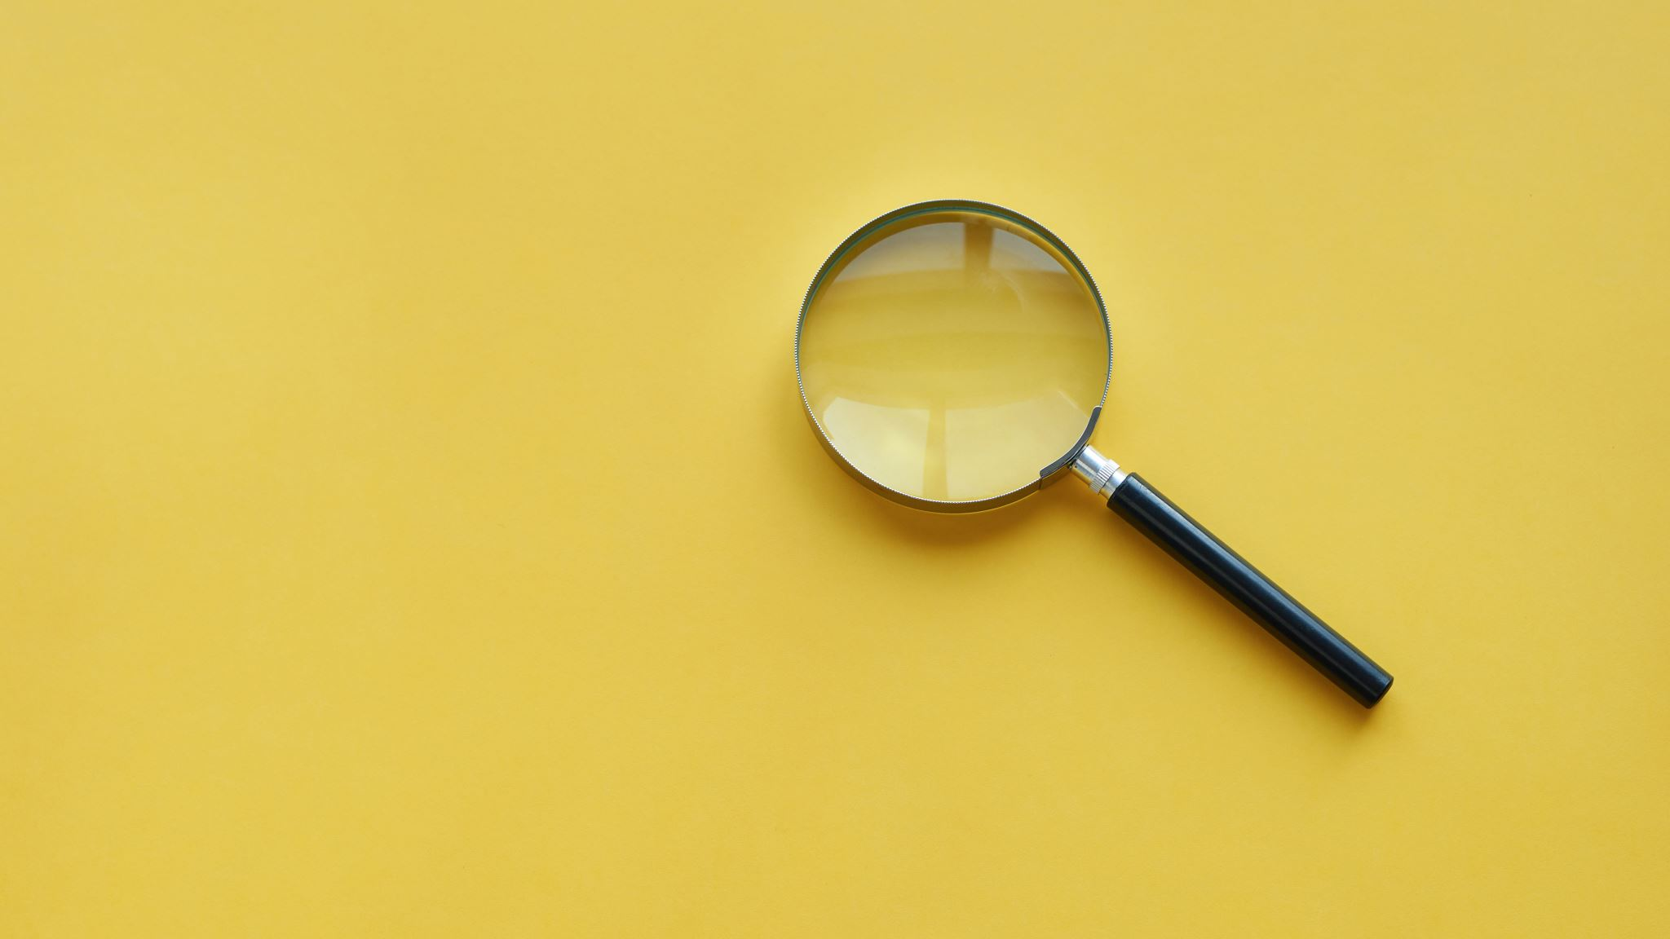
How Quiztastic are you?

Slide 2
Round 1 - Animals

Slide 3
1: What is the biggest animal in the world?
A: Elephant
B: Blue Whale
C: Giraffe
D: Killer Whale

Slide 4
2: Was the Diplodocus a herbivore or carnivore?

Slide 5
3: How many legs does a spider have?

Slide 6
4: What is a young cow called?

Slide 7
5: True or False?
Rabbits are born blind?

Slide 8
ANSWERS
Blue Whale
Herbivore
8
Calf
True

Slide 9
Round 2: Geography

Slide 10
1: What is the capital city of the UK?

Slide 11
2: From Newport we can see a large hill all the way over in Telford but what is it called?
A: Ben Nevis
B: The Wrekin
C: Snowdon
D: Moody’s Mound

Slide 12
3: True or False Mount Everest is the tallest mountain in the world?

Slide 13
4: In which country would you find the Statue of Liberty?

Slide 14
5: Which is the coldest place on Earth?
A: Mrs Greens office?
B: Antarctica
C: Iceland
D: UK

Slide 15
ANSWERS:
1: London
2: The Wrekin
3: True
4: USA / America
5: Antarctica

Slide 16
Round 3: Books

Slide 17
1: Who wrote the Harry Potter series of books?
A: Roald Dahl
B: JK Rowling
C: David Walliams
D: Enid Blyton

Slide 18
2: What is the name of this Character?

Slide 19
3: In what series of books would you find Frodo Baggins?
A: Harry Potter
B: The Chronicles of Narnia
C: The Lord of the Rings
D: Percy Jackson

Slide 20
4: True of False? Miss Trunchball is Matilda’s favourite teacher?

Slide 21
5: Which one of these books titles was written by David Walliams?
A: Millionaire Boy
B: Mr Smelly
C: The Girl Who Wore Trousers
D: Fing

Slide 22
ANSWERS:
1: JK Rowling
2: The BFG
3: The Lord of the Rings
4: False Miss Honey is Matilda’s favourite teacher
5: Fing

Slide 23
Round 4
Pictures

Slide 24
1: Can you guess who this is?

Slide 25
2: Can you guess who this is?

Slide 26
3: Can you guess who this is?

Slide 27
4: Can you guess who this is?

Slide 28
5: Can you guess who this is?

Slide 29
Answers
1: David Walliams
2: The Queen
3: Boris Johnson / The Prime Minister
4: Belle / Beauty
5: Mrs Moody / Gangster Granny!

Slide 30
Round 5: Logo’s

Slide 31
1.

Slide 32
2.

Slide 33
3.

Slide 34
4.

Slide 35
5.

Slide 36
Answers:
1. McDonalds
2. Xbox
3. Facebook
4. Pringles
5. Apple

Slide 37
Round 6:
General Knowledge

Slide 38
1. What is the name of the biggest planet in our Solar System?

Slide 39
2: Who loves marmalade sandwiches?

Slide 40
3: Who likes warm hugs?
A: Olaf
B: Wall E
C: The Ice Monster
D: The Snowman

Slide 41
4: How many sides does an Octagon have?

Slide 42
5: Which fairy tale character slept for 100 years?

Slide 43
6. What kind of creature is a Komodo Dragon?
A: Snake
B: Dragon
C: Lizard
D: Frog

Slide 44
7: How many Olympic rings are there?

Slide 45
8: What type of animal is Bullseye in the “Toy Story” films?

Slide 46
9: Where is the smallest bone in the human body?
A: The Ear
B: The Hand
C: The Foot
D: The Leg

Slide 47
10: How many hours are there in a day?

Slide 48
Answers:
Jupiter
Paddington Bear
A: Olaf
8 sides
Sleeping Beauty
Lizard
5
Horse
In the Ear
24 hours

Slide 49
Thank you
Mrs Yates

