Slide 2
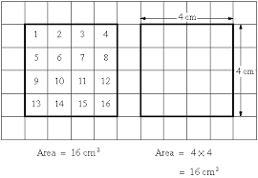
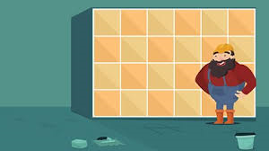
Thursday’s Maths for Year 4
This week we will be revising how to calculate the area of a shape. The area of a shape means looking at the amount of space on the inside of a shape. We do this by counting squares or by calculating length x width.
You can look at the calculation policy for more help:
https://newportjuniorschool.org.uk/home/key-info/policies/
What is area? Have a look at the power point we looked at yesterday to remind yourself of how we calculate area. Remember – Area is always written as units squared Finding the area is very important for laying patios and calculating how much carpet you need for a room and of course the amount of turf needed for a football pitch! Today’s work will be calculating the area of different shapes , some involving half squares. Have a look at the differentiated work sheets for today’s activity.

Slide 3
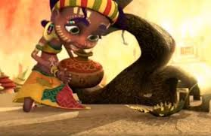
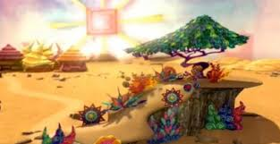
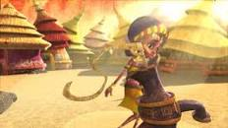
Thursday’s English for Year 4
This week we will be looking at stories from different cultures. A culture describes the way people live and around the world there are many different cultures.
We will be looking at a story from Africa. Watch the clip entitled Zahra from the website below
http://www.literacyshed.com/the-other-cultures-shed.html
Today watch the whole thing again.
Think about the story. As it is a silent film you can make up your own narrative. Over the next two days you are going to write your version of the story. Think about the extra details you could add in – where was the village? Who was Zahra? Does she have any family? What was the water for? How did Zahra feel when she saw the tree that grew? Did the tree actually grow or was Zahra just dreaming it? 1 star Begin to write your story remembering correct punctuation. 2 star Begin writing your story paragraphing your ideas. 3 star Begin writing your story. Remember you could include your improved paragraph from yesterday

Slide 4
Todays other activity:
E safety
Watch
https://www.thinkuknow.co.uk/8_10/watch/
Please note that you may have to copy and paste the website into the tool bar.
Now think about these questions:
What did you think about Play, Like, Share?
What different things do the children like to do online?
What problem did Alfie face at the beginning of the cartoon?
How did the gamer make Alfie feel?
What did Alfie do when he thought something was not quite right?
What happened when Selfie’s video was made public? How did it make them feel?
If you are completing this activity with a parent you could share your thoughts with them.

