Slide 2
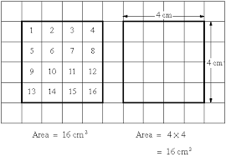
Tuesday’s Maths for Year 4
This week we will be revising how to calculate the area of a shape. The area of a shape means looking at the amount of space on the inside of a shape. We do this by counting squares or by calculating length x width.
You can look at the calculation policy for more help:
https://newportjuniorschool.org.uk/home/key-info/policies/
What is area? Have a look at the power point to remind yourself of how we calculate area. Remember – Area is always written as units squared - Today’s work will be calculating the area of different shapes following on from the power point. Have a look at the differentiated work sheets for today’s activity.

Slide 3
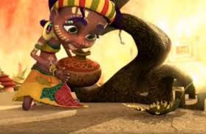
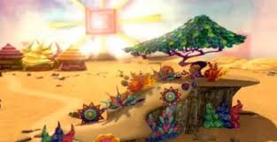
Tuesday’s English for Year 4
This week we will be looking at stories from different cultures. A culture describes the way people live and around the world there are many different cultures.
We will be looking at a story from Africa. Watch the clip entitled Zahra from the website below(today stop at the point when the water pumps stops.)
http://www.literacyshed.com/the-other-cultures-shed.html
Today we will be working on predictions. A prediction is a sensible guess about what will happen in a story based on what you have seen already. 1 star Create a mind map of ideas that you think will happen in the story. 2 star What do you think will happen in the story? Why is she watering the tree? What do you think the main character’s life is like? 3 star What do you think will happen in the story? Why is she watering the tree? What do you think the main character’s life is like? How is her life different to ours?

Slide 4
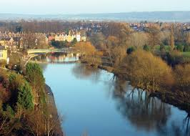
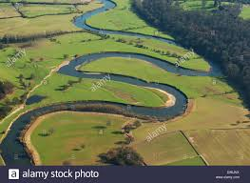
Todays other activity:
River Severn
The River Severn is one of our local rivers.
Today I would like you to find some facts out about the River Severn.
You could research the source and mouth of the river, towns it passes through, the speed of the river and the question of does it flood and if so what damage does it cause.
1 star: Find out 5 facts
2 star :Find 8 facts
3 star: Write 2 paragraphs describing what you have found out
about the River Severn.

