Slide 2
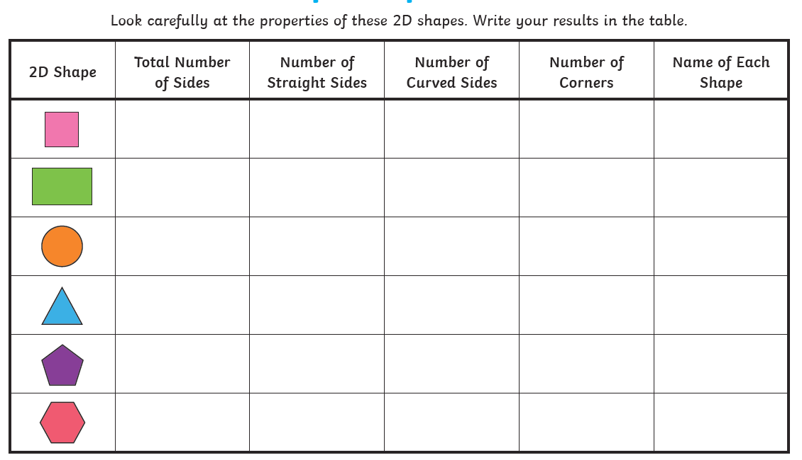
Home Learning: To identify properties of 2D shapes.
We are going to revise shape including 2-Dimensional today! Look at the shape below… fill in the grid to identify the sides, vertices (corners) and the name of the shape!

Slide 3
Answers:

Slide 4
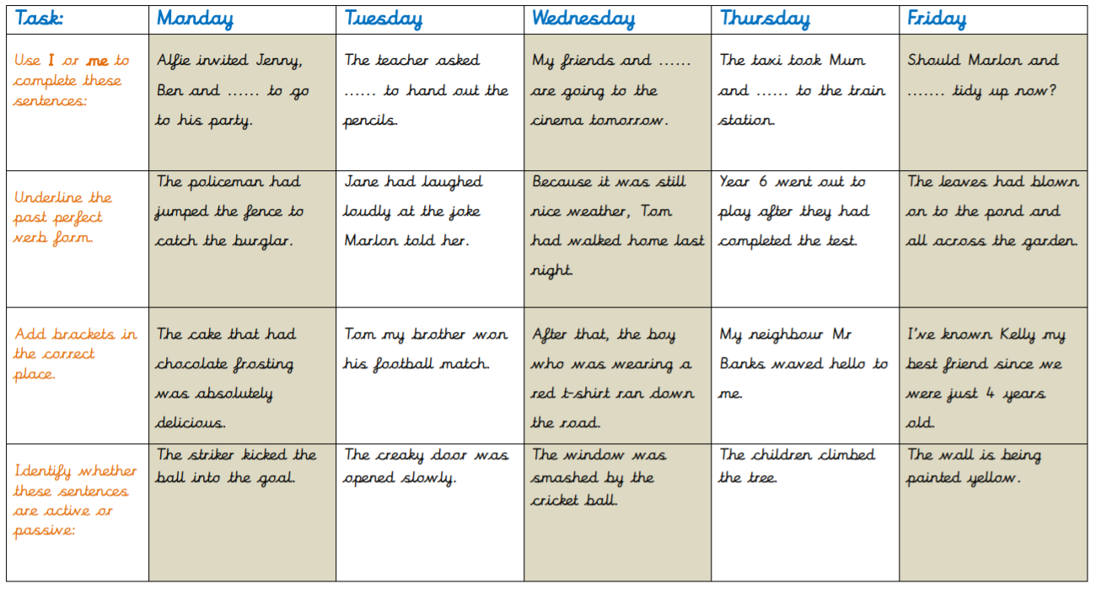
English Starter

Slide 5
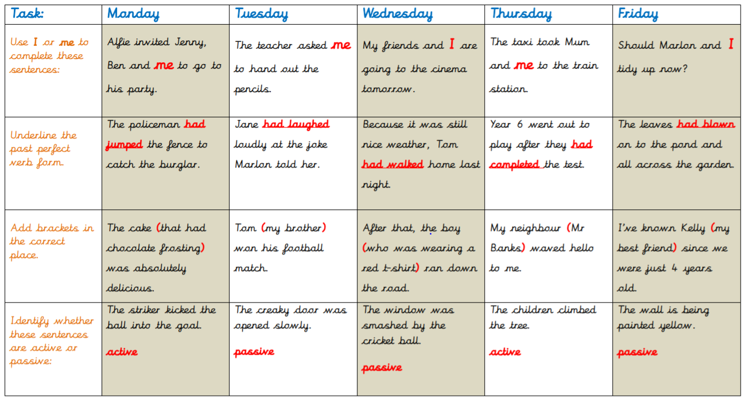
English Starter

Slide 6
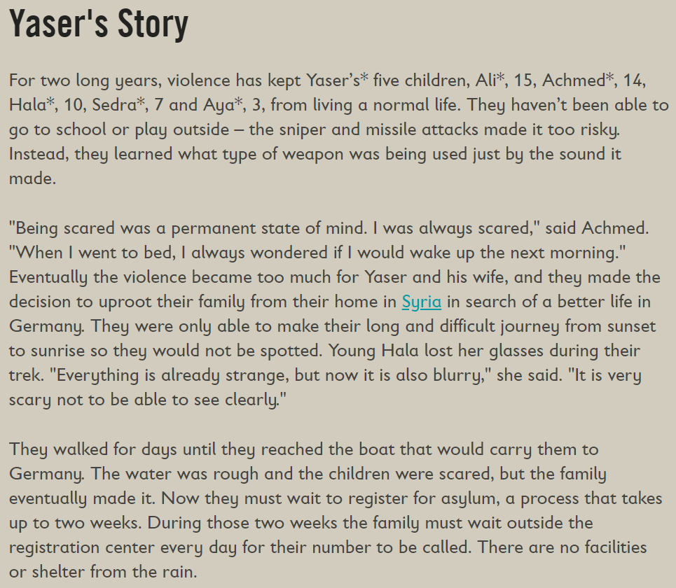
Thursday’s English for Year 6
L.O: To write a diary entry in character.
Yesterday, you looked at Yaser’s story.
Today, you are going to write a diary as Yaser or one of his children! In your diary, I want you to cover what you think you would have seen and done over 24 hours.
You could split your diary into 3: Morning, Afternoon and Evening.
Remember the story… they couldn’t travel until the sun had set. Think about what they would have seen, heard and felt during their time. Make sure you show me your feelings… don’t tell me!

Slide 7
Today’s other activity:
L.O: To develop reading comprehension skills.
Complete the comprehension questions on the next slide!

Slide 8
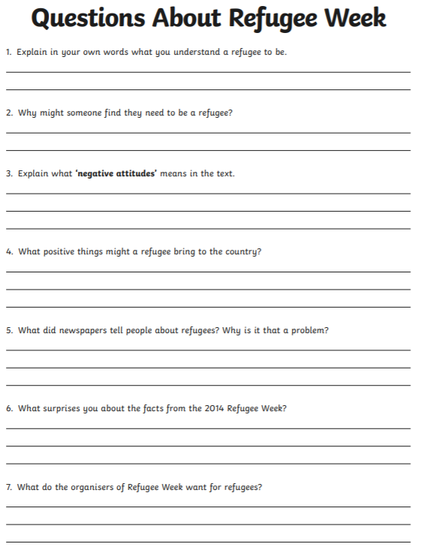
On the website you will find the original document should you struggle to read any of the questions.
This document contains a 1 star and 3 star version as well as the answers to all 3 challenge levels!

