Slide 2
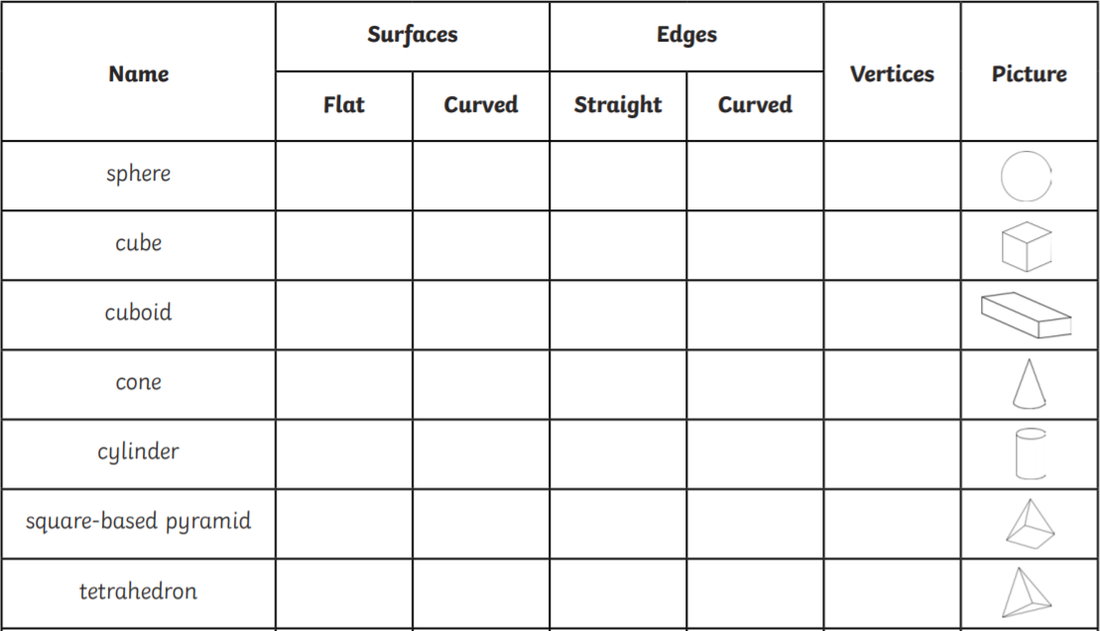
Home Learning: To recognise properties of 3-D shapes.
Today you are going to explore a range of 3D shapes to find the properties.
3D shapes are often described as having faces, edges and vertices (corners). Try as many as you can!
Helpful video:
https://www.youtube.com/watch?v=3-QwWFkz5hw

Slide 3
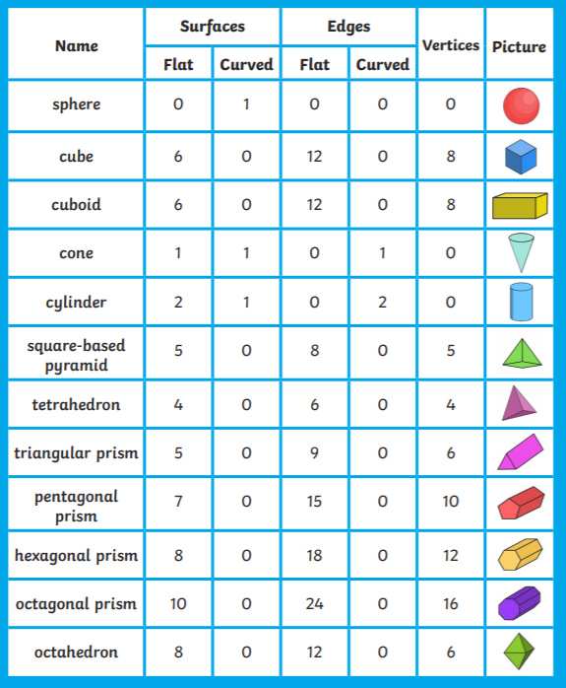
Answers:
How well did you do?
Which did you find the most challenging?

Slide 4
English Starter
Each question is worth points! How many can you get before the end of the week?

Slide 5
English Starter - Answers
How well are you doing after 3 days?

Slide 6
Wednesday’s English for Year 6
L.O: To decide a suitable problem for my mystery story.
Task… Now you have chosen a setting for your story, you are going to decide upon the problem! Try to think of 3 clear problems that could happen in your story (add as much detail about each problem as you can)! From here, choose 1 and explain why you have picked it.
Tomorrow, we are going to start looking at characters and suspects!

Slide 7
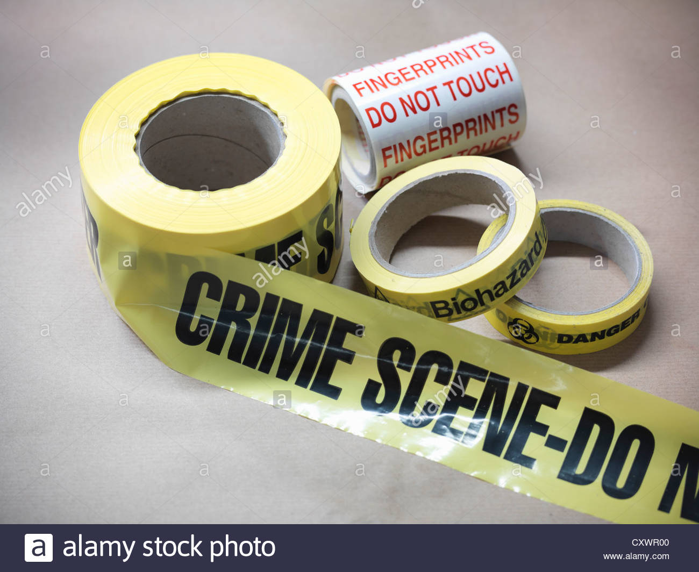
Today’s other activity:
L.O: To experiment with collecting finger prints!
Yesterday, you researched the use of fingerprints. Today, we are going to experiment to find our own.
You will need:
A glass (plain)
Sellotape
You are going to experiment with a variety of resources to see how you can get the clearest fingerprint on the glass.
Using the Sellotape, you will then remove the finger print and pop it onto blank paper. From here you can explain which resource you found to be the best when collecting a finger print!
The purple box offers many ideas on what resources you might like to use.
Remember when you collect them to label it on your page!
The next slide shows the step by step process
You could test with…
Chalk
Flour
Talc
Cocoa Powder
Oil
Cream
Pencil or Pens
Try them all if you can!

Slide 8
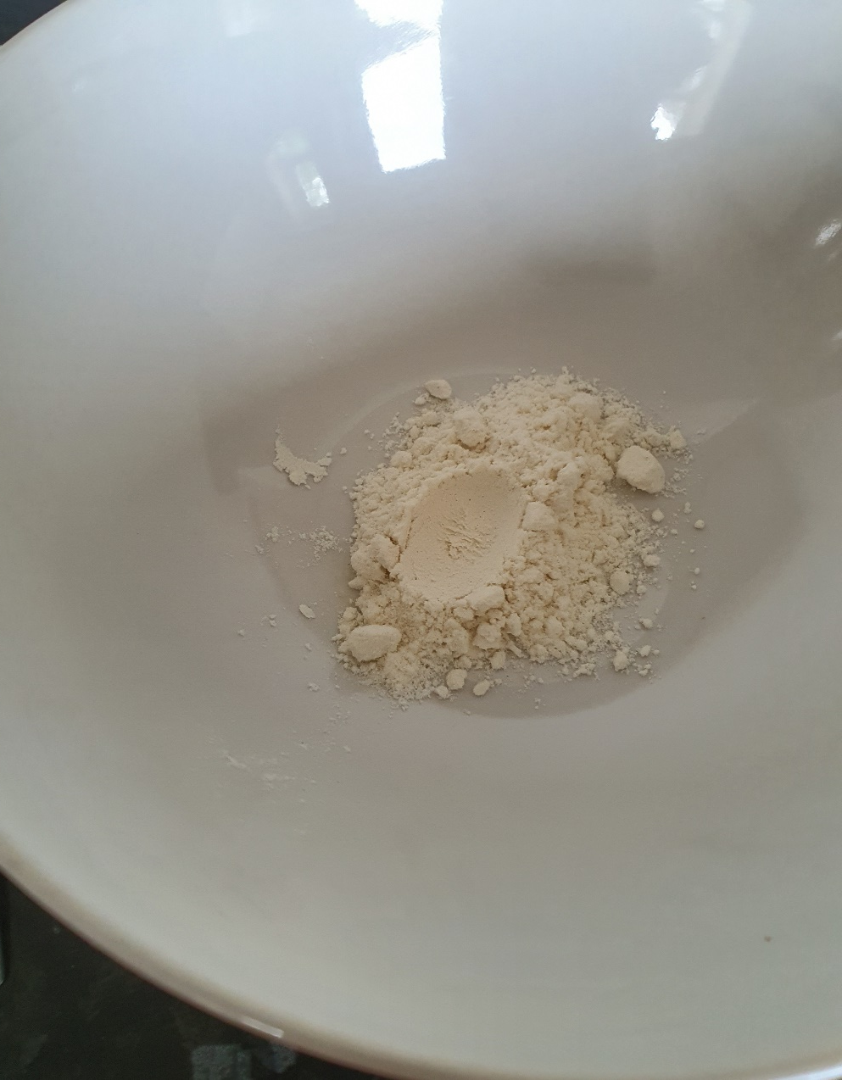
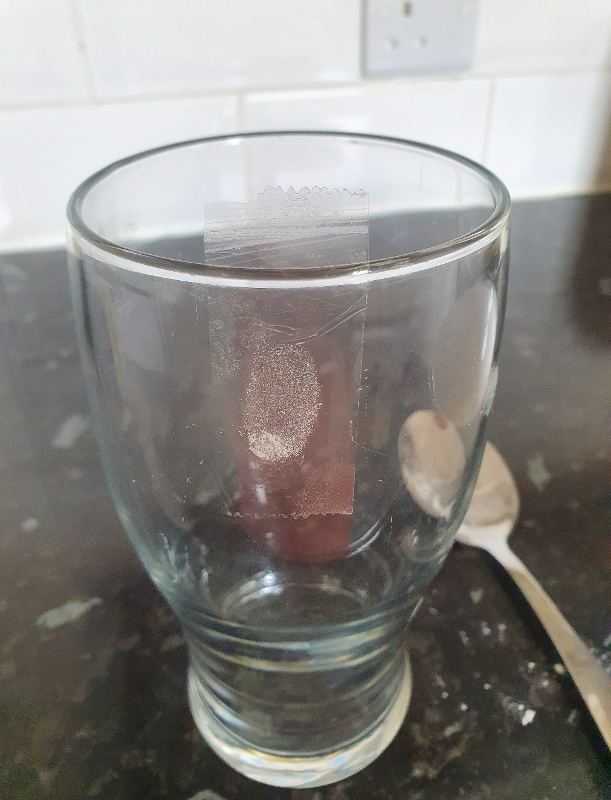
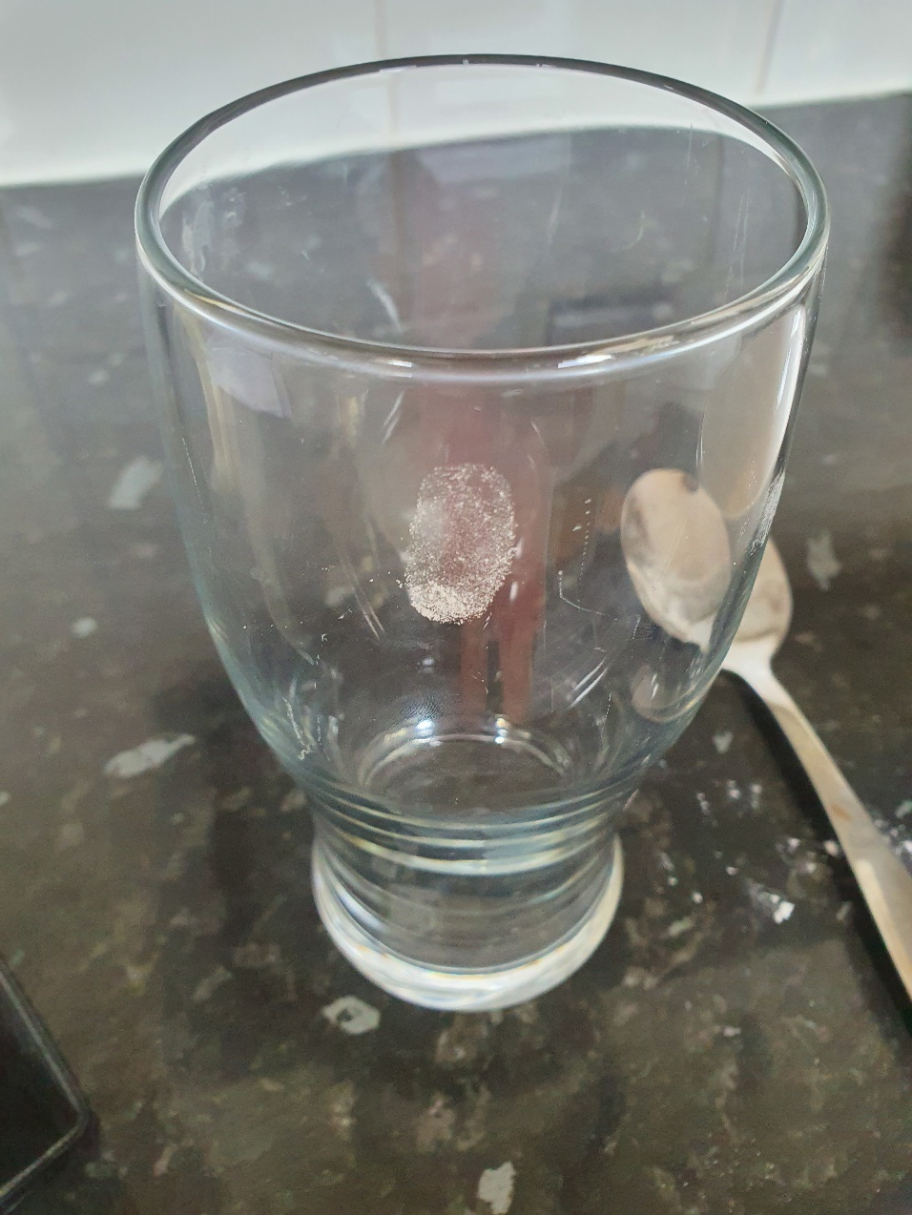
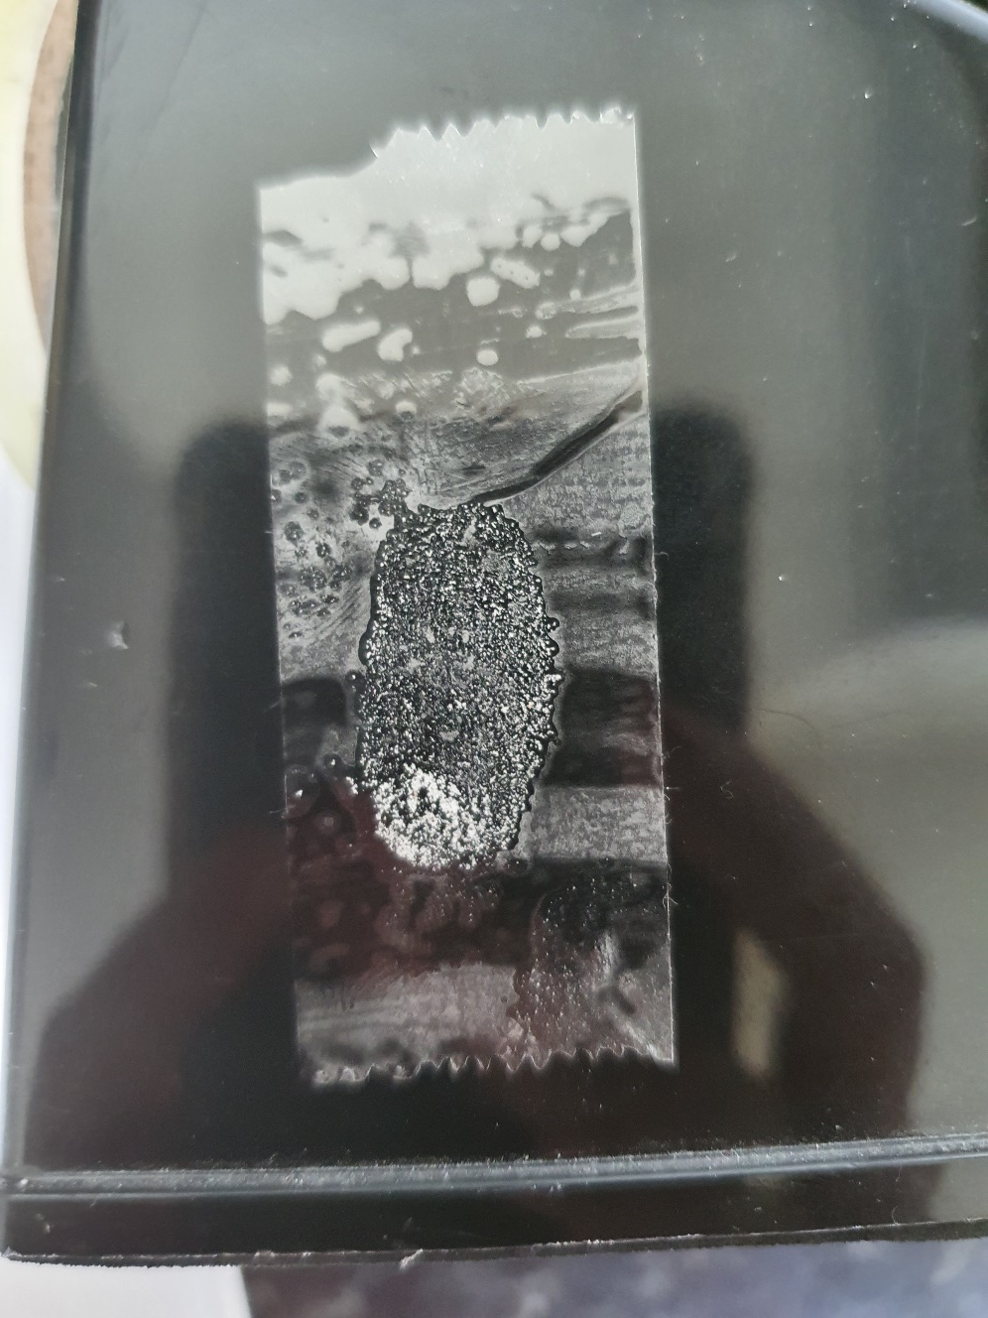
Step 4: Place the print onto a plain piece of paper.
HINT: If you have a light print, use a dark piece of paper. If you have a dark print, use a white piece of paper.
Step 2: Press your finger onto a plain glass.
Step 1: Pick your first resource. I choose flour! Dip your finger into the flour etc.
Step 3: Place a small piece of Sellotape on the top of your print. Remove gently.

