Slide 2
Home Learning: To plot missing co-ordinates in 4 quadrants.
Can you use what you know about co-ordinates to find the missing ones in the questions below?
On this one, is there only one answer?
Can you prove your thoughts.

Slide 3
Answers:
(1,1)
(2,1)
(6, -3) or (-2,7)
4. Various co-ordinates can be found. So along as they do not make equal length sides (6 squares).

Slide 4
English Starter
Brackets can be used with relative clauses or for extra information. If you read the sentence outside of the brackets, it should make sense on its on.
For example:
Miss Jones (who is a year 4
teacher) loves reading especially
Harry Potter.

Slide 5
English Starter - Answers

Slide 6
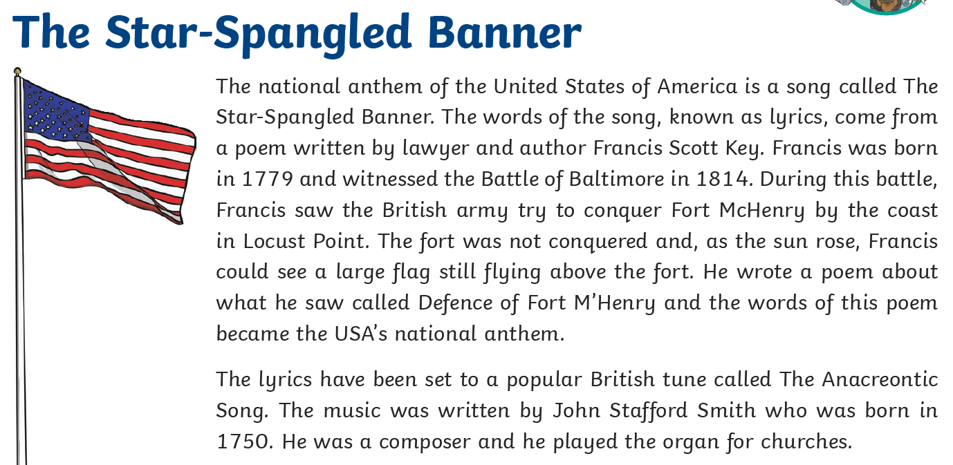
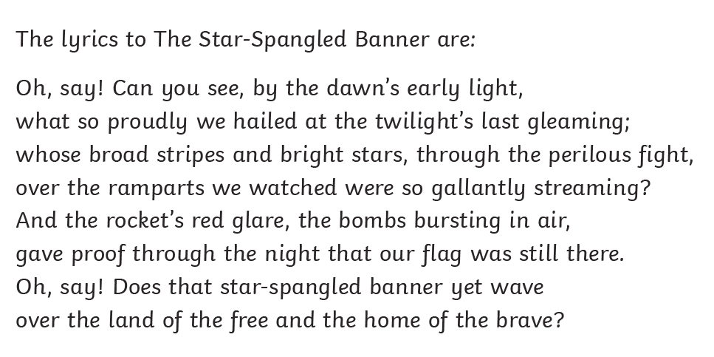
Friday’s English for Year 6
L.O: To develop reading comprehension skills.
Tomorrow is a big day for Americans; it is independence day! This day is a national holiday for the USA as they celebrate.
Who wrote the music that the lyrics were set to?
…and witnessed the Battle of Baltimore in 1814. What do you think this phrase means?
At what time of day did Francis see the flag? Explain how you know.
4. Fill in the missing words from the poem:
…the land of the ________ and the home of the _______
5. Find and copy one word that the poet uses to show that the fight was dangerous.
6. … what so proudly we hailed…
What do you think this phrase means?

Slide 7
Friday’s English Answers for Year 6

Slide 8
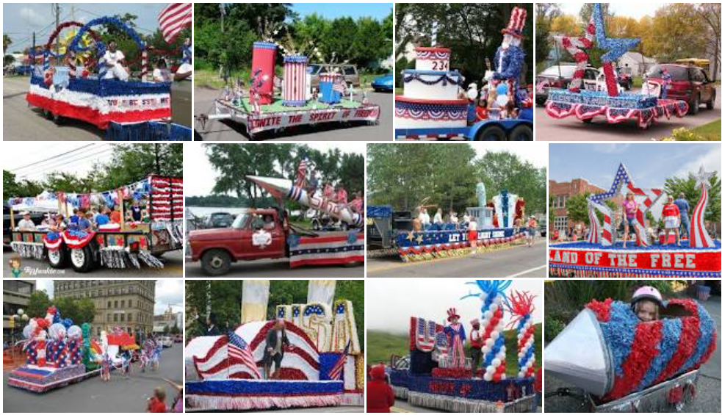
Today’s other activity:
L.O: To design a parade float for independence day.
Every year, Newport hosts the carnival and there is a theme. NJS work hard to make that theme come to life and many of you will have possibly sat on the float.
Tomorrow is a big day for Americans; it is independence day! This day is a national holiday for the USA as they celebrate.
Use the pictures on here to design your own float for the 4th of July parade.
Tip: Read the information on the next slide before starting your design!

