Slide 2
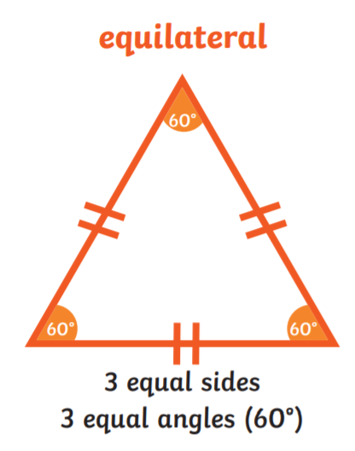
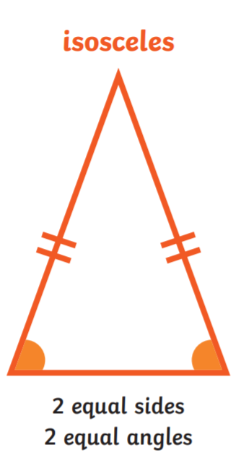
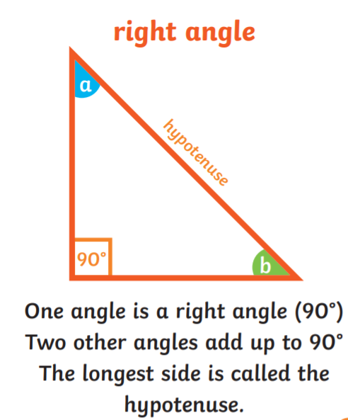
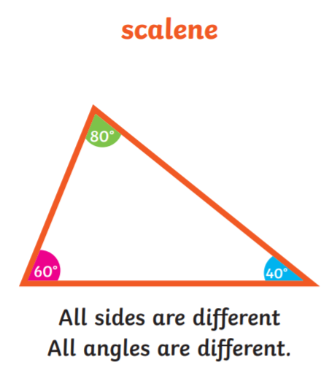
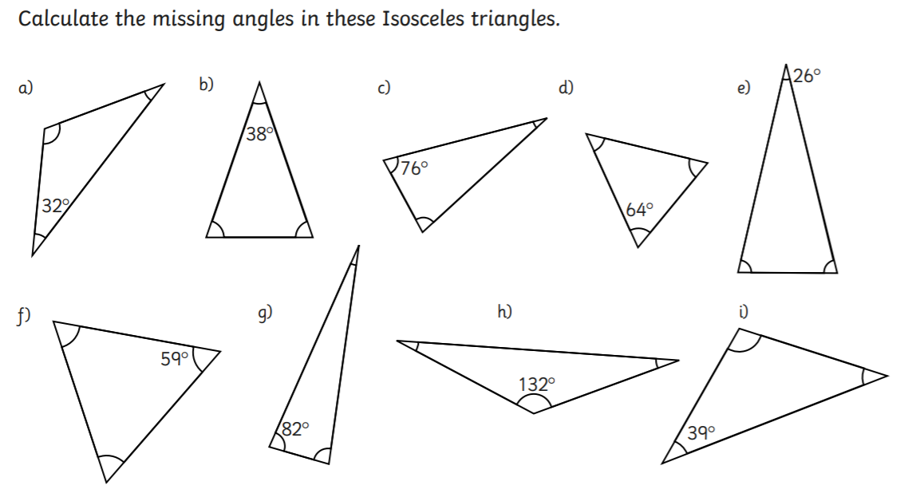
Home Learning: To calculate angles in triangles.
Read the information on types of triangles! All angles in a triangle add up to 180 degrees.
Today we are going to find the missing angles from an isosceles triangle. Remember… we already know that two angles are equal.
Try as many as you can!
Example:
b.
180 – 38 = 142
142 divided by 2
= 71
Each angle is 71 degrees

Slide 3
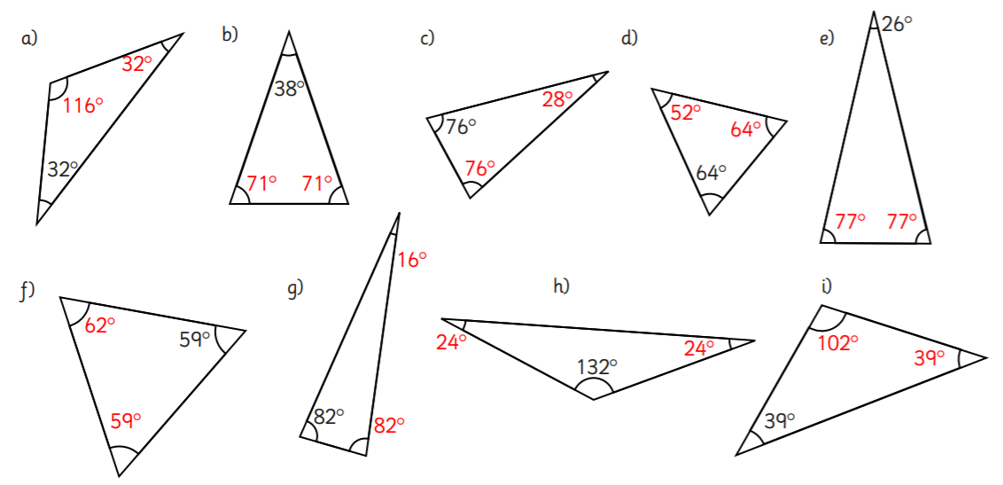
Answers…

Slide 4
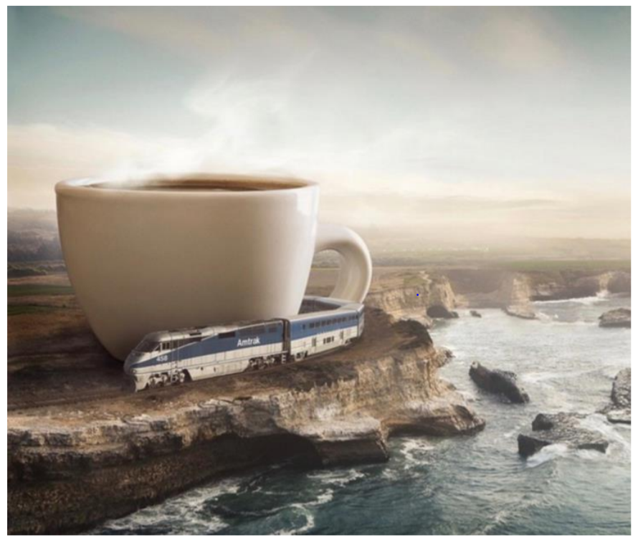
Friday’s English for Year 6
L.O: To continue a story from an opening.
Free Write Friday!
Can you finish the story below…
Have you ever wondered what causes the waves in the ocean?
Sometimes in life, things are not as they seem.
Footsteps could be heard in the distance. Not careful, quiet footsteps, like those someone like you might make mas you move about your living room. No. These footsteps were different: they shook the very earth with every colossal stride. He was coming…

Slide 5
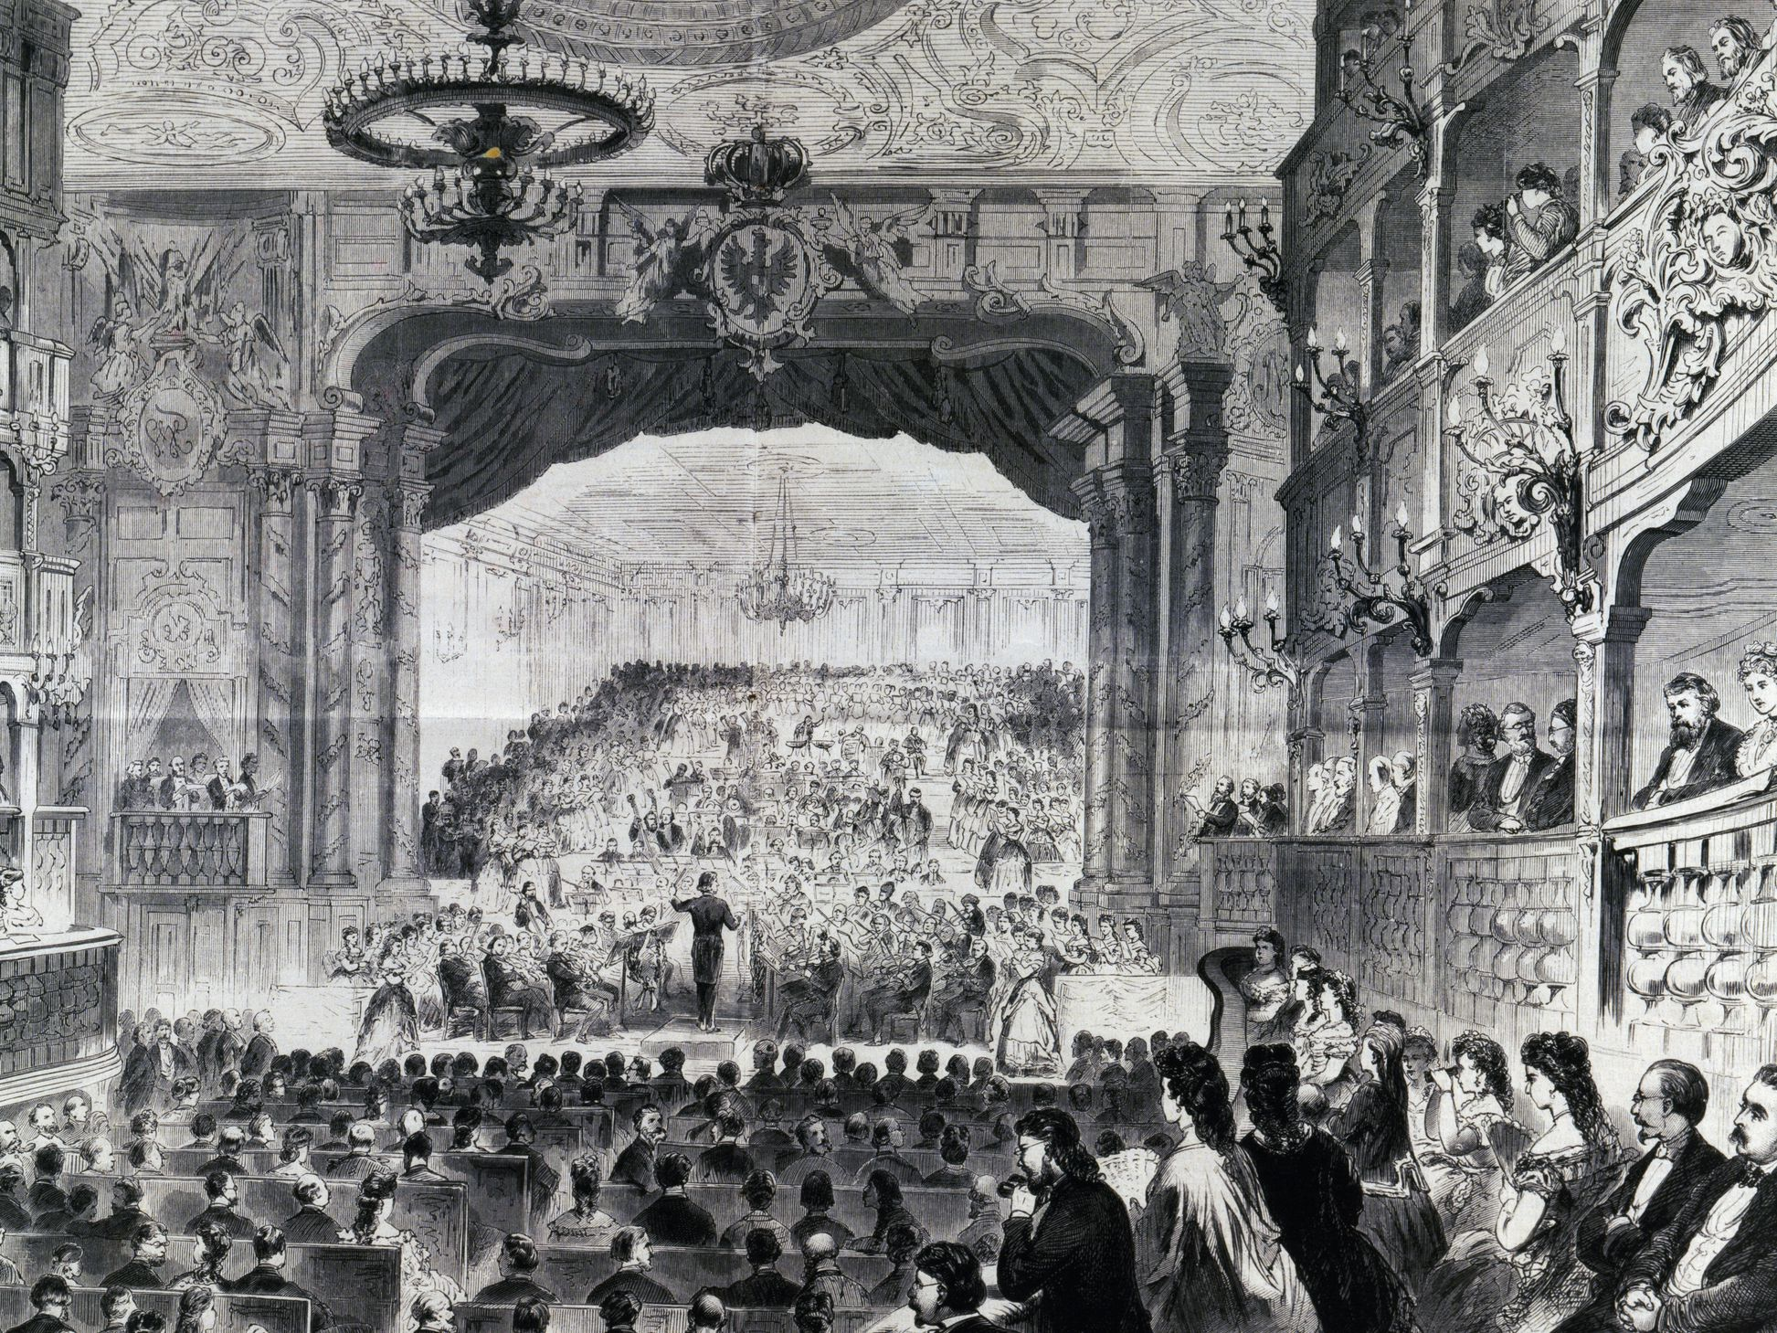
Today’s other activity:
L.O: To draw and label a diagram of a typical orchestra.
Now we have moved to romantic music, orchestras began to increase in size.
On the next slide is a poster of what a typical orchestra would look like.
Draw your own diagram with labels.
Then find 2 or 3 facts about the following:
Strings
Brass
Woodwind
Percussion
Conductor

Slide 6
