Slide 2
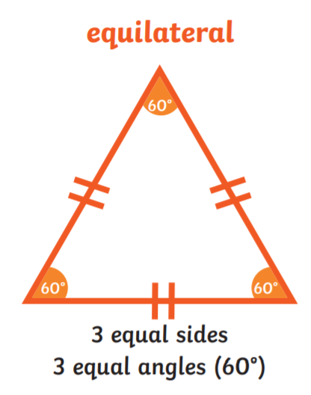
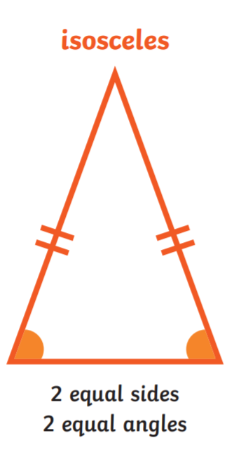
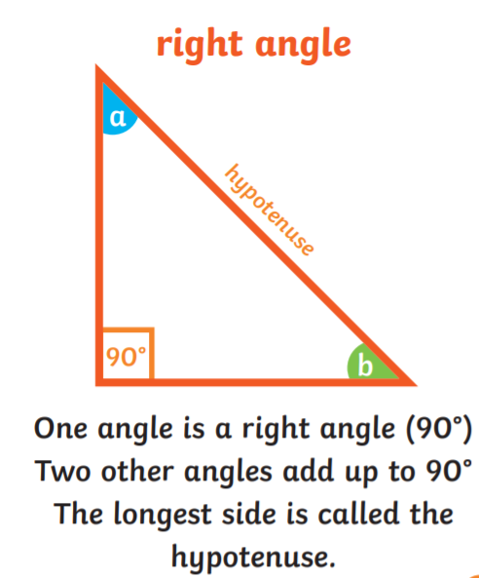
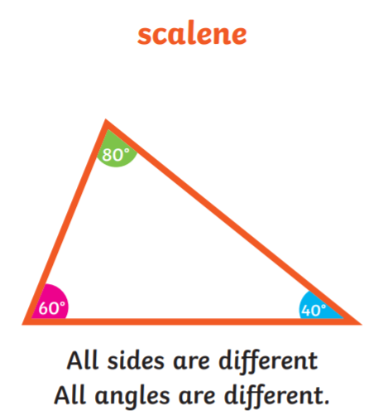
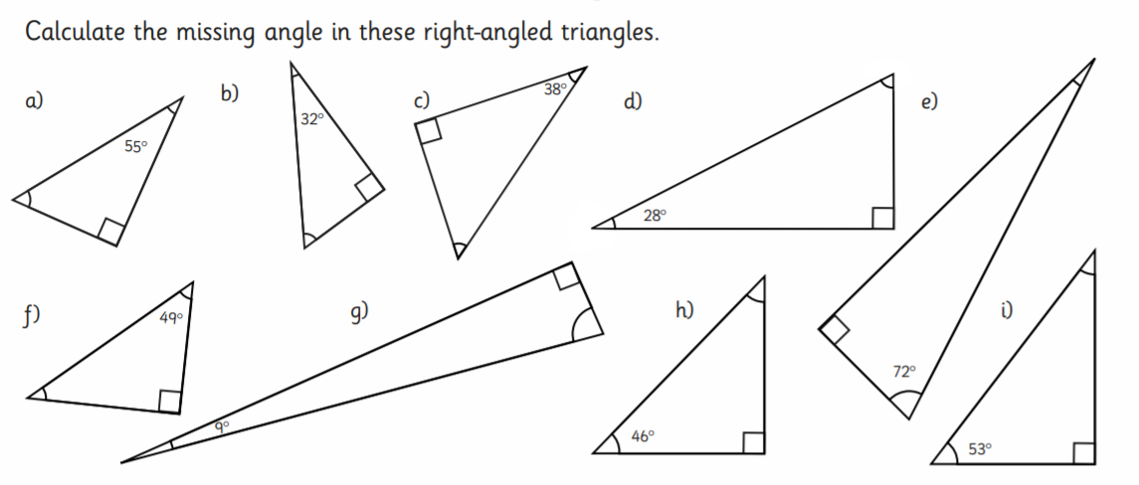
Home Learning: To calculate angles in triangles.
Read the information on types of triangles! All angles in a triangle add up to 180 degrees.
Today we are going to find the missing angles from a right-angle triangle.
Remember… we already know that one angle is 90 degrees.
Try as many as you can!
Example:
a. 90+55 = 145
180 – 145 = 35
Missing angle = 35 degrees

Slide 3
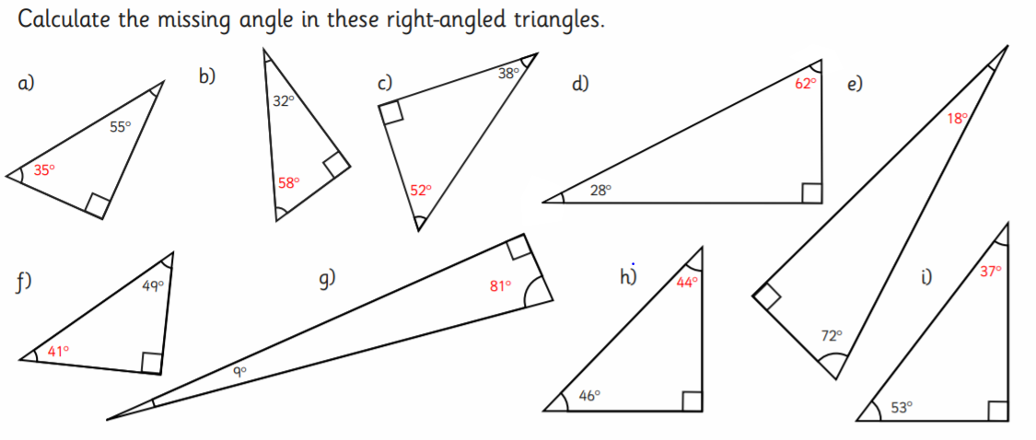
Answers…

Slide 4
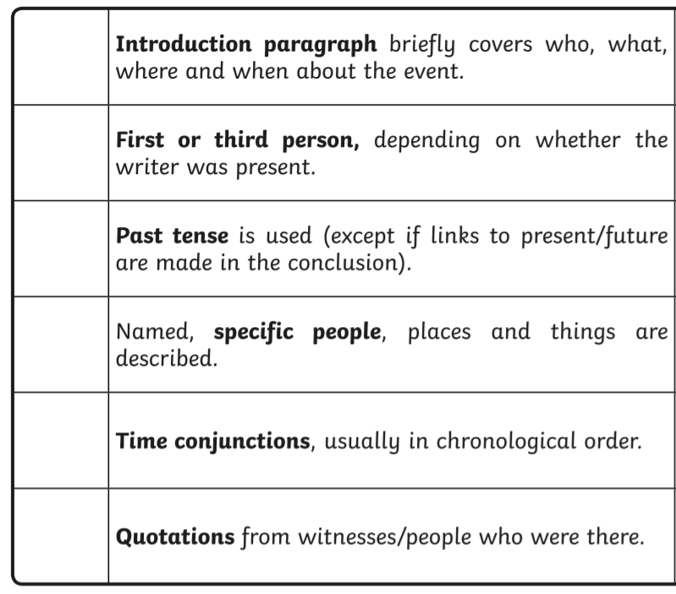
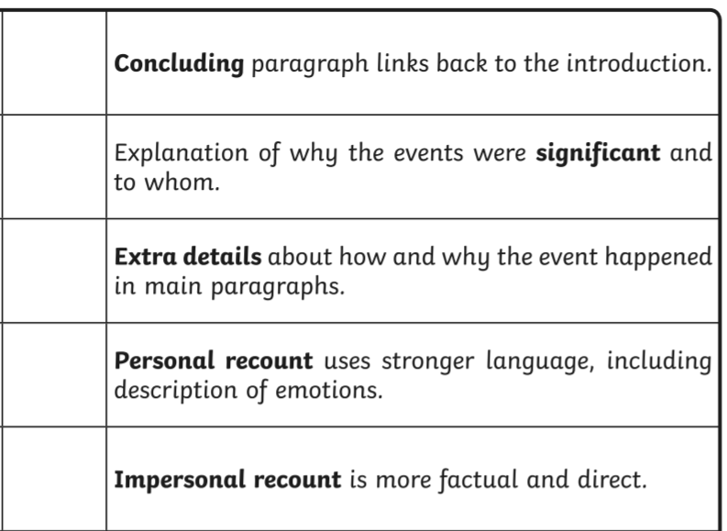
Thursday’s English for Year 6
L.O: To write a recount of my year 6 memories.
Yesterday, you looked back at your year 5 memories. Today… year 6 and what a year it has been! One that you will never forget.
Task 1… Mind-map every memory you have from year 6. Think about your teachers, trips, funny memories.
Task 2… Use the mind-map to write a recount of your time in Y6.

Slide 5
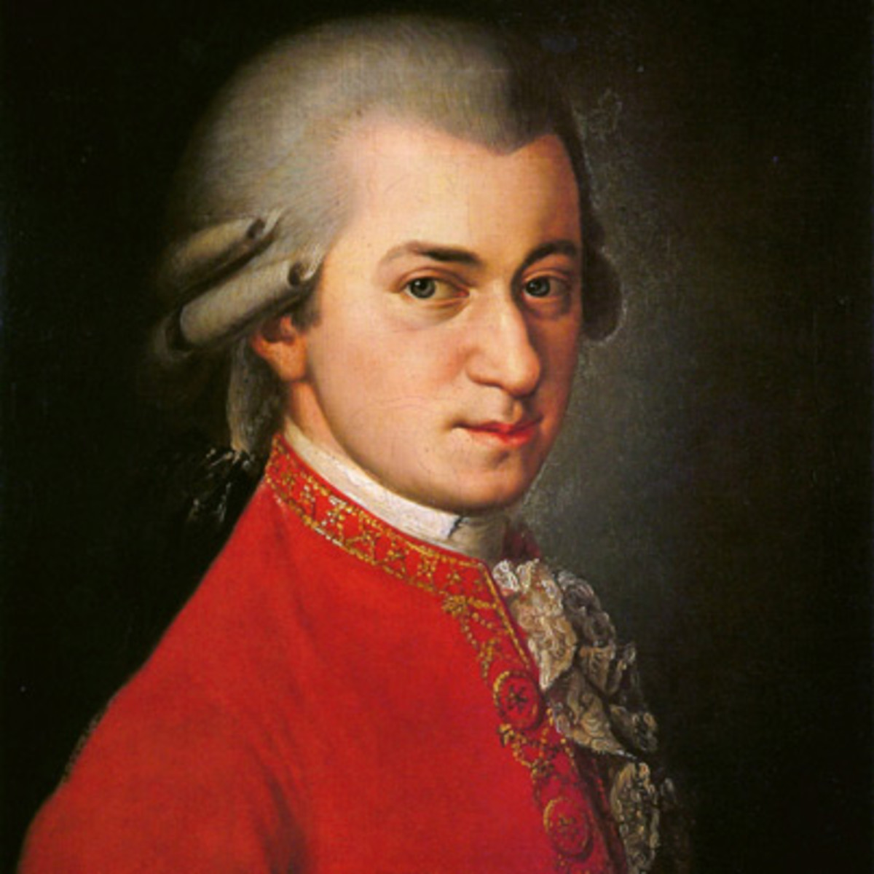
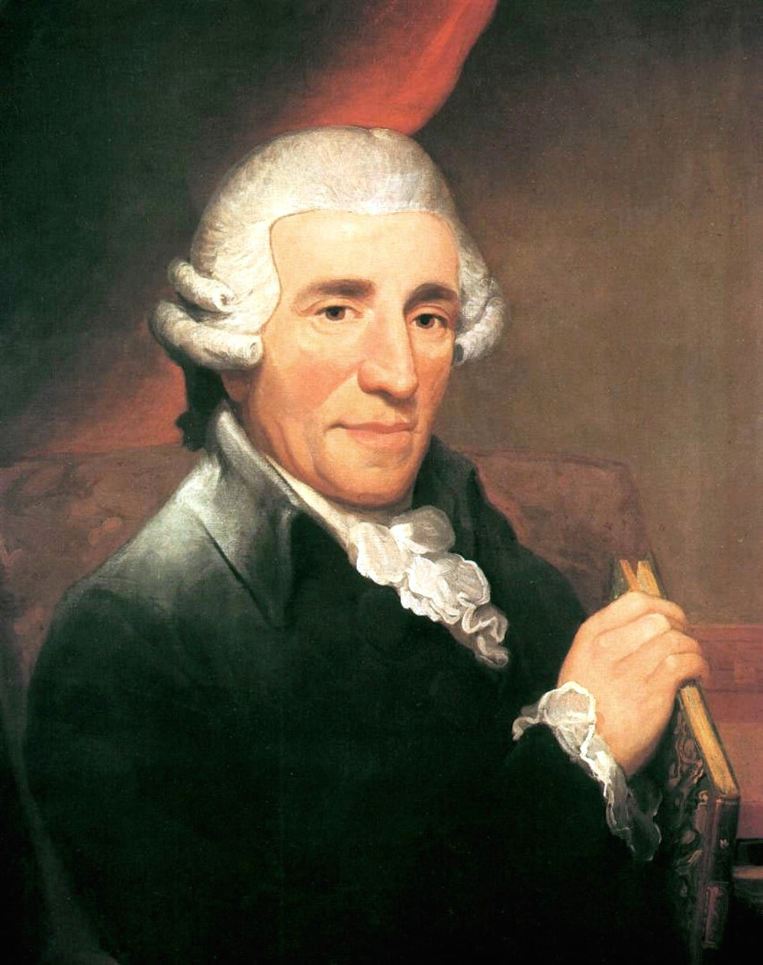
Today’s other activity:
L.O: To research a classical composer.
Listen to the links to find key features of classical music.
Then choose either Mozart or Haydn. Create a fact file about them.
Try to include as much information as you can about them. Can you add a paragraph about classical music?
Link 1: Mozart
https://www.youtube.com/watch?v=JTc1mDieQI8
Link 2: Haydn
https://www.youtube.com/watch?v=PhxZhDV9KHM
You only need to listen to small section on both!

