Slide 2
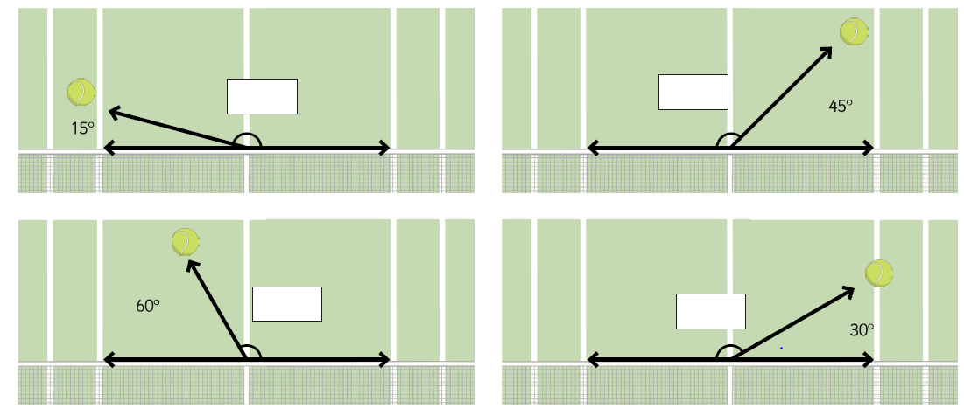
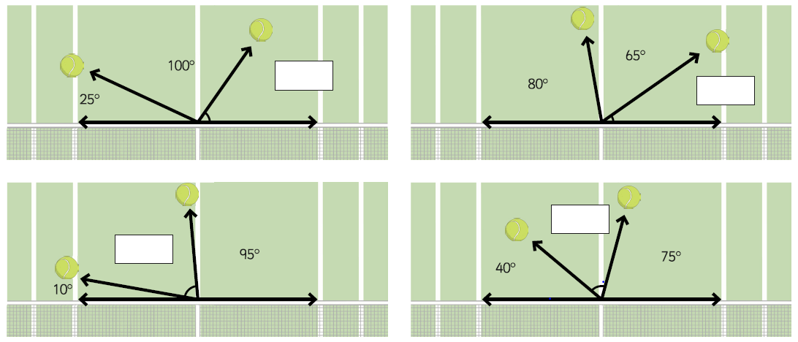
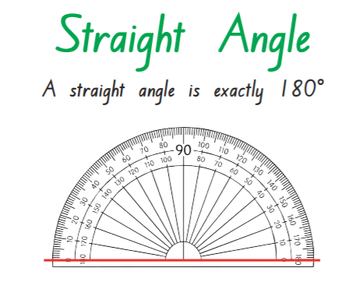
Home Learning: To calculate missing angles on a straight line.
We know that angles on a straight line add up to 180 degrees.
But what if an angle was unknown?
We can use what we know to find the missing angle!
If I have an angle of 80degrees. I know that 180-80 = 100.
So my missing angle would be 100 degrees.
Try as many of the questions as you can!

Slide 3
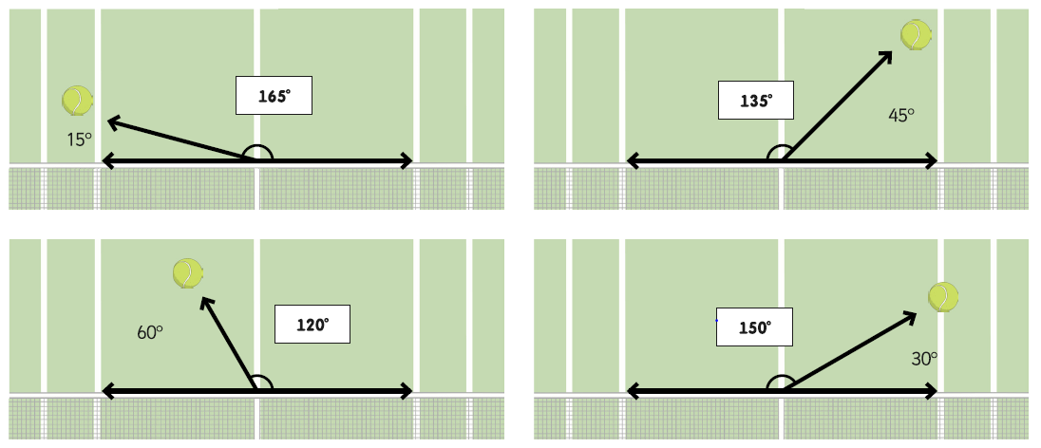
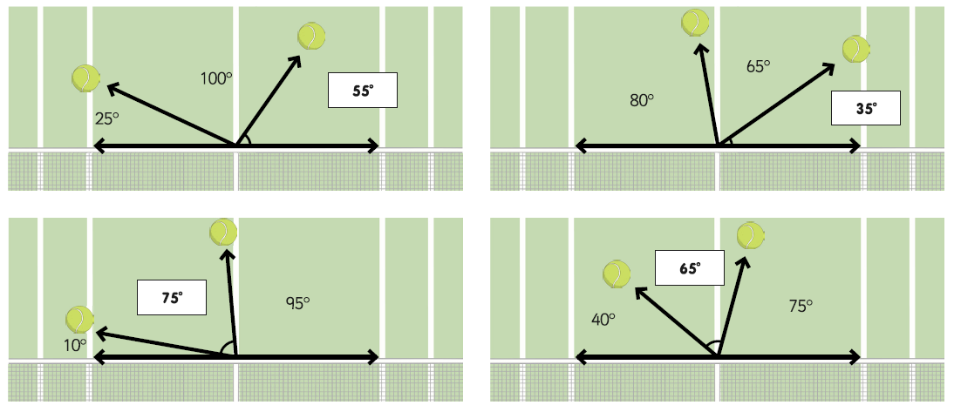
Answers…

Slide 4
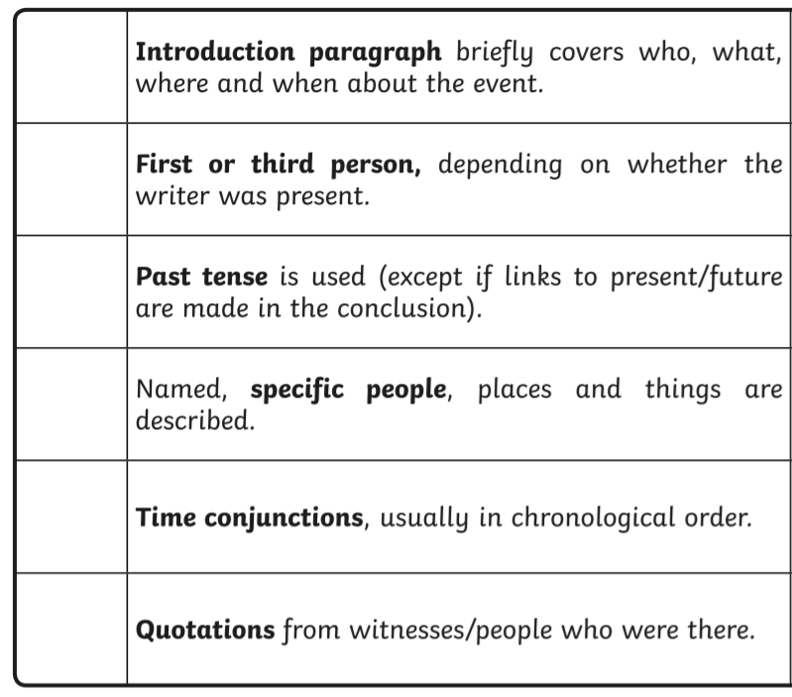
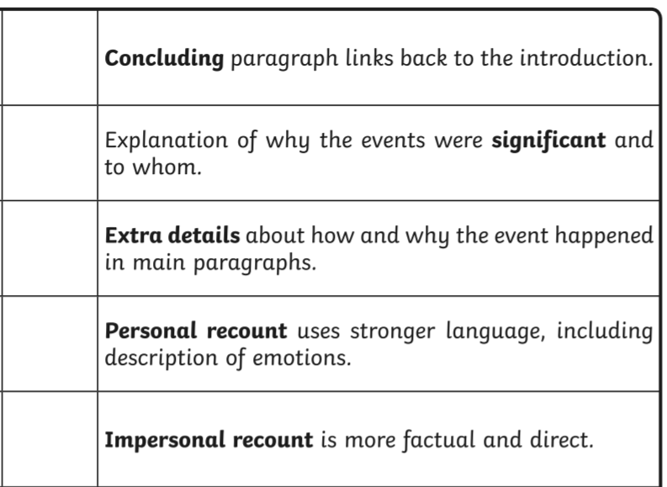
Wednesday’s English for Year 6
L.O: To write a recount of my year 5 memories.
Yesterday, you looked back at your year 4 memories. Today… year 5!
Task 1… Mind-map every memory you have from year 5. Think about your teachers, trips, funny memories.
Task 2… Use the mind-map to write a recount of your time in Y5. (If you were not at NJS, write about your previous school).

Slide 5
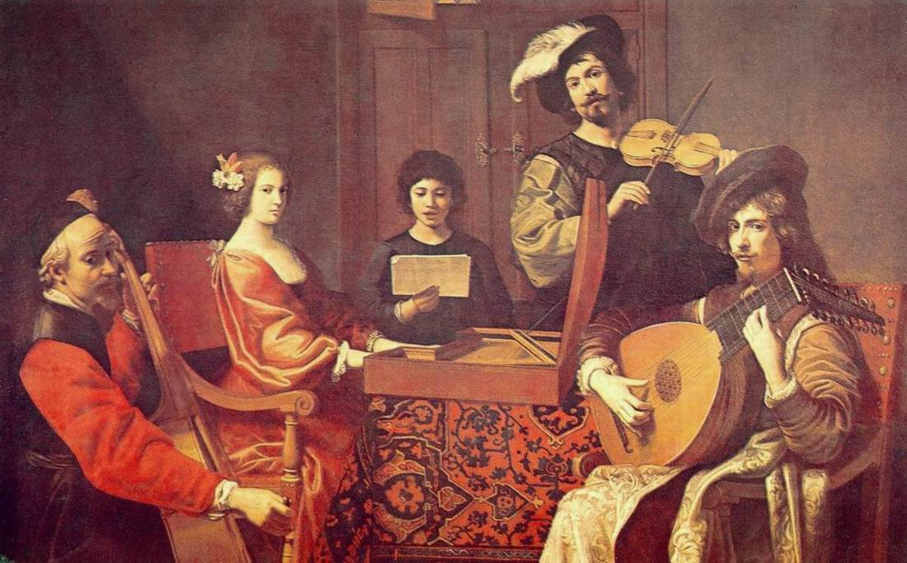
Today’s other activity:
L.O: To listen to music and decide what instrument has been used.
Listen to each link below…
Link 1 https://www.youtube.com/watch?v=SCm9O2KNEX4
Link 2
https://www.youtube.com/watch?v=PhRa3REdozw
Link 3
https://www.youtube.com/watch?v=5cs-IhTdAEA
After you have listened to each link, work out if it’s a piano, harpsichord or organ.
Then which two are Baroque pieces? How do you know this?

