Slide 2
Well Year 6…
What a year it has been? In September, the year started like always. The dreaded SATs word was mentioned more than normal. You moved into the block where your journey at NJS started. This year may have been different but one you will always remember.
As this is your last week at NJS, I’m going to set you a project. There will be no English or maths lessons this week!
Follow the instructions on each slide! I have separated them into days for you ☺
Enjoy!
Miss Jones x

Slide 4
Smooth Move Project
L.O. To plan, design, make and evaluate a product.

Slide 5
Monday!

Slide 6
Step 1: Discuss and Design
Design a PROUDUCT to help make the MOVE from primary school to secondary school SMOOTH!
Create a mind-map of ideas.
Choose one of your ideas and create a range of designs to choose from.
Write a short explanation to share what your design is for.

Slide 7
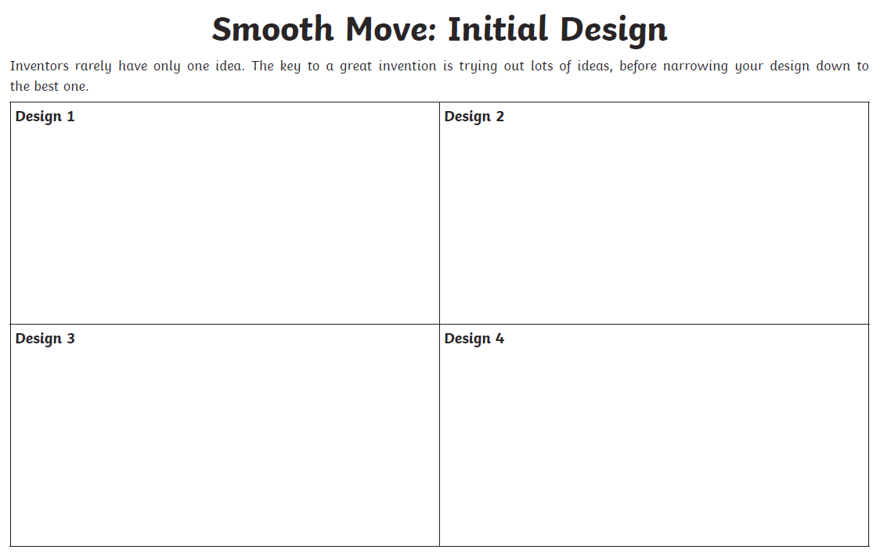

Slide 8
Tuesday!

Slide 9
Step 2: Build a Prototype
Use materials from home to create a prototype of your invention.
Remember
Appearance is more important than function.
Get the look right and then you can explain how it works.
For example, if you have chosen a technologically advanced invention, we are not expecting you to make a working model, but you do need to explain what it does.
What is a protoype?
A first version or model of a product to show what it will look like – may not be fully functioning.

Slide 10
Wednesday!

Slide 11
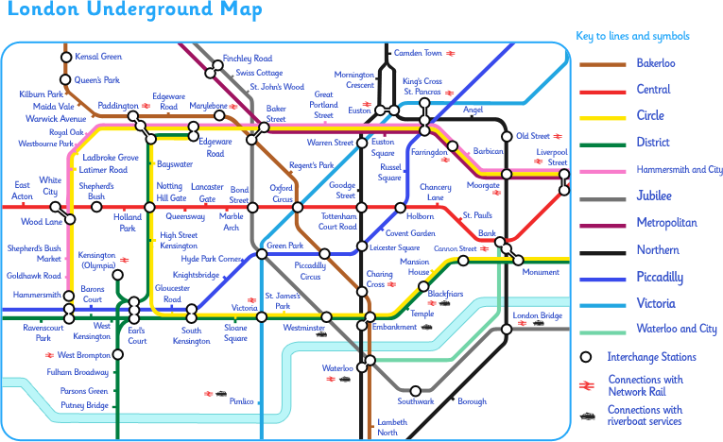
Step 3: Marketing
Thinking Task:
How are you going to advertise your product?
Use the worksheet provided to put together a marketing strategy. Then create your advertisements!

Slide 12
Smooth Move: Marketing
What do you think makes an effective sales pitch?
Know your product - make sure you know everything there is to know, so you can answer tricky questions.
Know your buyer – think about your target market and make your speech appeal to them.
Know your style – funny, serious, clever? Stick to your style and try to involve your audience.
Know your numbers – how much is it going to cost?
Is this an essential item for Y7s? Tell them why!

Slide 13
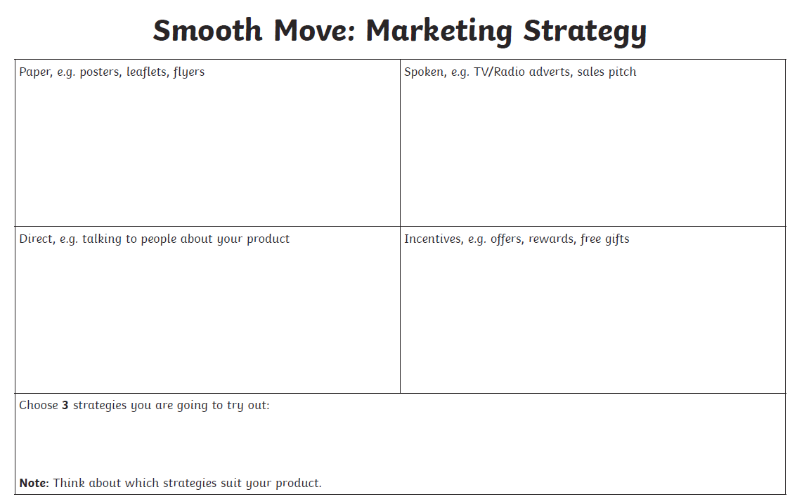

Slide 14
Thursday!

Slide 15
Smooth Move: Evaluating
How can we evaluate the success of our project?
You have 5 minutes to jot down ideas.
What went well?
What could be improved?
What do you like the most about your design? Why?
Why will your product help a smooth move to Secondary school?
What stage did you find the hardest? Why?
How will your product help a year 6 child moving to secondary school?
What would your catchy slogan be?

Slide 16
Friday!

Slide 17
Happy World Emoji Day and Happy Last Day at NJS!
Today we are going to have a little fun!
Draw an emoji to represent how you felt at the different points of your year. Write a short explanation to show why you chose your emoji.
The start of year 6!
January – a new term
School closing in March
SATs were cancelled in May
Your final day as an NJS pupil

