Slide 1
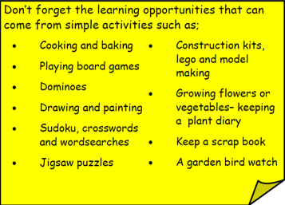
Year 3 Home School Provision Day 39
The following slides will be split into 3 separate activities. Each slide will be daily activities for you and your child to do at home. Due to a partial reopening of NJS, Miss Watson is undertaking the alternative provision for Year 3. Please email – chloe.watson@taw.org.uk if you need to contact her or would like to share a piece of home learning for the website. Thank you for your continuing support.
Useful websites for Home learning
Year 2 and 3 free resources for parents for Home Learning: https://www.twinkl.co.uk/resources/parents/wellbeing-parents/school-closures-category-free-resources-parents
Classroom Secrets free resources – laptop or PC needed
https://classroomsecrets.co.uk/free-home-learning-packs/
BBC Bitesize - https://www.bbc.co.uk/bitesize/levels/zbr9wmn
Pobble365 – website with inspiring pictures for Storywriting or Art https://www.pobble365.com/
White Rose Maths – Home Learning activities – great for home learning as we use these ideas in school. https://whiterosemaths.com/homelearning/
Children also have logins in their homelink books for Shropshire Schools Library Service e-Library – books can be borrowed fro up to 3 weeks at a time. https://shropshiresls.wheelers.co/

Slide 2
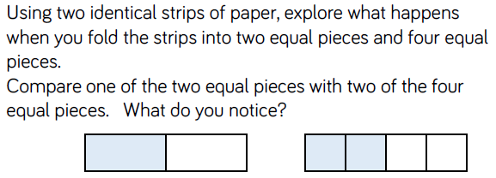
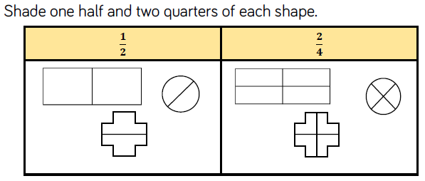
Daily Provision Pack – Day 39
Maths:
Objective: To understand the equivalence between half and two quarters.
English:
Objective: To complete the poetry comprehension.
1/2/3* activities on the following slides.
Remember to answer in full sentences using words out the questions with capital letters and full stops.
While you answer the questions think about a neat, joined handwriting – just like we would at school. In 3W we call it Mr Rotherham handwriting! Handwriting with tall ascenders and low descenders, all the other letters should be the same height.
Music
Objective: To illustrate what the music describes/portrays to you.
Activity on following slides.
Link needed: https://www.youtube.com/watch?v=ZR2JlDnT2l8
Remember, there is no right or wrong! It is your personal interpretation. Music is a personal experience for everyone.
What do you notice about one half and two quarters?
What do you know about the numbers 2 and 4?

Slide 3
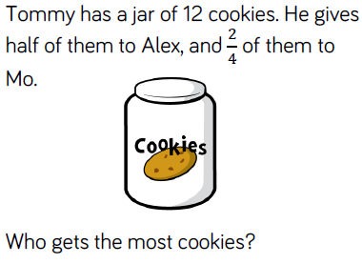
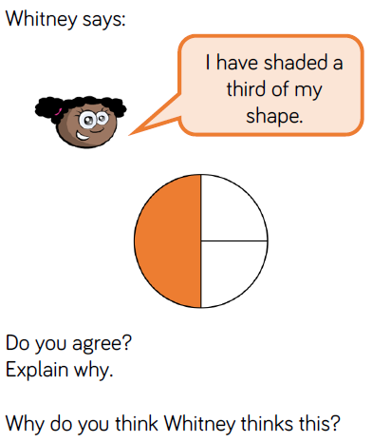
Maths continued
Would you rather:
½ of £10 or 2/4 of £10
½ of £24 or 2/4 of £24
½ of £60 or 2/4 of £60?
½ of £44 or 2/4 of £44
½ of £36 or 2/4 of £36
What do we know about ½ and 2/4?

Slide 4
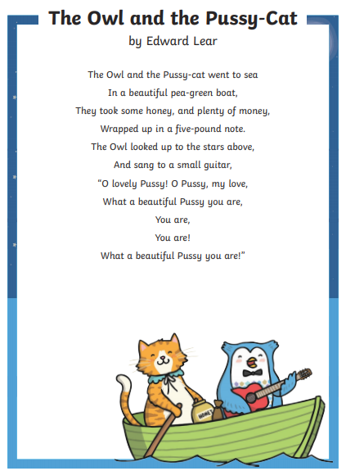
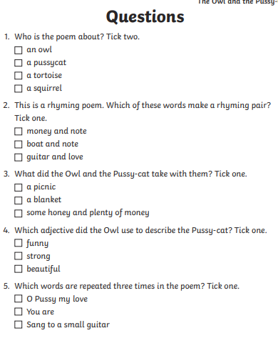
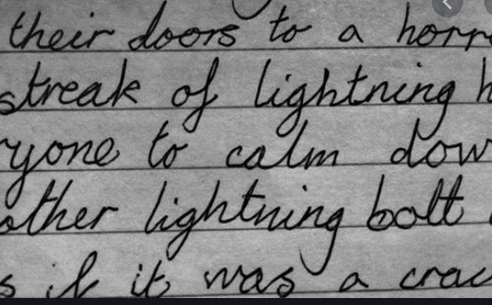
English continued
1 STAR
Writing out the different answers and options is a great opportunity to practice handwriting and letter formation! It’s what we would do at school!
Remember ascenders are tall and descenders are low!

Slide 5
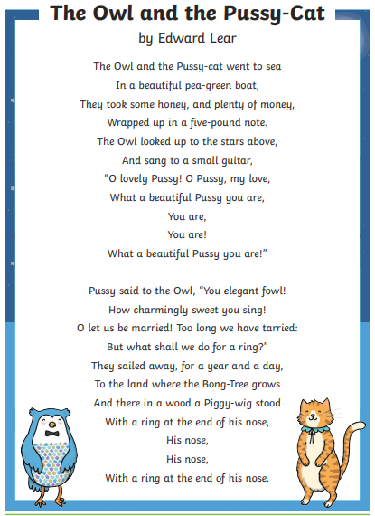
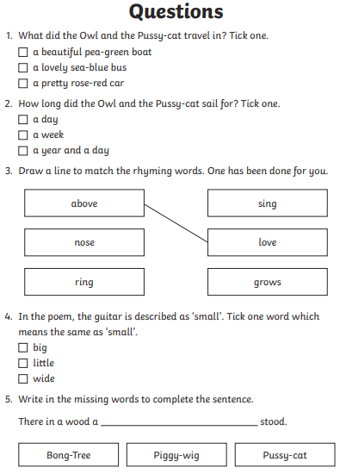
English continued
2 STAR
Writing out the different answers and options is a great opportunity to practice handwriting and letter formation! It’s what we would do at school!
Remember ascenders are tall and descenders are low!

Slide 6
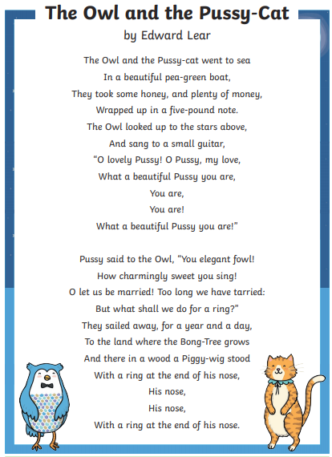
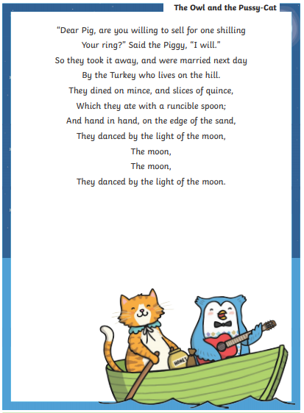
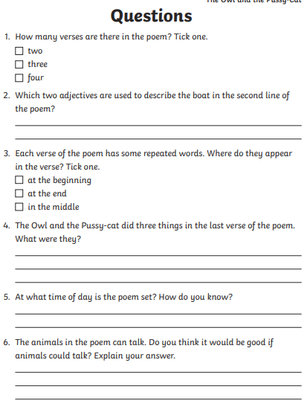
English continued
3 STAR
Writing out the different answers and options is a great opportunity to practice handwriting and letter formation! It’s what we would do at school!
Remember ascenders are tall and descenders are low!

Slide 7
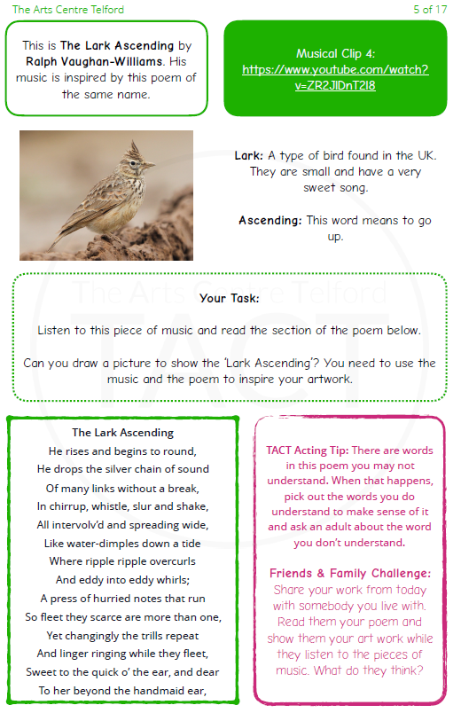
Music continued
Link needed: https://www.youtube.com/watch?v=ZR2JlDnT2l8
Remember, there is no right or wrong! It is your personal interpretation. Music is a personal experience for everyone.

