Slide 1
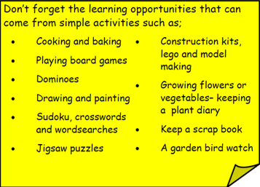
Year 3 Home School Provision Day 40
The following slides will be split into 3 separate activities. Each slide will be daily activities for you and your child to do at home. Due to a partial reopening of NJS, Miss Watson is undertaking the alternative provision for Year 3. Please email – chloe.watson@taw.org.uk if you need to contact her or would like to share a piece of home learning for the website. Thank you for your continuing support.
Useful websites for Home learning
Year 2 and 3 free resources for parents for Home Learning: https://www.twinkl.co.uk/resources/parents/wellbeing-parents/school-closures-category-free-resources-parents
Classroom Secrets free resources – laptop or PC needed
https://classroomsecrets.co.uk/free-home-learning-packs/
BBC Bitesize - https://www.bbc.co.uk/bitesize/levels/zbr9wmn
Pobble365 – website with inspiring pictures for Storywriting or Art https://www.pobble365.com/
White Rose Maths – Home Learning activities – great for home learning as we use these ideas in school. https://whiterosemaths.com/homelearning/
Children also have logins in their homelink books for Shropshire Schools Library Service e-Library – books can be borrowed fro up to 3 weeks at a time. https://shropshiresls.wheelers.co/

Slide 2
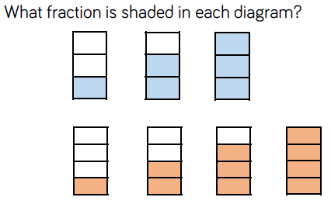
Daily Provision Pack – Day 40
Maths:
Objective: To be able to use non unit fractions.
English:
Objective: To match synonyms and use them in a sentence (SPAG).
Follow the link to play the matching adjectives game. Which words mean the same? What is a synonym?
See the following slides to see the 1/2/3* tasks.
TTRS and Guided Reading:
TTRS:
Objective: To complete a studio game as fast as possible and improve my time over 1 week.
Challenge yourself to complete a studio game as fast a possible. Can you beat your first time at the start of the week?
Fiction Express:
Objective: To read Chapter 5, vote by Tuesday 4pm and complete the quiz.
To develop understanding of spelling patterns: homophones.
Complete the reading of chapter 5, vote, and then complete the quiz on the following page
1* - complete with an adult to support
2* - try to complete independently but ask your adult if you need support
3* - complete independently
EXT: Write 5 questions of your own about the book.
EXT 2: Write a book review
Remember a unit fraction is where the numerator is 1, so a non unit fraction has a numerator of 2, 3, 4, 5 etc.
https://www.englishclub.com/esl-games/grammar/adjectives-synonyms-1.htm
Maths continued on next slide

Slide 3
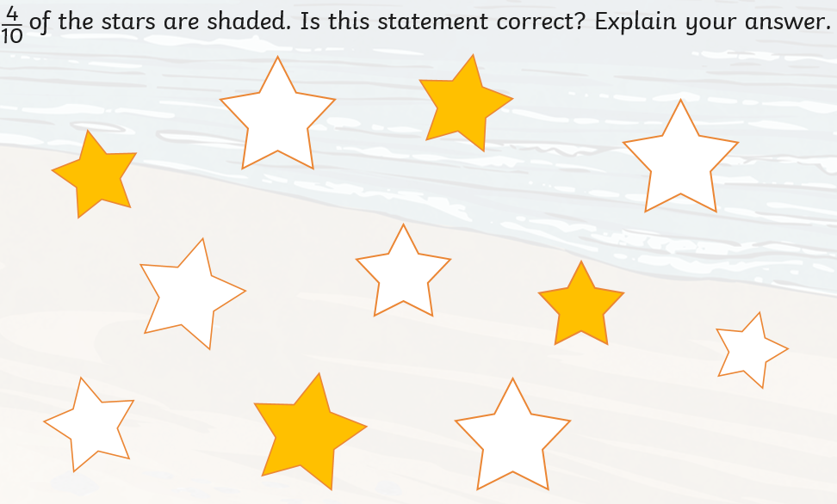
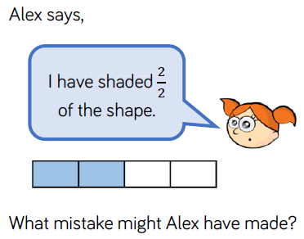
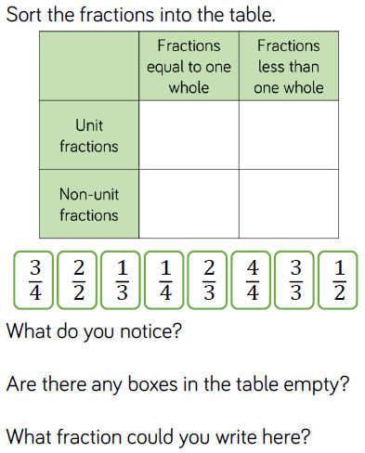
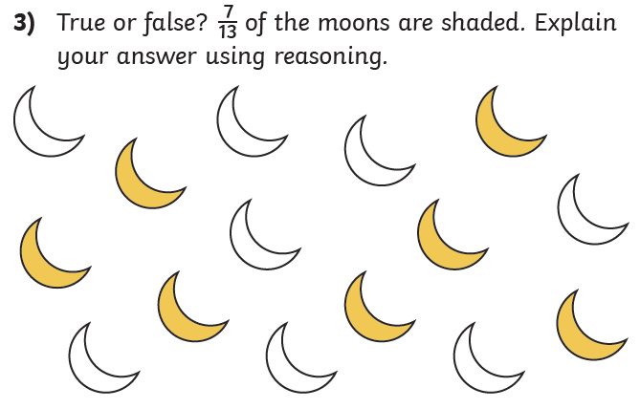
Maths continued

Slide 4
https://www.englishclub.com/esl-games/grammar/adjectives-synonyms-1.htm
English continued
1 Star
2 Star
3 Star
Loud Loud Loud Loud
1)
On bonfire night, there
1)
On bonfire night, (the 5th November)
Noisy Noisy Noisy Noisy
was a loud bang!
there was a loud bang!
2)
The neighbours were
2)
The neighbours (who were in the
being very noisy outside.
garden) were being very noisy.
Complete the word matching game. Synonyms are words that mean the same for example; loud and noisy. They both mean the same. Use the link above to play the game. Play one or more rounds – it’s up to you! Once you have finished, write the words out to practise your handwriting. Remember ascenders are tall and descenders are low but all the other letters are the same height!
Complete the word matching game. Synonyms are words that mean the same for example; loud and noisy. They both mean the same. Use the link above to play the game. Play two or more rounds – it’s up to you! Once you have finished, write the words out in sentences to practise your handwriting. Remember ascenders are tall and descenders are low but all the other letters are the same height!
Complete the word matching game. Synonyms are words that mean the same for example; loud and noisy. They both mean the same. Use the link above to play the game. Play three or more rounds – it’s up to you! Once you have finished, write the words out in sentences to practise your handwriting. Your sentences must use brackets (they add information in) as well as having beautiful handwriting. Remember ascenders are tall and descenders are low but all the other letters are the same height!

