Slide 1
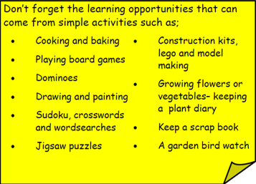
Year 3 Home School Provision Day 41
The following slides will be split into 3 separate activities. Each slide will be daily activities for you and your child to do at home. Due to a partial reopening of NJS, Miss Watson is undertaking the alternative provision for Year 3. Please email – chloe.watson@taw.org.uk if you need to contact her or would like to share a piece of home learning for the website. Thank you for your continuing support.
Useful websites for Home learning
Year 2 and 3 free resources for parents for Home Learning: https://www.twinkl.co.uk/resources/parents/wellbeing-parents/school-closures-category-free-resources-parents
Classroom Secrets free resources – laptop or PC needed
https://classroomsecrets.co.uk/free-home-learning-packs/
BBC Bitesize - https://www.bbc.co.uk/bitesize/levels/zbr9wmn
Pobble365 – website with inspiring pictures for Storywriting or Art https://www.pobble365.com/
White Rose Maths – Home Learning activities – great for home learning as we use these ideas in school. https://whiterosemaths.com/homelearning/
Children also have logins in their homelink books for Shropshire Schools Library Service e-Library – books can be borrowed fro up to 3 weeks at a time. https://shropshiresls.wheelers.co/

Slide 2
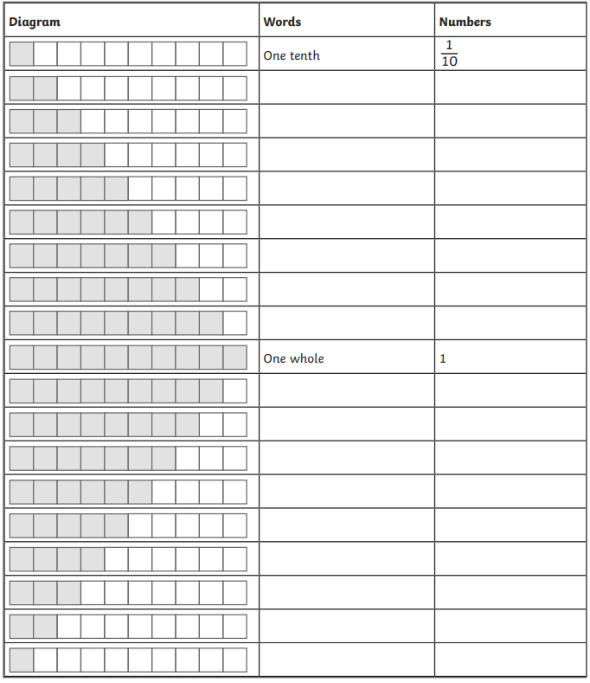
Daily Provision Pack – Day 41
Maths:
Objective: To recognise and understand tenths.
English:
Objective: To match opposing words and use them in a sentence (SPAG).
Follow the link to play the matching adjectives game. Which words mean the opposite? What is an antonym? Think about yesterday’s synonyms.
See the following slides to see the 1/2/3* tasks.
Computing:
Objective: To understand sequencing and animation.
Using the espresso coding logon below, explore unit 3 conditional events (section) to remind yourself of what sequencing and animation are.
You should work through each part of the unit slowly, reminding yourself what to do. You need to complete the programs called ‘space maze’ and ‘self driving car’.
Can you remember what an algorithm is?
https://online.espresso.co.uk/espresso/login/Authn/UserPassword
Username: student26976
Password: newport (all lower case)
https://www.englishclub.com/esl-games/grammar/adjectives-antonyms-1.htm
Maths continued on following slides

Slide 3
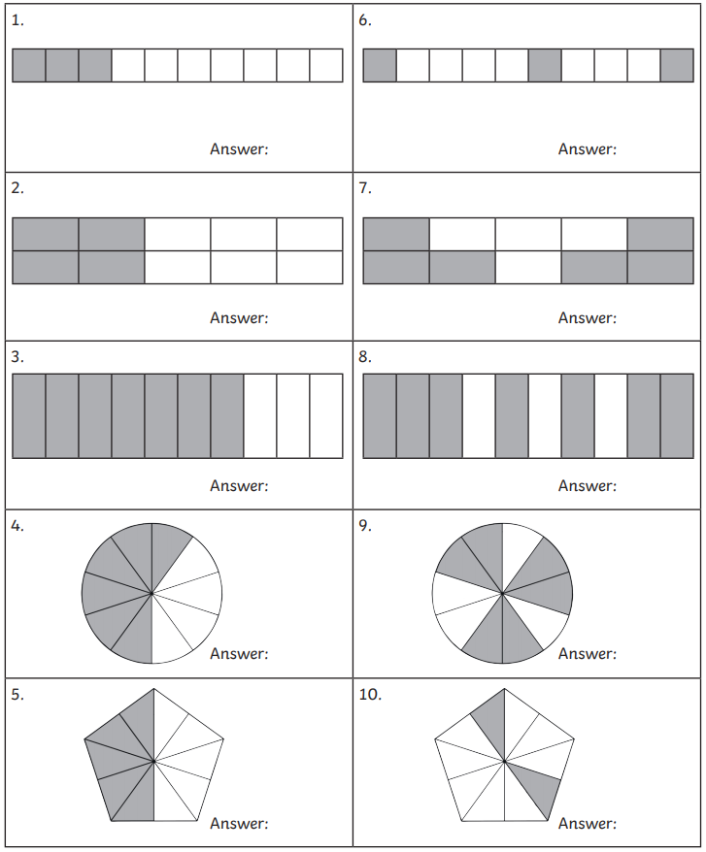
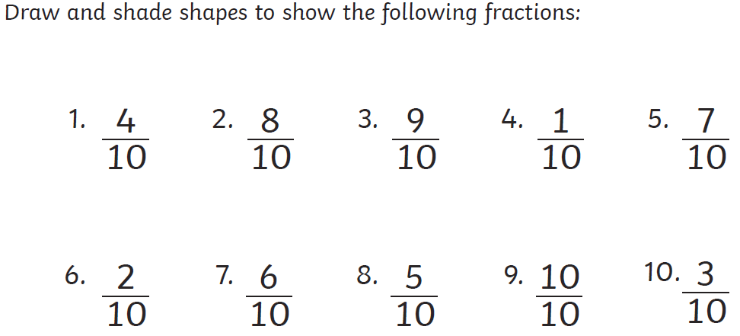

Slide 4
https://www.englishclub.com/esl-games/grammar/adjectives-antonyms-1.htm
English continued
1 Star
2 Star
3 Star
Light Light Light Light
1)
The light hurt my eyes
1)
In the middle of the night, the bright
Dark Dark Dark Dark Dark
in the black, gloomy room.
light shone through my window.
Little Little Little Little
2)
The sky was dark around
2)
Underneath the blue sea, the scaly,
Big Big Big Big Big Big
the glowing, white moon.
shiny fish swam in the dark water.
Complete the word matching game. Antonym are two words that mean the opposite. For example; big and little or light and dark. They mean the opposite. Use the link above to play the game. Play one or more rounds – it’s up to you! Once you have finished, write the words out to practise your handwriting. Remember ascenders are tall and descenders are low but all the other letters are the same height!
Complete the word matching game. Antonym are two words that mean the opposite. For example; big and little or light and dark. They mean the opposite. Use the link above to play the game. Play two or more rounds – it’s up to you! Once you have finished, write the words out in sentences to practise your handwriting. Remember ascenders are tall and descenders are low but all the other letters are the same height!
Complete the word matching game. Antonym are two words that mean the opposite. For example; big and little or light and dark. They mean the opposite. Use the link above to play the game. Play three or more rounds – it’s up to you! Once you have finished, write the words out in sentences to practise your handwriting. Your sentences must include a fronted adverbial (describes how, where or when). Remember ascenders are tall and descenders are low but all the other letters are the same height!

