Slide 1
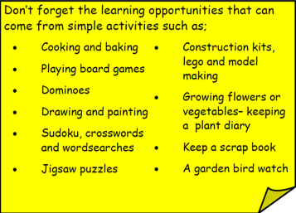
Year 3 Home School Provision Day 43
The following slides will be split into 3 separate activities. Each slide will be daily activities for you and your child to do at home. Due to a partial reopening of NJS, Miss Watson is undertaking the alternative provision for Year 3. Please email – chloe.watson@taw.org.uk if you need to contact her or would like to share a piece of home learning for the website. Thank you for your continuing support.
Useful websites for Home learning
Year 2 and 3 free resources for parents for Home Learning: https://www.twinkl.co.uk/resources/parents/wellbeing-parents/school-closures-category-free-resources-parents
Classroom Secrets free resources – laptop or PC needed
https://classroomsecrets.co.uk/free-home-learning-packs/
BBC Bitesize - https://www.bbc.co.uk/bitesize/levels/zbr9wmn
Pobble365 – website with inspiring pictures for Storywriting or Art https://www.pobble365.com/
White Rose Maths – Home Learning activities – great for home learning as we use these ideas in school. https://whiterosemaths.com/homelearning/
Children also have logins in their homelink books for Shropshire Schools Library Service e-Library – books can be borrowed fro up to 3 weeks at a time. https://shropshiresls.wheelers.co/

Slide 2
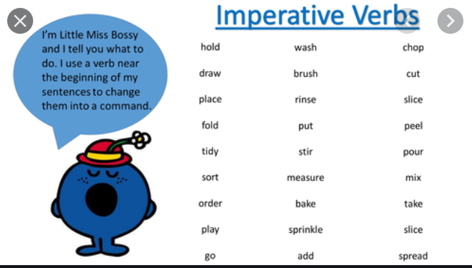
Daily Provision Pack – Day 43 – PROJECT DAY! Please complete the D&T project first and then complete Maths/English.
D&T:
Objective: To make a musical instrument using recycling and household items.
Today’s challenge is to design and build a musical instrument, mainly out of household recycling materials. Be as creative as you can. Use boxes, cartons (wash first!) lids, paper and basically anything else you can get your hands on!
Please check first that you are allowed to use it, as it may not be recycling after all!
Can you decorate / colour or paint your design?
Examples on following slide
English:
Objective: To write instructions on how to make your music instrument.
Using the checklist on the following slides, write instructions making sure you have all the features.
Maths:
Objective: To solve word problems
Measure how wide you instrument is.
Measure how long your instrument is.
Can you draw your instrument on paper using your ruler to measure so it is the exact size?
How many sides/faces does your instrument have?
How long (to the nearest minute) did it take you to make.
Write 5 of your own word problems and answer them.

Slide 3
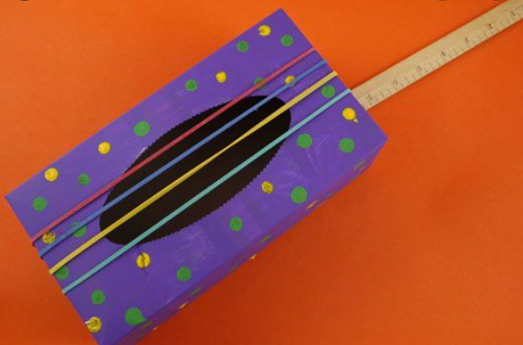
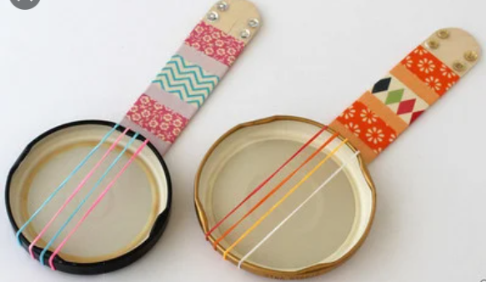
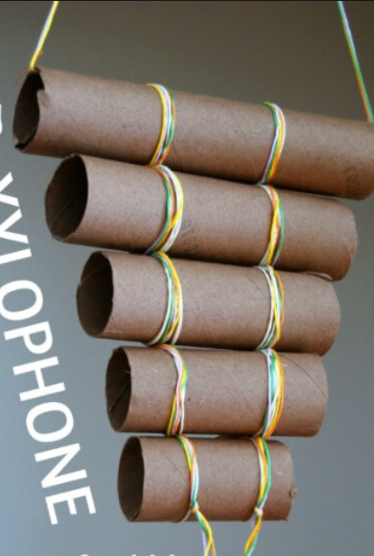
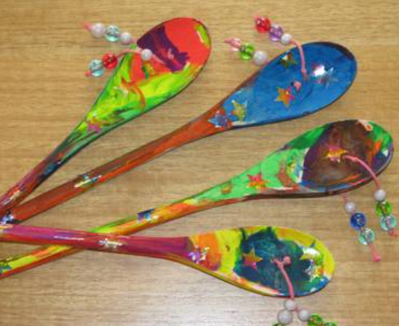
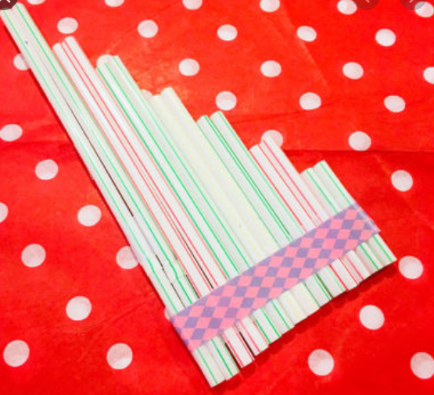
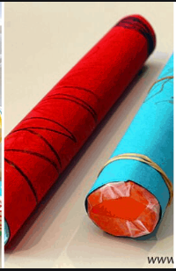
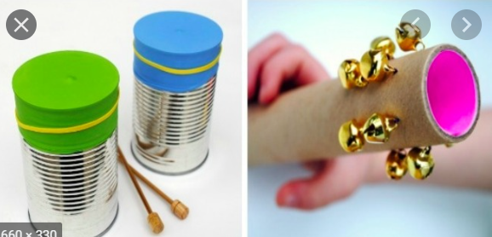
Some examples of different instruments you could design and make!
Please share your achievements with me;
chloe.watson@taw.org.uk

Slide 4
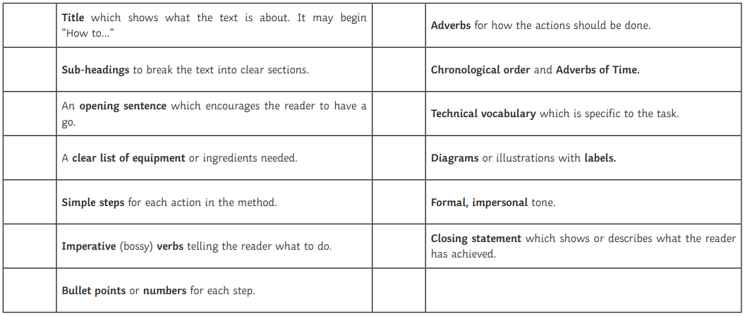
English continued
Instruction writing checklist: Make sure you use all the features off the list so someone else can make an instrument as good as yours!
1* - Ask for adult help (scribe if needed)
2* - Ask for adult help but write your own and try to include all the features
3* - Write your instructions independently using all the features
Remember we have covered instructions at school so we all know how to do it!

