Slide 1
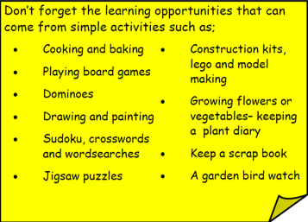
Year 3 Home School Provision Day 45
The following slides will be split into 3 separate activities. Each slide will be daily activities for you and your child to do at home. Due to a partial reopening of NJS, Miss Watson is undertaking the alternative provision for Year 3. Please email – chloe.watson@taw.org.uk if you need to contact her or would like to share a piece of home learning for the website. Thank you for your continuing support.
Useful websites for Home learning
Year 2 and 3 free resources for parents for Home Learning: https://www.twinkl.co.uk/resources/parents/wellbeing-parents/school-closures-category-free-resources-parents
Classroom Secrets free resources – laptop or PC needed
https://classroomsecrets.co.uk/free-home-learning-packs/
BBC Bitesize - https://www.bbc.co.uk/bitesize/levels/zbr9wmn
Pobble365 – website with inspiring pictures for Storywriting or Art https://www.pobble365.com/
White Rose Maths – Home Learning activities – great for home learning as we use these ideas in school. https://whiterosemaths.com/homelearning/
Children also have logins in their homelink books for Shropshire Schools Library Service e-Library – books can be borrowed fro up to 3 weeks at a time. https://shropshiresls.wheelers.co/

Slide 2
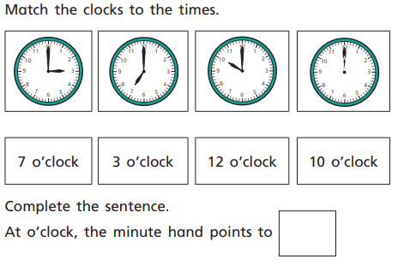
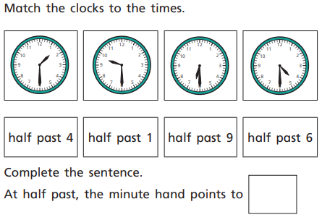
Daily Provision Pack – Day 45
Maths:
Objective: To be able to identify o’clock and half past.
English:
Objective: To identify features of a non-chronological report.
We have covered non-chronological reports in school lots of times and are really good at identifying the features.
On the following slides is an example of a non-chronological report and a list of features. Just like we would do at school. Read through the non-chronological report and find the features.
Please remember, you do not need to print the non-chronological report. You might talk it through with your adults or do it as follows;
TTRS and Guided Reading:
TTRS:
Objective: To complete a studio game as fast as possible and improve my time over 1 week.
Challenge yourself to complete a studio game as fast a possible. Can you beat your first time at the start of the week?
Fiction Express:
New book: MAYFLOWER STOWAWAYS by Jan Burchett and Sara Vogler.
Objective: To read Chapter 1, vote by Tuesday 4pm and complete the questions. Leave a review of the chapter for your teacher to read.
Complete the reading of chapter 1, vote, and then complete the quiz on the following page
1* - complete with an adult to support
2* - try to complete independently but ask your adult if you need support
3* - complete independently
EXT: Write 5 questions of your own about the book.
Feature | Example from the text
Title | Polar bears
Introduction | In bold, explains what the report is about but makes the reader what to find out more.
Maths continued on next slide

Slide 3
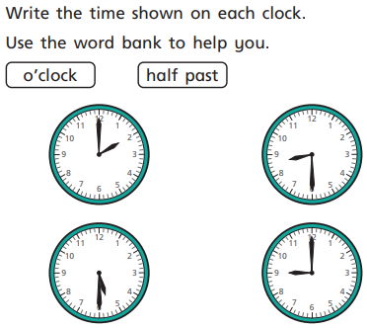
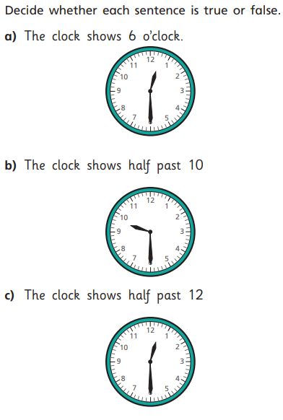
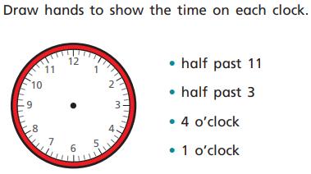
Maths continued
What learning can we link from our fractions and time?
Think about a whole.
Think about a half.
How does that help?

Slide 4
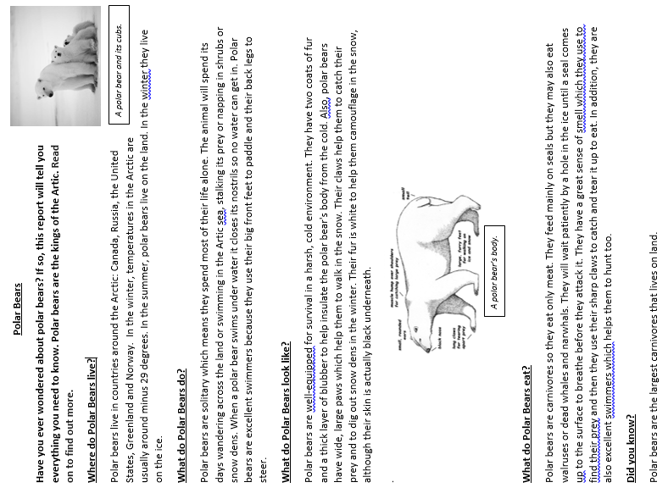
English continued
Example of a non-chronological report

Slide 5
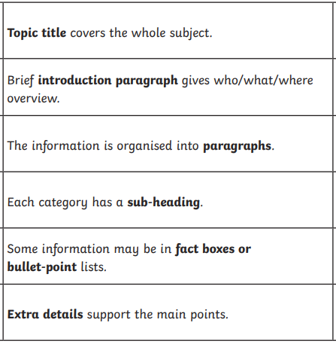
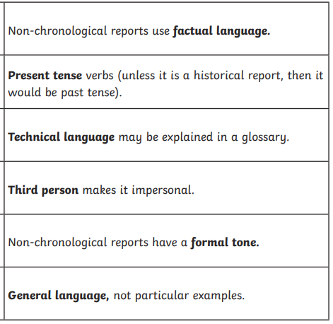
English continued
Features of a non-chronological report
Uses bullet points to list some information
Includes pictures or diagrams
Has fact boxes which include a fact
All pictures and diagrams have a caption. A brief sentence about what is in the picture or caption.

