Slide 1
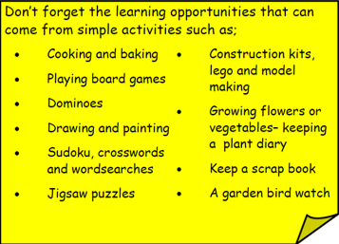
Year 3 Home School Provision Day 48
The following slides will be split into 3 separate activities. Each slide will be daily activities for you and your child to do at home. Due to a partial reopening of NJS, Miss Watson is undertaking the alternative provision for Year 3. Please email – chloe.watson@taw.org.uk if you need to contact her or would like to share a piece of home learning for the website. Thank you for your continuing support.
Useful websites for Home learning
Year 2 and 3 free resources for parents for Home Learning: https://www.twinkl.co.uk/resources/parents/wellbeing-parents/school-closures-category-free-resources-parents
Classroom Secrets free resources – laptop or PC needed
https://classroomsecrets.co.uk/free-home-learning-packs/
BBC Bitesize - https://www.bbc.co.uk/bitesize/levels/zbr9wmn
Pobble365 – website with inspiring pictures for Storywriting or Art https://www.pobble365.com/
White Rose Maths – Home Learning activities – great for home learning as we use these ideas in school. https://whiterosemaths.com/homelearning/
Children also have logins in their homelink books for Shropshire Schools Library Service e-Library – books can be borrowed fro up to 3 weeks at a time. https://shropshiresls.wheelers.co/

Slide 2
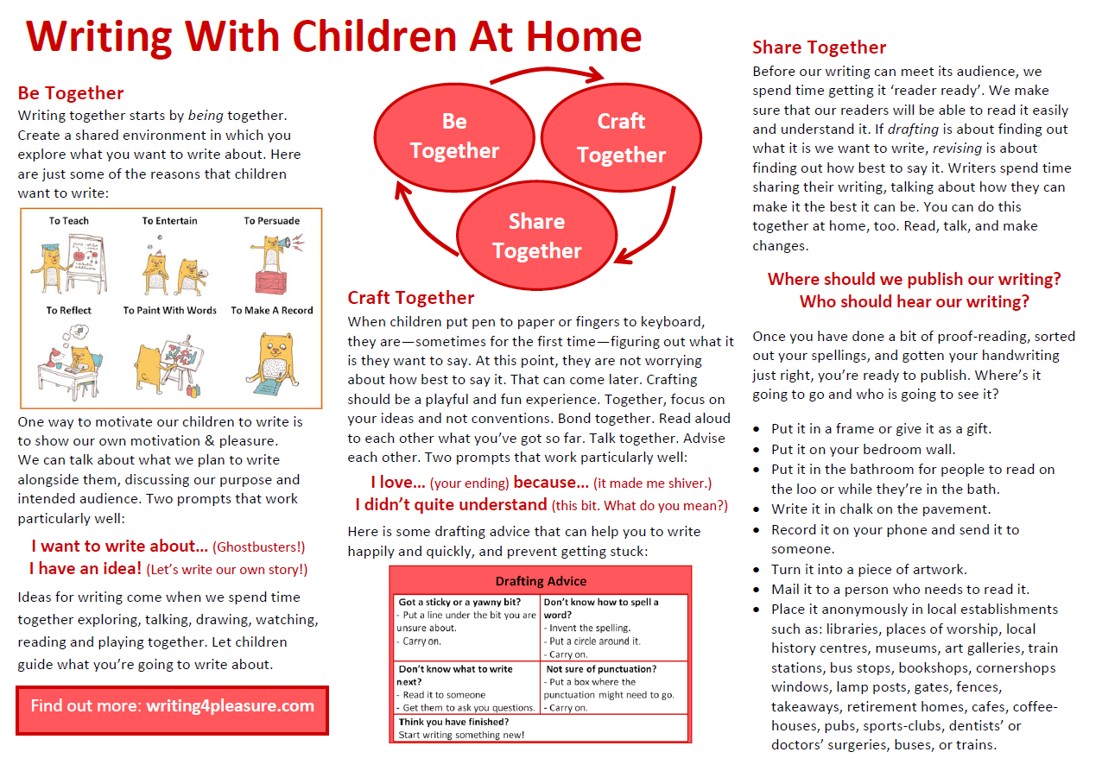
Document recommended by Mr Rotherham on how to support writing at home.

Slide 4
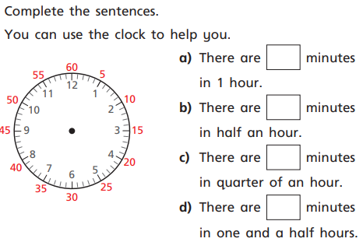
Daily Provision Pack – Day 48
Maths:
Objective: To understand hours and days
English:
Objective: To start writing your non-chronological report.
Using your research from the last couple of days we are going to start writing our non-chronological reports.
You’ve got your plan and your order, we just need to turn our notes into full sentences and paragraphs.
See the following slides for my example.
History:
Objective: To design your own Roman God or Goddess.
Following the template on the following slides design your own Roman God or Goddess.
History continued on following slides.
Maths continued on following slides

Slide 5
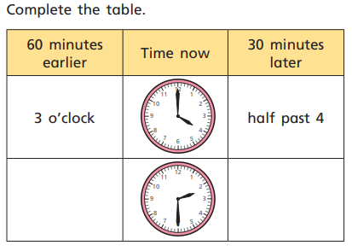
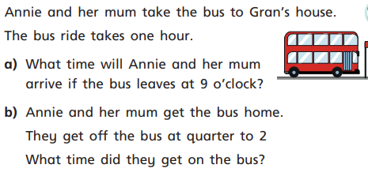
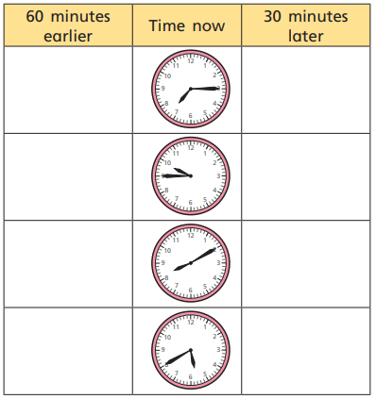
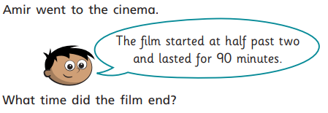
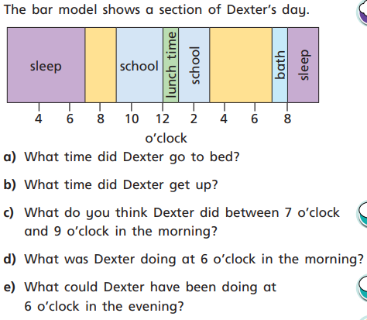
Maths continued

Slide 6
English continued
Barking mad – all you need to know about dogs!
This non-chronological report will tell you all you need to know about looking after your furry best friend. Dogs are very loyal to humans and spend their whole lives looking after their owners and cheering them up. Read on if you would like to know how to repay your four legged friend!
Where do dogs live?
Dogs can live in a variety of different places but the most common place is in the home. Alongside humans, dogs can inhabit a warm and loving home. As well as houses, dogs can live in kennels. The kennels must be warm and dry, have bedding as well as having water and food available. Just like humans, dogs need to be warm. Although they have big fur coats they are still warm blooded and need to live in a warm space. Usually, our four legged friends have fluffy beds although some can have cages or plastic beds (dogs aren’t fussy with where they sleep!). Unfortunately, some dogs are homeless (although this is mainly in foreign countries) and so can live outside. This is less than ideal as they do not have a warm space and good supply of food and water.
What do dogs eat?
Dogs can have various diets. It usually depends on their owners as to what they eat as dogs are not fussy. The most common diets for dog are dried biscuits or tinned meats which you can buy in any supermarket. Although dogs do like all foods, some human foods can be harmful to them such as chocolate…
As you can see, I have taken my notes and made them into full sentences. I’ve added the techniques from the checklist which is on the next slide. This is what you should complete today, write your intro and first two paragraphs following the layout I have used above. Remember to leave a space as we will be continuing tomorrow.

Slide 7
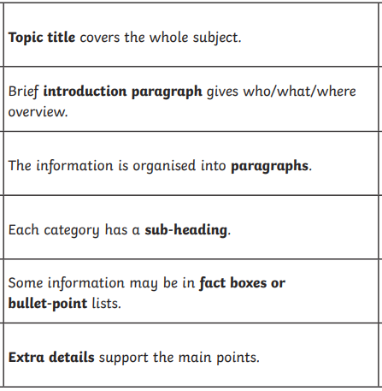
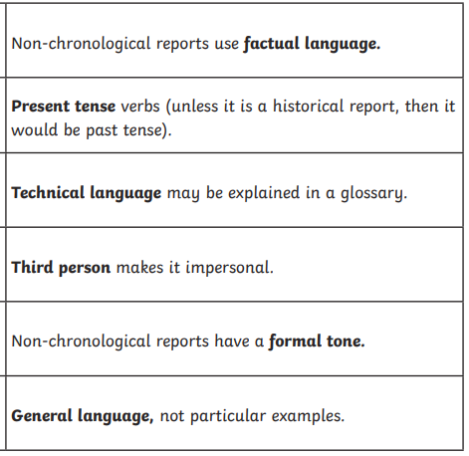
English continued
Features of a non-chronological report
Uses bullet points to list some information
Includes pictures or diagrams
Has fact boxes which include a fact
All pictures and diagrams have a caption. A brief sentence about what is in the picture or caption.

Slide 8
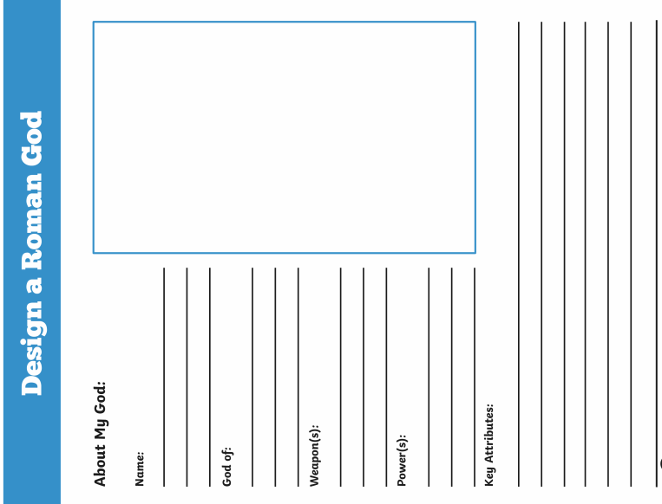
History continued

